Slide 1
Supportive Services for Veteran Families (SSVF) Program
Review of Non-Funded 2014 SSVF Priority 1 Grant Applications
October 2014

Slide 2
Presenters
John Kuhn, National Director, SSVF Program

Slide 3
Webinar Format
Webinar will last approximately 1 hour
Participants’ phone connections are “muted” due to the high number of callers
Questions can be submitted during the webinar using the chat function
Questions can also be submitted anytime to SSVF@va.gov
Notes:
Needs updated

Slide 4
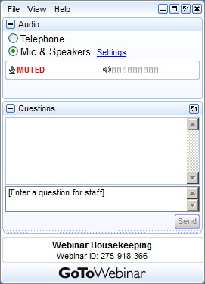
How to Submit Questions during the Webinar
Your Participation
You may submit your text questions and comments using the Questions Panel
Note: Today’s presentation is being recorded and will be provided within 48 hours.
Notes:
Needs updated

Slide 5
Priority 1 Requirements
$300 million was available
Awards made within CoC could not exceed designated resources
Must serve one of 76 priority CoCs
Funding request could not include areas outside of priority CoCs
Needed to follow all application requirements, submitting application as if a new grantee
Among grantees meeting requirements, those with highest score funded first

Slide 6
Priority 1 Requirements
CoC had to endorse application
Only 2 applications per CoC could be endorsed
VHA Network Homeless Coordinator also had to endorse
No limit on number of NHC endorsements
VA accepted all applications, but could not award to applicants who did not/could not adhere to NOFA rules
Ultimately $93 million remained from $300 million in available awards

Slide 7
Next Steps
On October 10, 2014 VA announced $93 million in available funds for SSVF
All funding to be used for priority CoCs (no other priorities)
Grants are for 3-year, non-renewable terms in 28 priority communities
Many communities were previously included in the January 14, 2014 NOFA
Differences are the result of previous funding decisions and newly available 2014 PIT data

Slide 8
NOFA
Maximum award of $2 million per year ($6 million over 3 year term of grant) per grantee
No limit on total applications per CoC (1 application per organization per CoC)
No designated funding level for each CoC, though VA will consider comparative need
Letters of CoC and NHC support are encouraged, but not required
Application form and questions are unchanged from previous NOFA
NOFA, application, and training available at www.va.gov/homeless/ssvf.asp

Slide 9
Q & A

Slide 10
Additional Questions?
SSVF Program Office
Phone:
1-877-737-0111
Email:
ssvf@va.gov
Website:
www.va.gov/HOMELESS/ssvf.asp

Slide 11
Thank you!

