Slide 1
Simulations for Clinical Excellence in Nursing Services
SCENS

Slide 2
SCENS
Diabetes:
Outpatient or Inpatient

Slide 3
Learning Objectives
SCENS
Perform a focused assessment for the patient experiencing a reaction to hyper/hypoglycemia (LPN collects data)
Demonstrate the steps required to provide safe and effective care for the patient with diabetes experiencing a hypo/hyperglycemic reaction
Perform the safe administration of a subcutaneous insulin injection
Communicate effectively when managing the care of the patient with diabetes experiencing a hyper/hypoglycemic reaction

Slide 4
Why?
SCENS
Approximately 25.8 million Americans have diabetes
8.3 percent of the U.S. population
Nearly 25% of all veterans have diabetes
National Patient Safety Goals
MyHealthyvet.va.gov
VHA Directive 1164
VA Hypoglycemia Safety Initiative (HSI)
Notes:
American Diabetes Association Standards of Care in Diabetes-2016
Joint Commission: 2016 Hospital National Patient Safety Goals
MyHealthyvet.va.gov
VHA Directive 1164
VA Hypoglycemia Safety Initiative (HSI)
Choosing Wisely Task Force
VHA Handbook 1050.01
VA/DoD Clinical Practice Guideline : Management of Diabetes Mellitus (DM) 2010
Office of Nursing Services: Clinical Practice Program Products

Slide 5
Veterans and Diabetes
SCENS
Close to 25% of all Veterans have Type 2 Diabetes
Associated with being overweight or obesity
Patients in VA facilities have a higher rate of obesity than the general population
Notes:
Close to 25% of all Veterans have Type 2 Diabetes (formerly known as Non-Insulin Dependent Diabetes Mellitus (NIDDM) or adult-onset diabetes
Possibly associated with exposure to pesticides and herbicides such as Agent Orange
Associated with being overweight or obesity
More than 70% of VA patients are considered overweight or obese

Slide 6
Hyperglycemia
SCENS
Causes
Clinical manifestations
3 P’s
Assessment
Diagnostics
Management
Complications
Diabetic Ketoacidosis (DKA)
Hyperosmolar hyperglycemic state (HHS)
Notes:
Causes
Can be caused by diabetes, medication, sepsis, stress, nutritional imbalances, etc.
Clinical manifestations
3 P’s Polyuria, polyphagia, polydipsia
Extreme thirst
Blurred vision
Nausea
Confusion
Weakness
Fever
Dehydration
Assessment
Diagnostics
Management
Diet
BMI
Exercise
Medication <Discuss medication available in formulary>
Insulin <May provide insulin handout>
Oral agents such as metformin (biguanide), glipizide (sulfonyureas), and injectable Liraglutide aka Victoza (Injectable glucagon-klike peptide analog and agonist)
Injectable
Insulin
Complications
Cardiovascular disease
Neuropathy
Renal (kidney failure)
Vascular (eye-retinopathy) leading to blindness
Cataracts
Shock
Blood clots
Acidosis
Cerebral edema
Electrolyte imbalances
Diabetic ketoacidosis (DKA)
Fat used for fuel causing the spilling over of ketones in the urine from fat breakdown
Treated with IV fluids before insulin
Monitor potassium closely
Insulin drip
Monitored unit admission, usually intensive care
Hyperosmolar hyperglycemic state (HHS)
Hyperglycemia causes severe dehydration and increases in serum osmolarity without ketoacidosis.
Usually with Type 2
Treated with IV fluids and not necessarily insulin
Correct hyperglycemia after rehydration
Monitored unit admission, usually intensive care

Slide 7
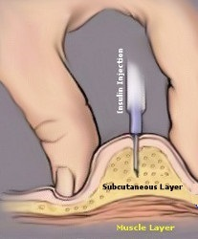
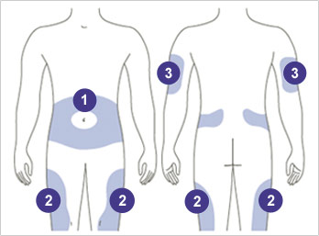
Insulin Administration
SCENS
Equipment
Safety check
Sites
Technique
Notes:
Equipment
Insulin needle
Safety needle
Proper disposal
Safety check
2 licensed nurse verification
Sites
Technique

Slide 8
Hypoglycemia
SCENS
Causes
Clinical manifestations
Assessment
Diagnostics
Management
Complications
Seizure
Coma
Death
Notes:
Causes
Diabetes, medication, dialysis, sepsis, nutritional imbalances, etc.
Clinical manifestations
Diaphoresis
Shaking
Anxiety
Dizziness
Hunger
Tachycardia
Impaired vision
Fatigue
Headache
Irritability
Assessment
Diagnostics
Management
Teach the patient and family signs and symptoms
Teach the patient 15(30)15 Rule
Keep 15 grams of carbohydrate handy at all times in the form of:
4 glucose tablets
6 pieces of hard candy
1 tube of glucose gel
8 ounces of skim milk
One half of a 12 ounce can of regular soda
Complications
Seizures
Coma
Death

Slide 9
15(30)/15 Rule for Hypoglycemia
SCENS
Normal blood glucose 70-100 mg/dL according to the American Diabetes Association (ADA)
Blood glucose less than 70
Administer 15 grams of carbohydrate
15 grams of carbohydrate examples
Wait 15 minutes to re-check blood sugar
If still below 70, add an additional 15 grams of carbohydrate
But, if blood glucose is below 50, add an additional 30 grams of carbohydrate
Wait another 15 minutes to re-check blood glucose
Notes:
Normal blood glucose 70-100 mg/dL according to the American Diabetes Association (ADA)
Blood glucose less than 70
Administer 15 grams of carbohydrate
15 grams of carbohydrate examples
4 glucose tablets
6 pieces of hard candy
1 tube of glucose gel
8 ounces of skim milk
One half of a 12 ounce can of regular soda
In the healthcare setting (One amp of Dextrose 50%=25 G dextrose IV would be appropriate if IV access is available and per protocol)
Wait 15 minutes to re-check blood sugar
If still below 70, add an additional 15 grams of carbohydrate
But, if blood glucose is below 50, add an additional 30 grams of carbohydrate
Wait another 15 minutes to re-check blood glucose
**Follow facility hypoglycemia protocol**
<Provide copies of facility specific hypoglycemia protocol>

Slide 10
Focused Assessment
SCENS
Role of RN, LPN, UAP
Targeted history
Last time the patient ate or drank anything
Medications
List of medications and when they were last taken
Role of RN, LPN, and UAP
Predisposing factors and considerations
Anticipate the need for equipment, supplies, and medications
Delegate where possible
Notes:
Role of RN, LPN, UAP
Targeted history
Last time the patient ate or drank anything
Medications
List of meds and when they were last taken
Role of RN, LPN, and UAP
Predisposing factors and considerations
Anticipate the need for equipment, supplies, and medications
Delegate where possible
Glucometer?
Labs?
Stretcher
Medications
IV access
ECG
Oxygen if appropriate

Slide 11
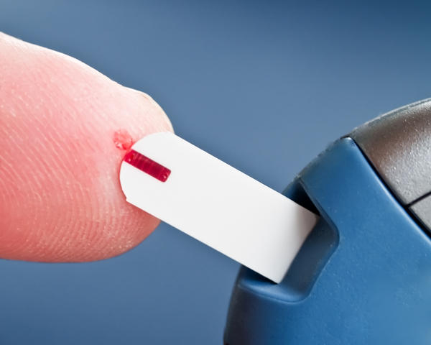
Hypoglycemia Protocol
SCENS
Rapid response activation
American Diabetes Association Standards
Apply oxygen for 93% sat or less per protocol
12 Lead ECG
Establish IV access
Fingerstick blood sugar
Capillary
Venous
Notes:
Rapid response activation
American Diabetes Association Standards
Apply oxygen for 93% sat or less per protocol
12 Lead ECG
Establish IV access
Fingerstick blood sugar
Capillary
Variations. Good correlation.
Venous
More reliable
Confirm results

Slide 12
Facility Specific
SCENS
Protocols
Equipment
State licensure
Scope of practice
Certifications
Job descriptions
Documentation
Communication
Know who to call
Communicating with the patient/family
Pertinent information to communicate
ISBAR
Notes:
Protocols
Equipment
Equipment needed
Calibration
Technique
State licensure
Scope of practice
Certifications
Job descriptions
Documentation
Communication
Know who to call
Communicating with the patient/family
Pertinent information to communicate
ISBAR

Slide 13
Safety
SCENS
Labs and diagnostics
Safety check for insulin
Insulin administration
Sites
Technique
Rights of medication administration
Rights of medication administration
Nursing process: ADPIE
Assess; Diagnosis (Nursing); Plan; Implement; Evaluate
Re-assess after interventions
Recognize changes in the patient status
Notes:
Labs and diagnostics
Re-check
Verify
Safety check for insulin
2 licensed nurses
Insulin administration
Sites
Technique
Rights of medication administration
Nursing process: ADPIE
Assess; Diagnosis (Nursing); Plan; Implement; Evaluate
Re-assess after interventions
Recognize changes in the patient status

Slide 14
Potential Issues
SCENS
Psychosocial
Outpatient versus inpatient
Conscious versus unconscious
Potential complications
Transfer to another unit/facility
What if…?
Notes:
Psychosocial
How would the care for this patient differ in an outpatient versus inpatient setting?
How would the interventions differ in a conscious versus unconscious patient?
Potential complications
What unit would the patient go to at your facility?

Slide 15
Summary
SCENS
Discussed components of a focused assessment for the patient experiencing a reaction to hyper/hypoglycemia (LPN collects data)
Reviewed the steps required to provide safe and effective care for the patient with diabetes experiencing a hypo/hyperglycemic reaction
Discussed safe administration of a subcutaneous insulin injection
Provided communication techniques to utilize when managing the care of the patient with diabetes experiencing a hyper/hypoglycemic reaction

Slide 16
SCENS

Slide 17
Diabetes: Outpatient or Inpatient
SCENS
Robert Harris
Fifty eight (58) year-old male with a complaint of fingerstick blood sugars (FSBS) above 375 mg/dL for the past “few days.” His symptoms are fatigue, blurry vision, polydipsia, polyphagia, and polyuria.
Past Medical History:
Type 2 diabetes
Hypertension
Past Surgical History:
Appendectomy
Medications:
Insulin Glargine 23 units subcutaneously daily
Insulin Aspart 5 units subcutaneously with meals
Lisinopril 20 mg by mouth daily
Allergies:
Penicillin
Notes:
Provide ISBAR communication after patient introduction

