Slide 1
Veterans Benefits Administration
Connecting With Those We Serve

Slide 2
VA Benefits
Helping disabled Veterans
Disability Compensation
Helping improve lives
Home Loans
Education
Helping through tough times
Pension
Veterans Retraining Assistance Program
Health Care
Helping families
Dependents & Survivors
Insurance
Burial
Vocational Rehabilitation & Employment
Notes:
2

Slide 3


Disability Compensation
What is it?
Service-connected disability compensation is a tax-free benefit paid to Veterans for a disability that was incurred in or aggravated by military service. Certain Veterans are eligible for disability compensation based on the presumption that the disability is service connected.
Who is it for?
Veterans who were discharged from service under conditions that were not dishonorable and have a current disability due to injury or disease incurred or aggravated in the line of duty.
Notes:
3

Slide 4
Other Programs for Veterans With Service-Connected Disabilities
Clothing Allowance – Annual payments for Veterans whose service-connected condition requires treatment (e.g., orthopedic appliance, skin cream) that irreparably damages outer garments.
Automobile and Adaptive Equipment– A one-time allowance to purchase an automobile or conveyance and additional allowances for adaptive equipment to accommodate certain severe service-connected disabilities.
Specially Adapted Housing (SAH)/Special Housing Adaptation (SHA) – Helps Servicemembers and Veterans with certain severe service-connected disabilities purchase, construct, or modify a home to accommodate the disability.
Veterans Mortgage Life Insurance (VMLI) – Helps the family of a disabled Veteran who received an SAH grant pay off the home mortgage in the event of the Veteran’s death.
Service-Disabled Veterans’ Insurance (S-DVI) – Life insurance benefit for Veterans with service-connected disabilities, but who are otherwise in good health
  Special Monthly Compensation – An additional amount paid to Veterans with certain severe service-connected disabilities
Notes:
4

Slide 5


Vocational Rehabilitation and Employment (VR&E)
What is it?
The VR&E program assists Veterans with service-connected disabilities to prepare for, obtain, and maintain suitable employment. Career counseling benefits are also available to recently separated Servicemembers and to those using VA education benefits.
Who is it for?
VR&E services are for Veterans with service-connected illnesses and injuries who:
May not be able to work right now and need rehabilitation and counseling services
Need specialized training and/or education
Need flexible work arrangements
Need help finding employment soon after separation
Need rehabilitation to live more independently
Notes:
5

Slide 6
VR&E Services After Evaluation
After the Veteran has been assessed, he or she will work with a Vocational Rehabilitation Counselor to determine which of the following options is the right fit:
Track | Goals of Rehabilitation Plan
Reemployment | Consultation with the employer, job accommodations, job modification, and case management; coordination and referral for services, such as work adjustment services
Rapid Access to Employment | Preparation to find employment including résumé development and job search assistance
Self-Employment | Services to help develop and implement a business plan including analysis of business concept, training in operating small businesses, and marketing and financial assistance
Employment Through Long-Term Services | Training and education, including On-the-Job Training (OJT), internships, and higher education
Independent Living Services | Assistive technology, independent living skills training, and connection to community-based support services
Notes:
6

Slide 7


Home Loan Guaranty
What is it?
The VA-guaranteed home loan program helps Veterans, Servicemembers, and eligible Reservists obtain, retain, adapt, or refinance a home. VA loans allow more favorable financing terms, including no down payment or mortgage insurance premiums.
Who is it for?
Home loan programs are available to Veterans, Servicemembers, eligible National Guard members and Reservists. Under the separate Specially Adapted Housing Program, Servicemembers or Veterans with certain permanent and total service-connected disabilities may be entitled to grant funds to help adapt their homes to enable or maintain independence.
Notes:
7

Slide 8
Related Home Loan Guaranty Programs
Native American Direct Loan (NADL) Program – Helps eligible Native American Veterans finance the purchase, construction, or improvement of homes on Federal Trust Land, or reduce the interest rate on an existing NADL.
Specially Adapted Housing (SAH) Grant Program/Special Housing Adaptation (SHA) Grant Program – Helps eligible Servicemembers and Veterans with certain permanent and total service-connected disabilities purchase, construct an adaptive home, or modify an existing home to accommodate their needs.
Veterans’ Mortgage Life Insurance (VMLI) – Helps the family of a disabled Veteran who received an SAH grant by paying off the home mortgage in the event of the Veteran’s death.
Notes:
8

Slide 9


Education
What is it?
  VA’s education programs may provide assistance for tuition, books, fees, housing for degree and non-college degree training, on-the-job training, licensing and certification, and work study programs. VA has four primary education benefit programs that offer different amounts of financial assistance and have different eligibility requirements:
  Post-9/11 GI Bill
  Montgomery GI Bill – Active Duty
  Montgomery GI Bill – Selected Reserve
  Reserve Educational Assistance Program (REAP)
Who is it for?
VA pays education benefits to eligible Servicemembers, Veterans, and dependents pursuing an approved education or training program.
Notes:
9

Slide 10
Additional information about the Post-9/11 GI Bill
The Post-9/11 GI Bill also offers the following in some instances:
Yellow Ribbon Program – provides additional financial support to individuals who attend a school where tuition and fees exceed the maximum Post-9/11 GI Bill benefit available by law
Transfer of Education Benefits (TEB) - allows Servicemembers to transfer unused benefits to their spouses or dependent children
Notes:
10

Slide 11
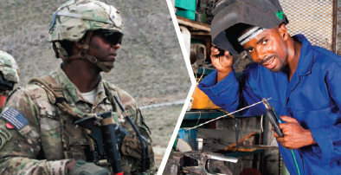
Veterans Retraining Assistance Program (VRAP)
What is it?
Veterans Retraining Assistance Program (VRAP) offers up to 12 months of training assistance to unemployed Veterans. The assistance must go toward an Associate Degree, Non-College Degree, or a Certificate from a VA-approved program for a high demand occupation.
Who is it for?
VRAP is for unemployed Veterans between the ages of 35 and 60.
Notes:
11

Slide 12


Pension
What is it?
Pension is a needs-based benefit paid to wartime Veterans who meet certain age or non-service- connected disability requirements.
[Typical beneficiary representative photo]
Who is it for?
Veterans who were discharged from service under conditions that were not dishonorable, served during a period of war, have limited income and net worth, and are either permanently and totally disabled or age 65 and older.
Notes:
12

Slide 13
Related Pension Programs
Special Monthly Pension – increased Pension paid to Veterans who require additional help to perform certain daily activities or are confined to their home
Survivors’ Pension – a monthly tax-free benefit based on limited income and net worth and paid to the un-remarried surviving spouse and/or child(ren) of a deceased Veteran with wartime service
Notes:
13

Slide 14


Insurance
What is it?
VA insurance benefits consider the extra risks involved in military service and provide Servicemembers, Veterans, and their families peace of mind knowing they are financially protected.
Who is it for?
VA provides insurance benefits to eligible Servicemembers, Veterans, and their families for financial security.
Notes:
14

Slide 15
Related Insurance Programs
Servicemembers’ Group Life Insurance (SGLI) – Active duty Servicemembers and full-time Reservists are automatically issued maximum SGLI coverage upon entry on duty. Members receive 120 days of free coverage from their date of separation; members who are totally disabled or have certain medical conditions may extend free coverage for up to two years from their date of separation.
Veterans’ Group Life Insurance (VGLI) – Veterans can convert their SGLI to a civilian program of lifetime renewable term coverage. They must apply within 1 year and 120 days from separation; if they apply within the first 240 days after separation, no medical underwriting is required.
Family Servicemembers’ Group Life Insurance (FSGLI) – Automatic coverage for spouses and children of Servicemembers with SGLI coverage. Dependent children are automatically covered at no charge.
Servicemembers’ Group Life Insurance Traumatic Injury Protection (TSGLI) – Automatic coverage for Servicemembers with SGLI coverage. Provides payments to Servicemembers who suffer traumatic injuries with severe losses, such as amputations, blindness, and paraplegia.
Notes:
15

Slide 16


Benefits for Dependents and Survivors
What is it?
VA honors the sacrifices of the families of Servicemembers and Veterans through benefit programs which may include payments based on financial need or service-related death; loans to help purchase, construct or improve a home; and assistance in obtaining a degree.
Who is it for?
These benefits are for the qualifying surviving spouse, dependent child(ren), and parent(s) of deceased Servicemembers and Veterans.
Notes:
16

Slide 17
Benefits for Dependents and Survivors
Dependency and Indemnity Compensation (DIC) — A monthly tax-free benefit paid to an eligible surviving spouse, dependent children, and/or parents of a Servicemember or Veteran whose death was related to service.
Dependents’ Educational Assistance (DEA) – Provides assistance to obtain a degree and pursue other eligible education and training including certificate programs, apprenticeships, correspondence courses, and on-the-job training.
Burial – A benefit that may include furnishing a headstone, marker, or medallion, a burial allowance, a Presidential Memorial Certificate, and an American flag to drape the Veteran’s casket, as well as the option of burial in a VA national cemetery.
Home Loans – A benefit that may be used to help purchase, construct, or improve a home, or refinance a mortgage.
Survivors’ Pension - a monthly tax-free benefit based on limited income and net worth, which is paid to the un-remarried surviving spouse and/or child(ren) of a deceased Veteran with wartime service.
Notes:
17

Slide 18
Outreach Programs
Military Outreach | Veterans Outreach
Overseas Military Service Coordinator | Homeless Incarceration/Justice Involved
Casualty Assistance | Women Veterans
Army Wounded Warrior | Former Prisoner of War (FPOW)
Marine Wounded Warrior | Minority Veterans
Operation Enduring Freedom/Operation Iraq Freedom/Operation New Dawn | Elderly Veteran
Recovery Care Coordinators (RCC) | Foreign
Transition Assistance Advisors (TAA) | Tribal/Alaskan Territorial Guard
Yellow Ribbon Reintegration Program (YRRP) | Faith Based and Neighborhood Partnerships
Chapter 63 | Burial/Indigent Veterans
Notes:
18

Slide 19
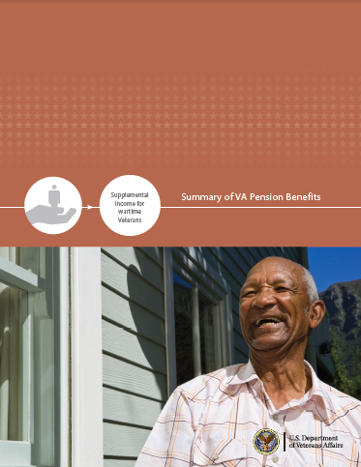
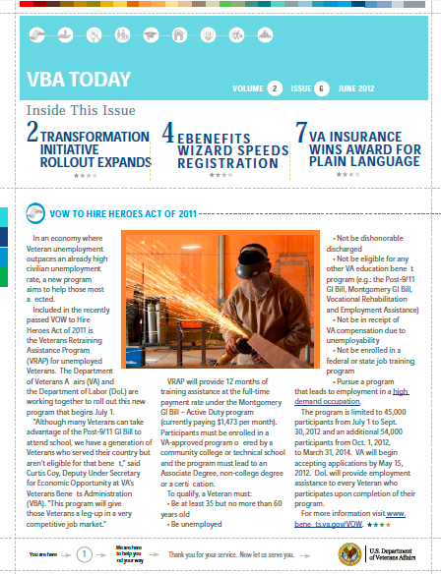

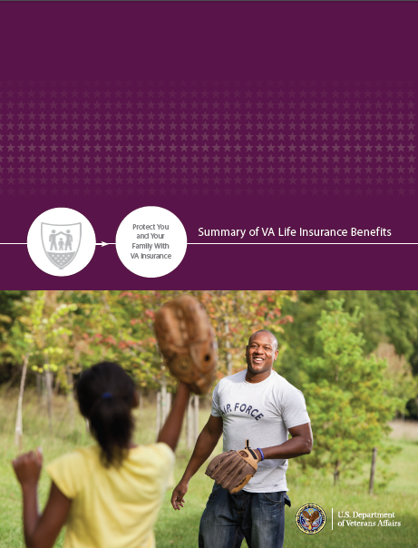
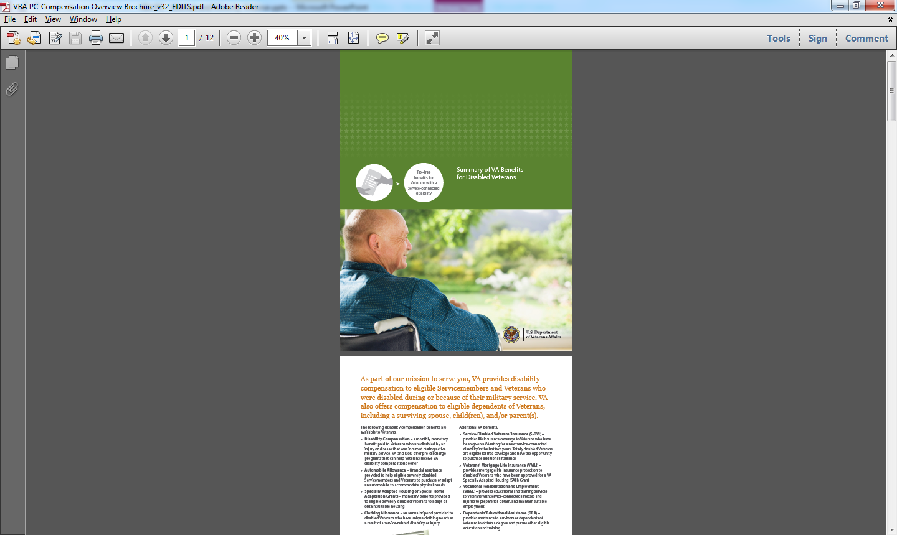
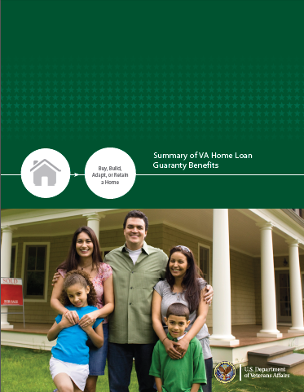


Outreach Resources
VA is continuously improving the resources available to help educate
Servicemembers, Veterans, and their families about their benefits
facebook.com/VeteransBenefits
@VAVetBenefits
Brochures & Fact Sheets
Newsletter
Notes:
19

Slide 20
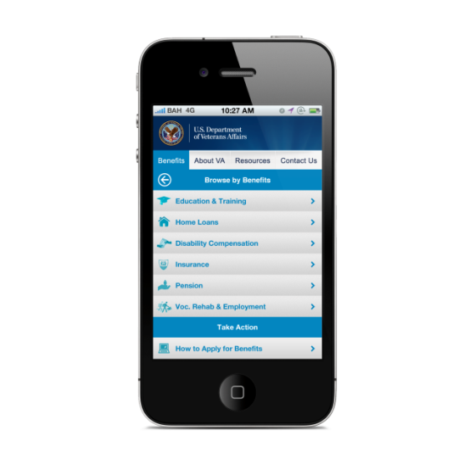
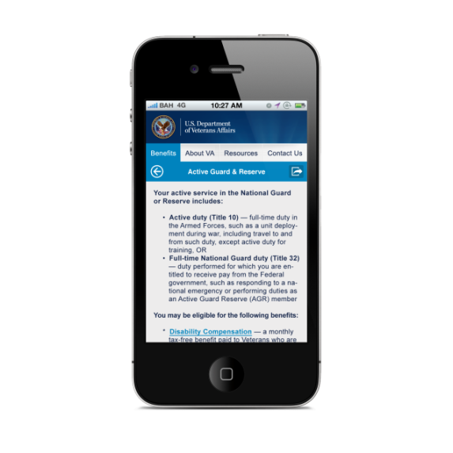
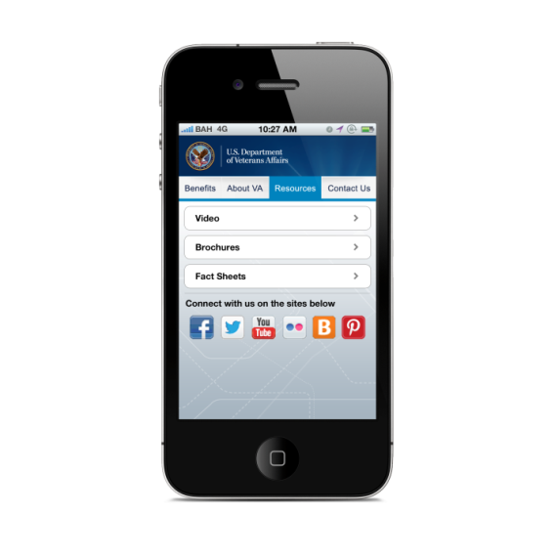
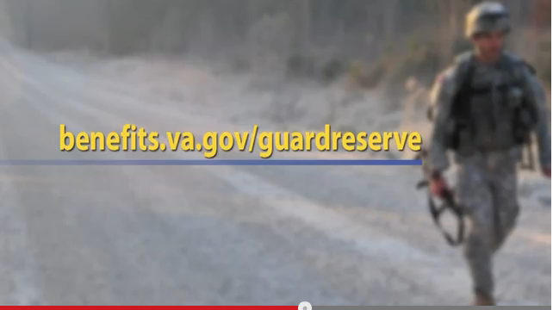


Innovative Outreach
VA is creating innovative outreach methods to increase access and inform our clients throughout the world.
National Guard and Reserve Benefits Video
On demand VA Benefits information
eBenefits Radio Public Service Announcement from NASCAR Driver Ryan Newman
eBenefits Public Service Announcement
Notes:
20

Slide 21

eBenefits
Servicemembers, Veterans, and family members can all access this online portal to browse VA and DoD benefits information.
After creating an account, users can:
Get quick access to eBenefits tools
Apply for many benefits online
Download military service records (e.g., Form DD 214)
View status of benefit claims
Notes:
21

Slide 22
Challenges Facing VBA
Increasing claims due to increased demand:
  Ten years of war with increased survival rates have resulted in more claims
  Post-conflict downsizing of the military
  Agent Orange presumptive disabilities for Veterans who served in Vietnam
Increasing complexity of rating decisions:
  Diabetes and its complications, Traumatic Brain Injury, Post-Traumatic Stress Disorder
  Increased contentions (GWOT Veterans claim three times more medical conditions than WWII Veterans)
Increasing need for employment and training:
  Post-conflict downsizing requires more training to assist Servicemembers’ transition to civilian employment
  A stagnant economy also drives more Servicemembers and Veterans to VA for assistance in obtaining employment

Slide 23
Benefits Assistance Service (BAS)
Mission
The Mission of the Benefits Assistance
Service is to serve as advocates for
Veterans, Service members, eligible
beneficiaries and other stakeholders,
to ensure they are knowledgeable and
informed about accessing and receiving
VA benefits and services.
Vision
Our Vision for the Benefits Assistance
Service is to be the premier
organization for our clients; to
proactively provide information and
knowledge about VA benefits and
services, in a positive 21st century
experience that is consistent, concise
and relevant.

Slide 24
Homeless Veterans Outreach Program
Full-time Homeless Veterans Outreach Coordinators (HVOC) located at 20 Regional Offices (RO) with the largest Veteran populations; remaining ROs have part-time HVOCs with ancillary duties
Provide information and assistance on VA benefits and services including, but not limited to, eligibility information, filing a claim, and referrals to Veterans Health Administration homeless program staff and local homeless providers
Conduct outreach to homeless Veterans and their families in various locations such as:
  homeless shelters
  VA Medical Centers, clinics and centers
  through state, tribal and local community partners
  Stand Downs
  Jails and prisons
  other areas where homeless Veterans may be located

Slide 25
Homeless Veterans Outreach Program
HVOCs:
  Assist women Veterans and their families from becoming homeless through coordination with VA’s Women Veteran Coordinators
  Make referrals to homeless coordinators at VA Medical Centers and Community-Based Outpatient Clinics
  Coordinate delivery of VA benefits access with local community homeless providers
  Provide VA benefits assistance to justice-involved Veterans participating in Veterans Treatment Courts or who will soon be released from incarceration
  Ensure claims are identified as homeless for expedited processing
During fiscal year (FY) 2012, over 11,965 hours of outreach were conducted by VBA field staff to over 50, 028 homeless Veterans.

Slide 26
VA Regional Office Locations
Togus
Seattle
Manchester
Anchorage
White River Jct.
Portland
Ft. Harrison
Fargo
St.
Paul
Boston
Boise
Sioux Falls
Milwaukee
Detroit
Buffalo
Providence
Cheyenne
Des Moines
Pittsburgh
Hartford
New York
Lincoln
Chicago
Cleveland
Newark
Reno
Salt Lake
City
Indianapolis
Philadelphia
Oakland
Denver
St. Louis
Huntington
Wilmington
Wichita
Baltimore
Louisville
DC
Los Angeles
Roanoke
Nashville
Winston Salem
Albuquerque
Muskogee
Little
Rock
San Diego
Phoenix
Atlanta
Columbia
Montgomery
WACO
Jackson
Eastern Area
Southern Area
Central Area
Western Area
New Orleans
Houston
St. Petersburg
Honolulu
San Juan

Slide 27
Claims Processing for Homeless Veterans
Expedited claims processing for homeless Veterans at each RO
VA Central Office oversight for homeless claims
Electronic “homeless” flash to properly identify homeless Veterans
The number of homeless claims completed continues to increase
  FY 2009: 5,451
  FY 2010: 7,754 (42% increase over FY 2009)
  FY 2011: 11,197 (44% increase over FY 2010)
  FY 2012: 15,230 (9% increase over FY 2011)
  FY 2013: 6,418 (April)

Slide 28
Questions and Contact Information
Jenée Bailey
Homeless Veterans Outreach Program Manager
Benefits Assistance Service
Veterans Benefits Administration
jenee.bailey@va.gov
(202) 530-9415
VA’s National Call Center for Homeless Veterans
Toll-free, 24/7 assistance
1-877-424-3838
www.va.gov/homeless

Slide 29
Veterans Healthcare Administration
Therapeutic Employment Services
Sarah Mahin
SSVF Regional Coordinator
Sandra Foley
SSVF Regional Coordinator

Slide 30
Getting VHA services
Eligibility for most VA benefits is based upon discharge from active military service under other than dishonorable conditions. In order to expedite benefits delivery, veterans seeking a VA benefit for the first time must submit a copy of their service discharge form (DD-214).
For most veterans, entry into the VA health care system begins by applying for enrollment. To apply, complete VA Form 10-10EZ, Application for Health Benefits, which may be obtained from any VA health care facility or regional benefits office, on line at www.1010ez.med.va.gov/sec/vha/1010ez or by calling 1-877-222-VETS (8387). Once enrolled, veterans can receive health care at VA health care facilities anywhere in the country.

Slide 31
VHA Acronyms
Outreach (CRRC, HCHV)
National Call Center for Homeless Veterans (NCCHV)
Prevention (HCRV, VJO, SSVF, VHPD)
Emergency Shelter (HCHV Contract Housing, Domiciliary)
Transitional Housing (GPD, CWT/TR)
Residential Rehab (RRTP)
Voc Rehab (CWT, DVRE)
Permanent Supportive Housing (HUD-VASH)
Services must address needs identified by those we serve.
Program info: www.va.gov/homeless

Slide 32
Therapeutic and Supported Employment Services (TSES)
This strategy includes a multi-pronged effort aimed at improving financial opportunities for Veterans, including, at minimum, vocational training and workplace skills development.
VA’s Work programs provide paid work experience and vocational assistance services to approximately 50,000 Veterans each year.
These services are integrated into the Veteran’s overall mental health treatment plan.

Slide 33
TSES-Compensated Work Therapy (CWT)
CWT is a vocational rehabilitation program that endeavors to match and support work ready veterans in competitive jobs, and to consult with business and industry regarding their specific employment needs. In some locations CWT is also known as Veterans Industries; these designations are synonymous.
The primary goal of CWT is competitive employment.
CWT is considered a medical benefit and is provided to eligible Veterans under VA medical care

Slide 34
TSES-Compensated Work Therapy (CWT)
CWT has three main components
Transitional Work (TW)
  VA Healthcare facilities based
  Community Based
  Time limited (3 to 9 months)
Supported Employment (SE)
  Mental Health -Veterans with Psychotic Disorders
  Polytrauma and Spinal/Cord Injury
Homeless Veteran’s Supported Employment Program (HVSEP)

Slide 35
Homeless Veteran’s Supported Employment Program
400 Vocational Rehabilitation Specialists (VRS)across the VA
VRS integrated into to Homeless Services Teams
Community Based Supported Employment services
Targeted job search
Job placement
Ongoing Employment Support

Slide 36
SSVF and TSES
Identify where the TSES is located within VA Medical Center
Establish criteria for cross referrals
Coordinated outreach and linkages to employers, job fairs, and other employment resources
www.cwt.va.gov

