Slide 1
Aging and the Homeless Community Follow Up Presentation: Implications for the Field
Thursday, January 27, 2016 1:00 p.m.—2:30 p.m. EST
VHA’s National Center on
Homelessness among Veterans
Roger Casey, PhD
Brenda Johnson, LCSW, CCM, VHA-CM

Slide 2
Call Overview
Conference call process
Mute computer speakers if dialing into VANTS
TMS link
Call Archive
Downloads
HERS Proceeding Document, December 2015
HERS Follow Up – Implications PowerPoint Slides
Structure of the call

Slide 3
The National Center on Homelessness among Veterans
To promote the development of policy and practice that targets ending and preventing Veteran homelessness through supporting the implementation of relevant research findings into clinical practice, providing education and training for VA and community partners, disseminating evidence-based and emerging best practices, and developing new empirical knowledge.

Slide 4
Presentation-Overview
HERS – Summary
Implications
Medical and Psychiatric Considerations
Building a Community Consortium
Cognitive Decline
The Importance of Working with Entitlements – SOAR
Building Relationships and Providing Support in the Community
Decisional Capacity and Barriers

Slide 5
Aging and the Homeless Community Homeless Evidence and Research Synthesis (HERS) Round Table November 19, 2015
Brought together researchers on homelessness and aging to discuss
Population predictions
Special needs
Impact of aging on service delivery.

Slide 6
Implications for the Field
Opportunity to
Explore these populations shifts and the effects these changing demographics may have on
Implementing services
Developing alternatives
organizational
management

Slide 7
Today’s Presenters
Introductions
Goodlett McDaniel
Medical and Psychiatric Considerations
Araceli Orona
Building a Community Consortium
John Schinka
Cognitive Decline in Aging Homeless Veterans
Marilyn Warlick
Building Relationships and Providing Support in the Community
Ana Shahan
The Importance of Working with Entitlements – SOARS
Lisa Moody
Decisional Capacity and Barriers

Slide 8
HERS Summary
Population expectations
Population characteristics
Program considerations

Slide 9
HERS Presentation Summary Projecting changes in the scope and health services utilization of older Veterans who experience homelessness
Thomas Byrne, PhD
Investigator – The Center
2010 - largest age group among male homeless 49-51 y/o
11.3% Veterans; only 5.9% non-Veteran
Veterans ages 62-74 expect to increase by 50 – 250% (by 2020)
Those Veterans 60 and older – projected increase from 16,921 (2015) to 21,350 (2020)
Health care cost increases
Between $10,000 and $15,000 under 25-51 y/o
Over $15,000 over 55 y/o
Summary: geriatric conditions and end of life issues in homeless programing
Staff training
Facility changes
Systematic efforts to target population needs

Slide 10
HERS Presentation Summary Mortality risk and factors influencing death in older homeless Veterans
John Schinka, PhD
Investigator – The Center
35% entering homeless programs 55 y/o, or older
Mortality in 55 y/o and older group
Homeless group - higher proportions of death associated with
Mental health, infections, accidents, self harm
Suicide rare but odds greater in homeless; 0.4% as opposed to those housed 0.2%
Predictors of death sample of homeless Veterans
Those variables moderately associated with increase risk of death included: serious medical problems, hospitalization for alcohol, alcohol dependence, unemployment three years and age 60 years old.
Summary
Homelessness increases mortality rates in older veterans
Possible risk index could be constructed as predictor and identity those most vulnerable.

Slide 11
HERS Presentation Summary Planning palliative care for homeless Veterans at the end of life
Evelyn Hutt, MD
Internist/palliative care physician VA Colo Health Care System
Study – informing palliative care – HSR&D (2013)
Approaches to care
Barriers
Framework for meeting needs and program design
Challenges found
Symptom management, addiction, unstable housing, and behavioral health care
Housing
Too limited, programs require functional independence and sober facilities
Continuity of care within VA systems
Need for collaboration with homeless staff
Summary
Education for providers on housing; VA resources and linkages, housing criteria flexibly; priority housing for end of life needs; hospital to home

Slide 12
HERS Presentation Summary The aging of the homeless populations: emerging clinical issues
Margot Kushel, MD
Professor of Medicine U of California, San Francisco
Median age 50 y/o; health age 70-80 y/o
Key health concerns
Chronic diseases: substance use, geriatric conditions (chronic functional and visual impairment, falls, and incontinence.
Leading causes of mortality - all homeless 45 y/o plus
Heart disease and cancer
Managing chronic disease
Medications, compliance, diets, activities,
Older homeless;
39% difficulty with ADLs
38% global cognitive impairment
40% executive function impairment (managing complex tasks)
34% reported fall in past 6 months
48% screened positive for incontinence
45% visual impairments
36% hearing impaired
Summary
Acute and chronic health issues by the aging homeless population

Slide 13
Implications
Research Implications
Changing demographics
Homelessness increases mortality risk and rates in older Veterans
Geriatric conditions and end-of-life issues
Unmet needs of veterans who are unhoused
Requirements for care - flexible
Staff awareness of and linkages with available VA and community resources
Strategies for:
Chronic diseases, substance use, and cognitive, functional and visual impairment, falls, and incontinence

Slide 14
What are Implications for…..
Direct Care
Assessment in prevention and outreach
Relationship / coordination with medical providers, community, other agencies and resources
Health and mental health care needs
Sustainability and support
Program Design
Future programing shifting demographics
Facilities
Community collaboration
Agency linkages

Slide 15
Aging and the Homeless Community Medical/Psychiatric Considerations
J. Goodlett McDaniel, EdD, PMHNP-BC, MBA

Slide 16
First thoughts…
Average life expectancy for a US male in early 2000’s was 78 years. For a chronically homeless male, average life expectancy between 42 and 52 years (O’Connell/NHCHC, 2005). 64 for single males and 69 for single females in 2015 HERS
Collaborative care more than doubled the effectiveness of depression treatment for older adults in primary care settings. At 12 months, 50% of patients had a 50% reduction in depressive symptoms, compared to only 19% of others (O’Connell/NHCHC, 2005)
Multi-disciplinary Teams function best when increasing access to onsite care, facilitating testing and specialty referrals, maximizing community and outreach services, improving housing retention rates, and finding and serving American heroes living without basic shelter
ARNP “Provides direct service and coordinates with care Team as appropriate in order to assist Veteran to remain in permanent supportive housing”
Notes:
PMHNP & Teaming in VISN 8 Thank Vianne Marchese and Shawn Liu
VASH JAX
VISN 8
N FL & S GA
Largest city geographically in US
VA hospitals > 40 miles in Gainesville and Lake City
Top 3 cities for returning Vets
3rd most female Veterans in US
What defines role?
The care that results from a practice team of primary care and behavioral health clinicians, working together with patients and families, using a systematic and cost-effective approach to provide patient-centered care for a defined population. This care may address mental health and substance abuse conditions, health behaviors (including their contribution to chronic medical illnesses), life stressors and crises, stress-related physical symptoms, and ineffective patterns of health.

Slide 17
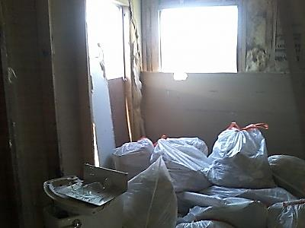
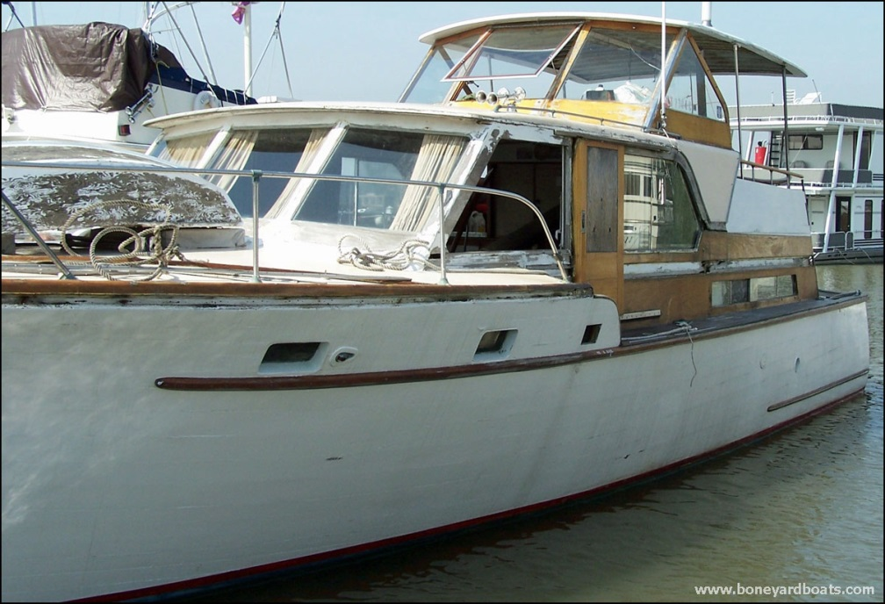
I would like you to meet….
Mr. Y.
Mr. H.
ARNP climbed through a mobile home window, Vet on floor, blue..
Vet slept in boat after hours “lived
in a bubble”…
Notes:
Models
Enhanced referral relationships
Co-location
Staff model; co-habitation
Full integration as a multi-disciplinary care team

Slide 18
Mr. H. and Mr. Y.
69 y.o., Air Force, Pilot
16 active problems (Depression, ETOH abuse, Wandering, Dementia, GAD, Pain, Insomnia, Vision problems)
Pre-screen for care giver report + for cog def,
Good health generally
Living in HUD VASH apartment
Strengths:
Caregiver via Craiglist, family in area, bicycle for transport, able to make medical f/u
Good health, active, wants help
Stressors:
Loss of former wife and girlfriend at Holidays
Decrease in executive functioning (memory, money, meds?)
Immediate Treatment Goals:
Team approach (Neuropsych consult, MD reports, caregiver’s sudden exit, family questions arise, PsyD charting, Psychiatrist asked to help, Flag posted)
Diagnostic clarification- Appt scheduled for meeting with PsyD
SAFETY
62 y.o., Viet Nam Veteran
7 hospitalizations in one year
36 active problems (Depression, Polysubstance, Suicidal, Explosive, Dementia, GAD, Pain, Pneumonia, Neuropathy, Dehydration, Weight loss, Incontinence, Multiple fractures)
5 active medications, >300 discontinued/expired
5 psych, 5 medical, 3 psychosocial diagnoses
16 procedures/diagnostic tests, 16 consults
Last discharge to Nursing Home (day-to-day)
Strengths:
Physically resilient
Manages $
Stressors:
Poor health, fractures, falls, dementia
Decrease in executive functioning (memory, money, meds?)
Immediate Treatment Goals:
Frequent contact with nursing home Social Worker
Monitoring health gains
SAFETY
Similar problems require unique solutions: ^BP, Lipids, Glucose; Poverty; Substance use
(ETOH*); ED use; Weapons; Frequent hospitalizations; Multiple providers (Multiple f/u referrals with 19% “no show” rate: - Prosthetics, Psychiatry, Kinesiotherapy, Smoking Cessation, Psychology, Neurology, Medicine, Occupational Therapy, Physical Therapy, GI, Pain, Speech, Neuropsychology, Ophthalmology, Dental?)
Notes:
Goals
Accessibility – Provider comfort with open access, walk-in, adjustment of daily schedule to accommodate individuals
Patient-centered approach – Histories, struggles with severe mental illness, discomfort with medical interaction
Physical exams are not performed on the first visit “complete physical exam is discussed and planned together”
Developing trust and comfort – Clinicians help facilitate connections with PCP
Everyone observes something important (i.e. grip strength, balance, changes in loc, behavior, diet, cleanliness, etc.)
Measures
PHQ-9
GAD 7
Medical
Blood Pressure—quarterly
Body Mass Index—quarterly
Waist circumference—quarterly
Breath CO—quarterly
Plasma Glucose (fasting) and/or HgbA1c—annually Lipid Profile (HDL, LDL, triglycerides)—annually National Outcome Measures (NOMs)—every 6 months
Satisfaction (Veteran, Providers, Services)
Measures?
Patient/Client Satisfaction Surveys
PHQ9 scores (baseline, diagnostic, measure improvement)
# of warm hand offs
BHC Monitor patients referred for longer term care
Make smooth transition
Don’t fall through the cracks
Staying in service
Follow up reports to Primary Care Provider from BHC
BHC encounters for sustainability for 100 hours a month
Patient outcomes
Patients with a repeat PHQ-9 score of less than five within 1 year of the elevated PHQ- 9.
Patients with a positive alcohol and/or substance abuse screening who were referred for treatment.
Patients with at least 2 follow up visits per year after initiation of medication.
# of visits per month per behavioral health provider
# of patients per month seen by behavioral health
Minutes Provider delay for BH concerns
Chronic disease care
―Most frequent medical diagnoses
Tobacco use
Hypertension
Obesity
Lipid disorders
Diabetes
Hepatitis C
Musculoskeletal disorders
Pain
Tools of use
CPRS
Lync
E-mail
Telephone
Fax

Slide 19
Building a Community Consortium
Araceli Orona, LCSW

Slide 20
Aging Veteran Project
Brief Overview of Project (Hx., Purpose, Goal)
Eligibility, Criteria & Referral Process
Services Rendered
Clinical Significance of Project

Slide 21
Aging Veterans Project
“Almost half of homeless veterans in the United States are over the age of 51 and are comprised primarily of veterans representing the Baby Boomers and are veterans of the Vietnam War years.”
“The issue of homeless veterans is not just a matter of finding homes for those who currently lack housing, but also establishing proactive programs aimed at preventing homelessness for those most at risk.”
Khadduri J, Culhane D. 2010 Annual Homeless Assessment Report to Congress. Darby, Pa, USA: Diane Publishing; 2011.

Slide 22
Aging Veteran Project Goal
Brief Overview of Project (Hx., Purpose, Goal)
History: Initiated in 2011 as a result of VA and Community Research regarding homelessness among the aging veteran population
Purpose: To assist veterans in maintaining and sustaining independent housing.
Goal: To purchase Homemaker/Home Health Aide services for veterans active in the homeless program and for veterans who are at risk of becoming homeless.
Eligibility, Criteria & Referral Process
VA healthcare eligible
Needing assistance with ADLs and/or IADLs to sustain independent or supportive housing as a result of compounding medical, cognitive, and/or severe mental illness
A consult must be submitted by veteran’s Primary Care Provider (physician, nurse practitioner, or psychiatrist).
Services Rendered
Homemaker Services: Light housekeeping, laundry services/ironing, bed linen changing, grocery shopping, meal preparations/cooking, and navigating public transportation
Home Health Aide Services: Transferring/mobility, Bathing, Dressing, Toileting, Feeding & HMKR services

Slide 23
Aging Veteran Project Clinical Significance
Vignette
Decrease in ER visits, Nursing Home Placements, and Assisted Living Facilities
Increase in emotional & physical well-being
Increase in housing stability
Decrease isolation and loneliness
More cost-effective than long-term care

Slide 24
Cognitive Decline in Aging Homeless Veterans
John Schinka, PhD

Slide 25
Cognitive Decline in Aging Homeless Veterans
NCHAV Presentation
January 2016

Slide 26
John A. Schinka, PhD
School of Aging Studies,
University of South Florida, Tampa FL

Slide 27
1/Definitions and Basic Facts
I will be discussing dementia, which is a major issue for the veteran population.
Dementia is not a specific disease.
Dementia is a general term that describes a condition primarily characterized by a decline in cognitive ability, particularly memory, sufficient to affect the ability to perform daily activities.

Slide 28
2/Definitions and Basic Facts
Most cases of dementia are progressive and irreversible. The most common of these is Alzheimer's disease (AD), which accounts for 70+ percent of cases. The second most common dementia is vascular dementia.
The very large majority of cases of dementia have late onset and occur at age 65+. Early onset AD is very uncommon (1% of cases of AD).

Slide 29
3/Definitions and Basic Facts
Late onset AD and other dementias do have a complex genetic component. These dementias are not inherited in classic "dominant/recessive" pathways but rather as an interactive combination of multiple genes.
The veteran population is aging and approximately 45% of veterans are now age 65+--they have entered the age of risk for dementia and particularly AD.

Slide 30
4/Definitions and Basic Facts
The veteran homeless population also has a significant number of age 65+ veterans. In FY15, 8.3% (1 in 12) of veterans receiving housing services from VA were age 65+.

Slide 31
5/Assessing Cognitive Change
Significant memory loss is not a characteristic of normal aging. However, some degree of cognitive decline does occur, beginning as early as age 50 in some individuals.
Normal cognitive decline is usually characterized by common complaints that do not interfere with functional capacity.

Slide 32
6/Assessing Cognitive Change
"I came into this room to get something and I forget what it is."
"I can't find my car keys (glasses, wallet).
"I know I put that screwdriver (spatula, hairbrush) on that counter and now it is gone."
"I ran into a person at Home Depot who is a church member but I couldn't remember her name."

Slide 33
7/Assessing Cognitive Change
What are signs of possible early dementia in someone who is age 65 or older?
1. Memory loss that disrupts daily life: forgetting recently learned information, important dates or events, asking for the same information over and over; relying on others to take over or complete tasks.

Slide 34
8/Assessing Cognitive Change
2. Problems in planning and execution: difficulty in following a plan or working with numbers, confusion in following a familiar recipe or keeping track of monthly bills, taking much longer to do routine task, confusion in following the rules of a familiar game.
3. Repeatedly losing track of dates, seasons, and the passage of time.

Slide 35
9/Assessing Cognitive Change
4. Problems following/joining a conversation: stopping in the middle of a conversation, repeating the same information, problems finding the right word or calling things by the wrong name (e.g., calling a wrench a "turn tool").

Slide 36
10/Assessing Cognitive Change
5. Losing or misplacing things: putting things in unusual places (e.g., wallet in bathroom cabinet), losing something and not be able to retrace steps to find the object, accusing others of stealing.
6. Poor judgment: giving large amounts of money to telemarketers, paying less attention to grooming or hygiene.

Slide 37
10/Assessing Cognitive Change
7. Withdrawal: decreased participa-tion in social activities or sports, trouble keeping up with a favorite sports team, stopping a hobby or interest without a good reason.
8. Changes in mood/personality: episodes of confusion, suspicious-ness, depression, fearfulness; easily upset at home, work, with friends or in places when out of comfort zone.

Slide 38
11/Some Considerations
Sudden onset of confusion, disorientation, or behavioral change is not a feature of dementia or normal aging at any age and should trigger a medical evaluation.

Slide 39
12/Some Considerations
There are few factors that produce an earlier age of onset. The most important of these is significant head trauma producing solid evidence of substantial brain injury or repeated minor incidents of head trauma (e.g., as is seen in professional boxers and football players.

Slide 40
13/Some Considerations
A history of common head injury is reported by most older adults and the large majority of alcoholics. There is no evidence that these injuries are related to earlier onset of dementia.
Alcohol abuse over long periods of time has a small effect on increase in risk for AD.

Slide 41
14/Some Considerations
A family history of dementia should not be considered a diagnostic criterion in assessing cognitive decline.
Reliable assessment of cognition in alcoholic veterans should be done after at least 30 days of sobriety.

Slide 42
15/How to Assess and Refer
If there are indications that a veteran age 65+ is showing signs of cognitive problems, a quick screening may help to focus a consult request.
Currently, the most reliable and efficient of the screening instruments for dementia is the Montreal Cognitive Assessment (MOCA).

Slide 43
16/How to Assess and Refer
The MOCA has been widely studied and used in the US and is frequently used in VA settings. It is relatively easy to learn to administer and can be completed and scored in about 15 minutes. There is no fee/charge.
The MOCA form and instructions for administration/interpretation for the English version can be obtained at http://www.mocatest.org/

Slide 44
17/How to Assess and Refer
MOCA consists of 13 mini-tests:
Trail-Making, Copying, Clock Drawing
Animal Naming
List Learning (Immediate Recall)
Digit Span, Letter ID, Serial 7s
Sentence Repetition, Letter Fluency
Abstractions
List Recall (Delayed Recall)
Orientation

Slide 45
18/How to Assess and Refer
If your MOCA screen is positive, you want to refer the veteran for a full dementia workup.
Check with your local VA hospital/clinic Neurology and/or Psychology Services to see which clinics handle these referrals.
Your referral should briefly state the clinical reason for concern and the result of the MOCA evaluation.

Slide 46
19/Sample Consult Request
This is a 68 y/o homeless veteran with HS educ, previously employed as a store sales manager. He is sober X 2 mos, medically stable, has no acute health problems. In our program, he has difficulty organizing his day, becomes confused following even simple instructions, forgets appts, repeats same questions about appointment, tasks, etc. over and over. A MOCA administered yesterday revealed a score of 21. Please evaluate for cognitive decline/dementia.

Slide 47
Building Relationships and Providing Support in the Community
Marilyn Warlick, LCSW, LCAS, C-CATODSW

Slide 48
Building Relationships and Providing Support in the Community
Effects of losses in aging are increased through experiences of being:
A Veteran
A Homeless Person
Two individual Veterans and Case Management
-- benefits offered in connecting…….

Slide 49
Advocate….. to manage change and connecting to community
70+ year old Veteran kicked out of his house after he and his wife separated. The Veteran received $780 a month in SSD income not eligible for a NSC Pension. He had severe COPD and was living in his car for about 4 months. The Veteran presented to the PACT team social worker who advised the HUD VASH team in but there were no vouchers.
The Veteran was hospitalized frequently in local community hospitals generally 4-5 times a month for a few days at a time where they would recommend o2 for him but were unable to provide it as he lived in a car.
He would spend his days at the outpatient clinic canteen area so he didn’t have to sit in the car, and nights after the clinic closed at a local Walmart until he went to his local car to sleep. His case worker worked with him to try to find alternatives until he was willing to move then contacted HUD VASH to see if there were vouchers available in that county.
Housing was found quickly for him in a 55+ apartment complex. He was hospitalized about 8 times between the intake and his move in as it was summer and very very hot, but he didn’t want to go to a shelter. He’s been in housing now over a year and a half. Has home 02, is active with the local elderly services department who helps him with food and transportation, and has started to reconnect to his family who he was estranged from for several years.

Slide 50
Isolation: health care and housing accommodations for aging: “ I can talk with you “
60 y/o Successfully managed HUD VASH independent living 4 years with 4+ yrs sobriety, meetings close communications with two children and former wife
Past 6 months saw, 3 Admissions due to dehydration, wt loss, depression. Increasing difficulty with digestion, lack of interest to prepare meals care for his home.
Refused Social Security application living off 30%SC.
Through Discuss of losses, feelings of loneliness and value of relationships with his children could motivate for application to Social Security.
Family discussion of care in place, discussions with members in acute care Medicine and Psychiatric Units as well as Primary Care Provider Team Members for in home supports, extended in hospital stay or move to other extended stay options.

Slide 51
Foundations for Clinicians in Building Relationships and Providing Support in the Community
Build skills of meeting the Veteran where they are – In Their Home.
Role of mentors and resources over the years
Presence to the suffering in this moment
Connecting Best Practices in Research to the present moment, the present relationship
Effective use of self and team - resilience

Slide 52
The Importance of Working with Entitlements – SOAR
Ann Shahan, BSN, M.Ed

Slide 53
Mainstream Income Benefits
Ann Shahan
VACO-HUD-VASH
Regional Coordinator
206-437-9125
ann.shahan@va.gov

Slide 54
SSI & SSDI: The Basics
SSA: Social Security Administration
SSI: Supplemental Security Income; needs based; federal benefit rate is $733 per month in 2016; provides Medicaid in most states
SSDI: Social Security Disability Insurance; amount depends on earnings put into SSA system; Medicare generally provided after 2 years of eligibility
The disability determination process for both programs is the same

Slide 55
Definition of Disability
The definition of disability and application process is different for VA and SSA benefits
Discharge status is not a factor in SSI/SSDI determination
Disabling condition does not need to be related to military service
Those denied for VA benefits may still be eligible for SSI/SSDI
Veterans can access SSA benefits while they are waiting for VA benefits
There is no partial disability with Social Security

Slide 56
SOAR Technical Assistance Initiative
SOAR – SSI/SSDI Outreach, Access & Recovery
Focuses on people who are experiencing or at risk of homelessness
A model for assisting individuals to apply for Social Security disability benefits
Sponsored by the Substance Abuse & Mental Health Services Administration (SAMHSA) in collaboration with SSA since 2005
SOAR is active in all 50 states; no direct funding is provided to states
SOAR TA Center helps states and communities by providing technical assistance and training

Slide 57
Importance of SSI/SSDI for Veterans
SSA disability benefits can provide access to:
Income – Veterans can receive SSI/SSDI in conjunction with, or as an alternative to, VA disability benefits
Health insurance – Veterans can use the Medicaid and Medicare health benefits that comes with SSI/SSDI to supplement VA health services
For Veterans with disabilities, SSI/SSDI can increase income and housing stability, and reduce their future risk of homelessness
Opportunity for staff serving Veterans to help with both SSA and VA disability benefits

Slide 58
VA Caseworker’s Guide

Slide 59
SOAR Online Course
http://soarworks.prainc.com/
Free, web-based course to train case managers in completing SSI/SSDI applications using SOAR
Standardized, self-paced training
Includes completion of a practice SSI/SSDI application
Individualized feedback from the SOAR TA Center
16 CEUs from NASW
Class 1 of the course provides a SOAR 101

Slide 60
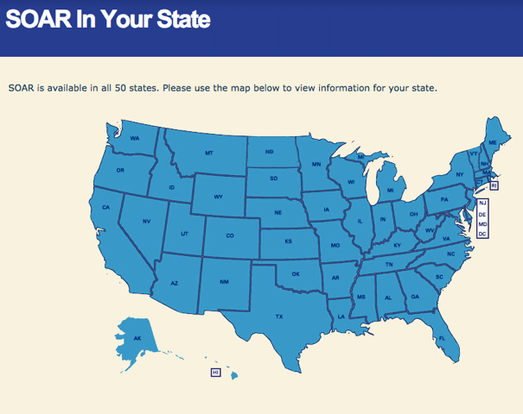
Get Involved with SOAR
Find your SOAR TA Center Liaison
Find your SOAR State Team Lead
Connect with SOAR in your community
Problems? Let us know!
http://soarworks.prainc.com/directory

Slide 61
Competency Assessments and Barriers
Lisa Moody, LCSW

Slide 62
DECISIONAL CAPACITY: THE MENTAL OR COGNITIVE ABILITY TO UNDERSTAND THE NATURE AND EFFECT OF HIS OR HER ACTS
• Ability to express choice
• Ability to understand relevant information
• Ability to appreciate information as it impacts self
• Ability to reason using relevant information in one’s case

Slide 63
What Rights are Examined?
MEDICAL
FINANCIAL
LEGAL
RESIDENTIAL

Slide 64
BRAINSTORMING FOR THE FUTURE
Partnerships with other agencies.
Expansion of medical foster homes.
Developing small, group homes.
Expanding the use of vouchers in medical foster homes, community living centers, assisted living facilities, etc.
Committees/Boards

Slide 65
The alleged incapacitated person has the capacity to:
make informed decisions regarding his/her right to marry.
make informed decisions regarding his/her right to personally apply for government benefits.
make informed decisions regarding his/her right to have a driver’s license or operate a motor vehicle.
make informed decisions regarding his/her right to travel.
make informed decisions regarding his/her right to seek or retain employment.
make informed decisions regarding his/her right to contract.

Slide 66
(continued)
The alleged incapacitated person has the capacity to:
make informed decisions regarding his/her right to sue, or assist in the defense of suits of any nature against him or her.
make informed decisions regarding his/her right to manage property or to make any gift or disposition of property
make informed decisions determining his/her residence.
make informed decisions regarding his/her right to consent to medical and mental health treatment.
make informed decisions affecting the social environment or other social aspects of his/her life.

Slide 67
Please indicate those areas in which the person LACKS THE CAPACITY to make informed decisions regarding his/her rights and for which a less restrictive method of protective services is not adequate to protect the person from a substantial risk of harm to his/her personal welfare or financial affairs.
Decisions concerning travel or where to live.
Consent to or refusal of medical or other professional care, counseling, treatment or service.
Permitting access to, refusal of access to or consent to release of confidential records and papers.
Control or management of real or personal property or income from any source.
Acting as a member of a partnership.

Slide 68
Continued….
Management of a business.
Making contracts.
Payment or collection of debts.
Making gifts.
Initiation, defense, or settlement of lawsuits.
Execution of a will or waiving the provisions of an existing will.
Decisions concerning education.

Slide 69
Aging and the Homeless Community Follow Up Presentation: Implications for the Field
Research to Practice
Medical and Psychiatric Considerations
Building a Community Consortium
Cognitive Decline in Aging Homeless Veterans
Building Relationships and Providing Support in the Community
The Importance of Working with Entitlements – SOARS
Decisional Capacity and Barriers

Slide 70
Aging and the Homeless Community Follow Up Presentation: Implications for the Field
Thanks to presenters
TMS – registration link
Archive will be available
Thanks for attending

Slide 71
Presenter Bios
James Goodlett McDaniel, EdD, PMHNP-BC, MBA
James Goodlett McDaniel is certified as a PMHNP-Family working for the Veteran’s Health Administration in the Health Care for Homeless Veterans Program in Jacksonville, Florida. Licensed in both Virginia and Florida. Dr. McDaniel has been a nurse practitioner since 1995. He has served as an associate provost at a large public University, created and managed psychiatric and long-term care programs; created new community models for delivery of capitated services with a community mental health center; and, has delivered, managed, and taught in innovative educational programs for undergraduate and graduate nurses.
ARACELI ORONA, LCSW
Since 2010, Araceli Orona, Licensed Clinical Social Worker, has served in various capacities within the homeless program at Jesse Brown VA Medical Center in Chicago, IL. Araceli Orona has had the privilege in contributing to the VA mission as a HUD VASH SUD Specialist, HPACT Social Worker, Program Coordinator for Community Resource and Referral Center, and currently as the Coordinator for the Aging Veteran Project and a Team Lead for the HUD VASH program. Throughout her experiences within the VA, Ms Orona continues to demonstrate great passion and conviction in meeting the VA’s mission to End Homelessness.
John Schinka, PhD
After receiving his PhD at the University of Iowa, John A. Schinka joined the staff of the Tampa VA Medical Center and the Department of Psychiatry at the University of South Florida. He established the Memory Disorder Clinic at the Tampa VA and helped to develop the Byrd Alzheimer's Disease Center at the University. After thirty years of clinical work, research in aging and cognition, and supervision of interns and residents, Dr. Schinka joined the National Center on Homelessness among Veterans to work on research on homeless veterans. He recently retired from the VA and is now a Professor of Aging Studies at the University of South Florida.
Marilyn Warlick, LCSW, LCAS, C-CATODSW
Ms Warlick has worked within the VAMC for over 25 years. During these years she has worked in various settings including Geropsychiatry and Substance Abuse Programs and serving as Clinical Coordinator for the OEF/OIF Program and Coordinator for Hospice and Palliative Care Program. Marilyn is currently working as Case Manager with the HUD/VASH Program serving our homeless Veterans in Tampa, Florida.
Ann Shahan, BSN, M.Ed.
Ann Shahan, BSN, M.Ed., started her career with the Veterans Health Administration in 1983 as a staff nurse on an inpatient psychiatric unit. Prior to her current positon with VACO as Housing and Urban Development-Veterans Administration Supportive Housing Regional Coordinator, Ann was the Network Homeless Coordinator for VISN 20 and Homeless Coordinator for Puget Sound Health Care System in Seattle, Washington.
Lisa Moody, LCSW
Lisa Moody is a Licensed Clinical Social Worker currently working with the HUD VASH team in Tallahassee, Florida. Ms Moody also worked with Home Based Primary Care with the VA before transferring to HUD VASH. Lisa holds a small clinical practice outside the VA and conducts capacity evaluations for the Courts.

Slide 72
Contact: VHA’s National Center on Homelessness among Veterans
Roger Casey, PhD
Director, Education and Dissemination
roger.casey@va.gov
Brenda Johnson, LCSW, CCM, VHA-CM
Education Coordinator
brenda.johnson4@va.gov

