Slide 1
Library Network Office Knowledge Nook Training Series
Welcome!
We’ll get started at the top of the hour.
If you’d like to explore the library resources before we get started, feel free to visit the VHA National Desktop Library at www.va.gov/library

Slide 2
Knowledge Nook Training Series
Notes:
Good afternoon.
I’m pleased to welcome you to today’s Knowledge Nook training session.
I’m [name, and role] of the VHA Library Network Office, and I’ll presenting for today’s session, which is focusing on how to search for evidence in library resources.
I’m going to go over a few housekeeping items, which will also give people a few extra minutes to join the call.

Slide 3
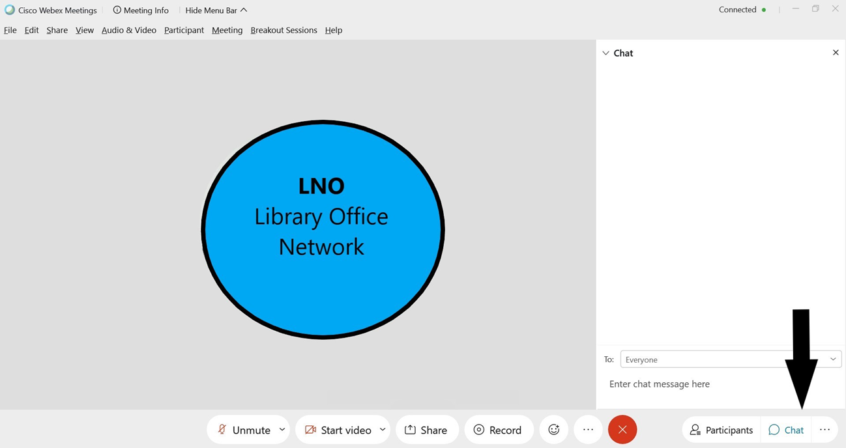
Chat for Questions
Library Network Office
Notes:
To minimize interruptions and ensure optimum audio quality, all lines have been muted.
We also request that you turn off your camera, as that reduces the bandwidth and will improve the quality of the call.
Use the chat box, which is in lower right-hand corner of your screen.
As questions come in, I will try to answer your question or my colleagues Nancy or Molly will answer in the chat window.

Slide 4
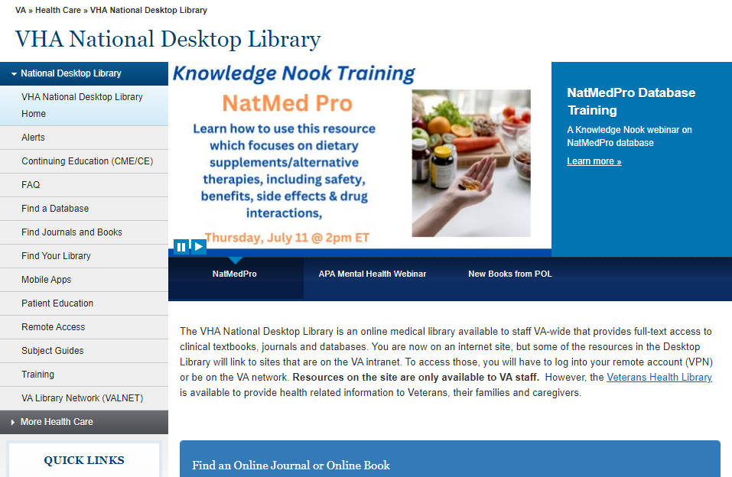
VHA National Desktop Library
www.va.gov/library
Library Network Office
Notes:
To access the electronic library resources that are available VA-wide, [CLICK] visit the VHA National Desktop Library at www.va.gov/library.
This serves as your landing page to access all nationally subscribed online resources, as well as a shortcut to your local medical center library, which may subscribe to additional resources.

Slide 5
Find a Database
Library Network Office
Notes:
To find those resources, locate the Find a Database link in the left-hand navigation on any page.

Slide 6
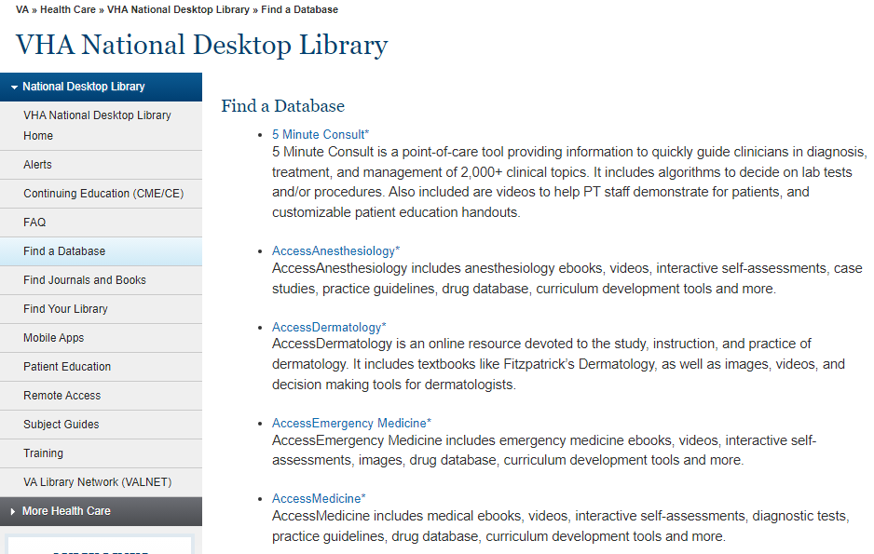
Find a Database
Library Network Office
Notes:
The Find a Database page includes descriptions of each of the online databases available VA-wide. The title of each database is hyperlinked to take you directly to that resource.

Slide 7
Remote Access
Library Network Office
Notes:
If you are on travel, or working from home, you will need to use a remote access account to access library resources remotely.
To establish a remote access account, click on ‘Remote Access’ in the left-hand menu.

Slide 8
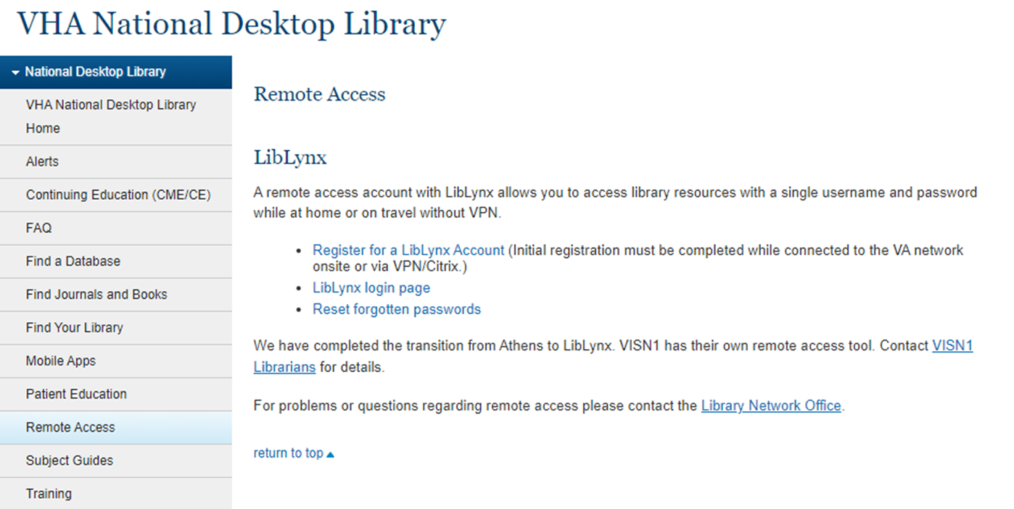
LibLynx Registration
Library Network Office
Notes:
And when you get to this page, click on “register for a LibLynx account.” [CLICK]
Note that VISN 1 has their own remote access tool for now, so if you’re in VISN 1 you’ll need to use the link on this page to contact your VISN 1 librarians. If you’re watching the recording of this presentation, please check this page of the website for instructions if you’re in VISN 1.

Slide 9
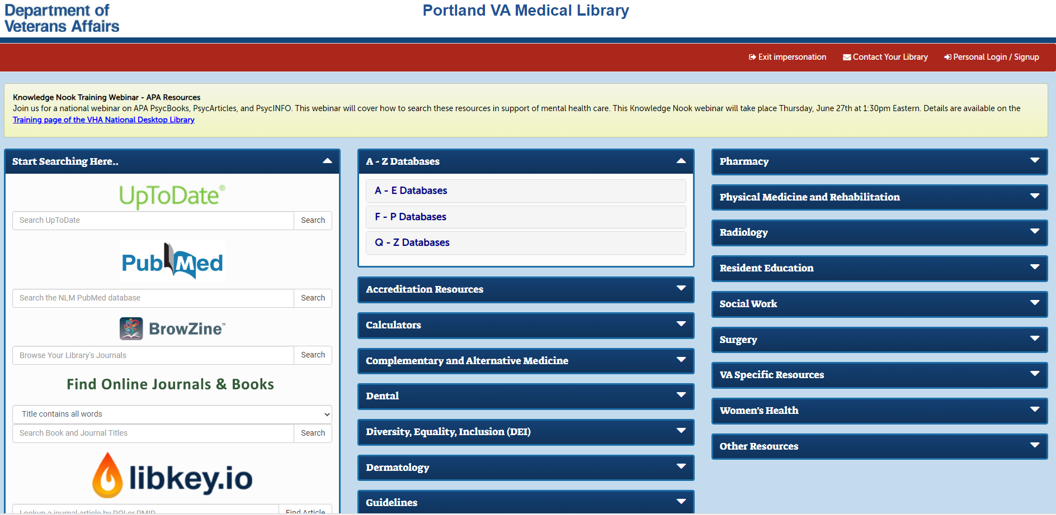
LibLynx Library Portal
Library Network Office
Notes:
Once you’re logged in to LibLynx, you’ll find a page that looks like this, and you’ll be able to navigate to all of your facility’s library resources, including any that have been purchased at the local level.
Announcements of future trainings are featured in the yellow bar at the top of this page, or you can also find them on the Desktop Library website.

Slide 10
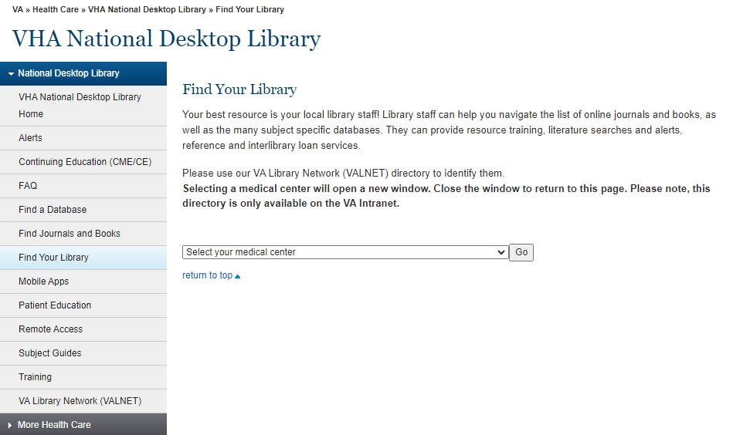
Find Your Library
Library Network Office
Notes:
Back on the Desktop Library website, if you have additional questions about using any of the online resources, your local library staff are available to help.
To locate your local library website or find contact information for your library staff, use the Find Your Library page of the Desktop Library website and then find your facility in the dropdown, which is organized by VISN.

Slide 11
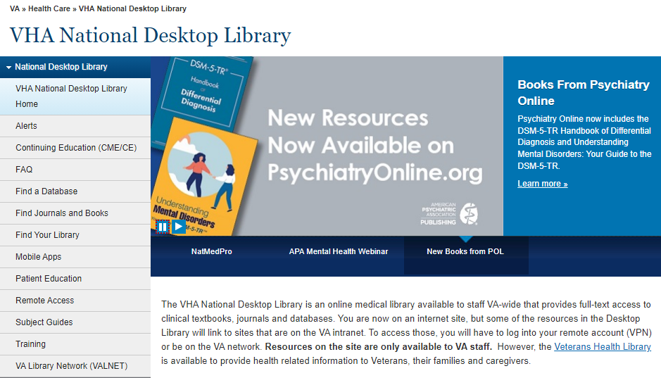
Training Resources
Library Network Office
Notes:
Today’s training is being recorded, and the recording will be posted to the Training page.

Slide 12
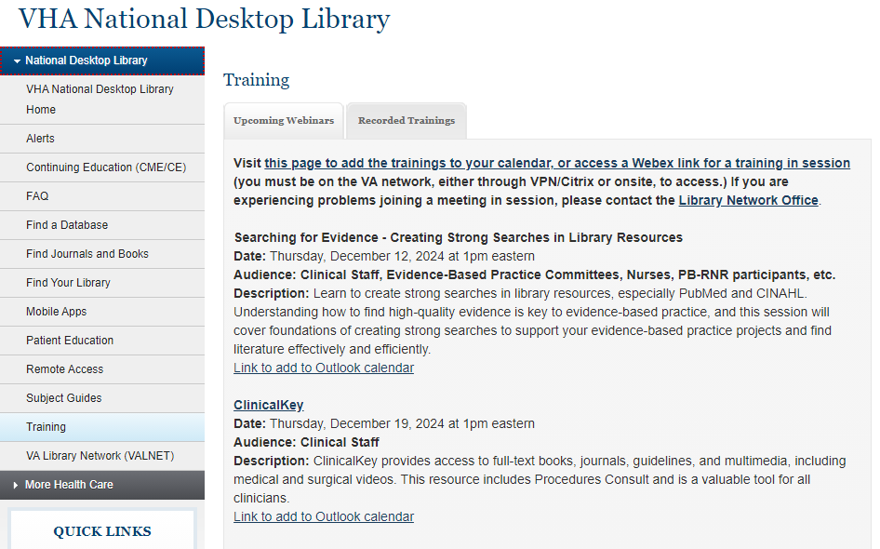
Training Page
Library Network Office
Notes:
There are two tabs at the top of the training page. The default tab is to Upcoming Webinars, which allows you to see what training sessions are planned for the future. You can also jump to a VA SharePoint page to snag the calendar invitations for upcoming webinars from this page.

Slide 13
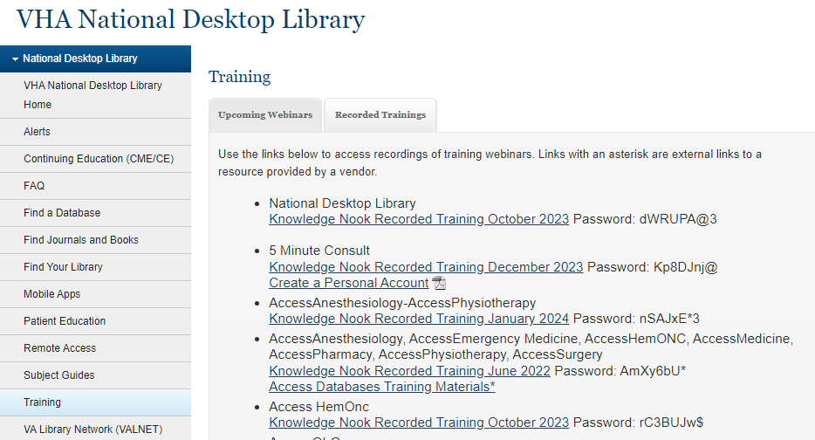
Recorded Webinars
Library Network Office
Notes:
The 2nd tab – Recorded Trainings - is where you will find the recording of today’s program as well as recordings of trainings for other electronic resources.

Slide 14
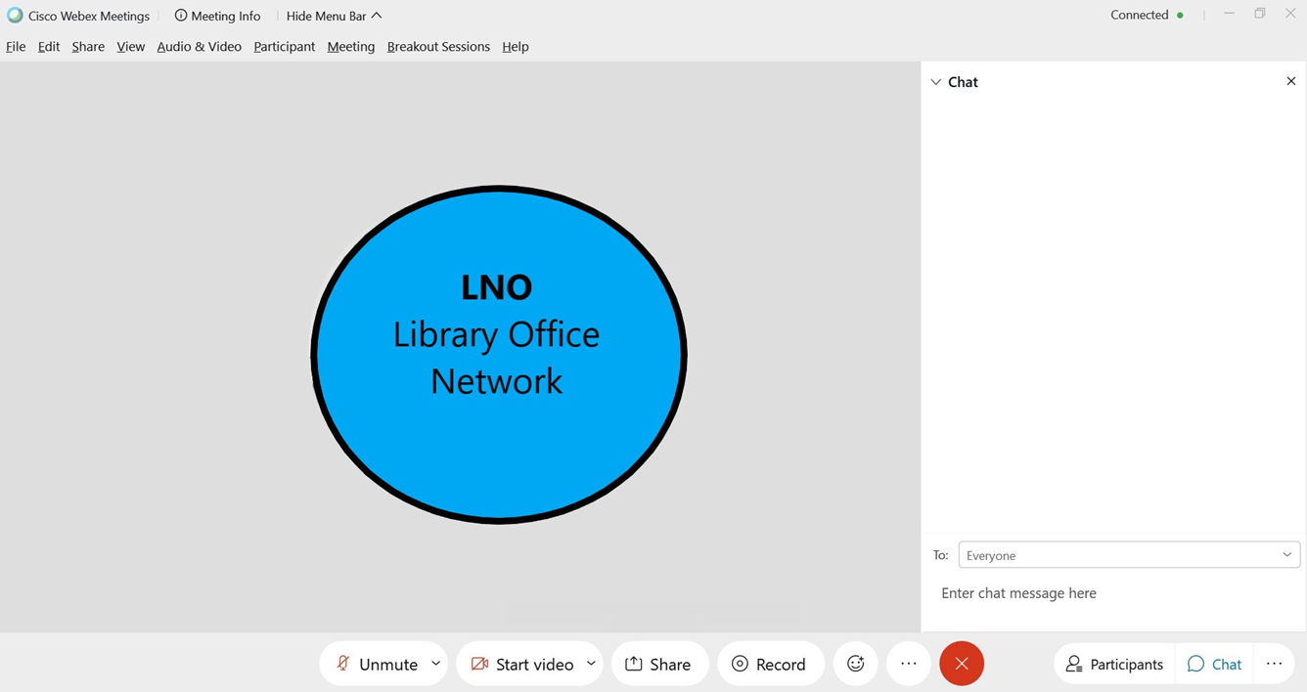
Remember to use the chat!
Library Network Office
Notes:
If you’ve joined late, just a quick reminder that all lines have been muted to cut down on background noise. Also, we ask that you turn off your cameras to reduce the bandwidth, which increases the quality of the presentation.
To ask a question, please use the chat feature in WebEx, located in the lower right-hand corner.

Slide 15
Contact Us
Have questions?
Contact
the Library Network Office
VHALNO@va.gov
Library Network Office
Notes:
If you have any questions about the VHA National Desktop Library, or Knowledge Nook training program, please contact the VHA Library Network Office at vhalno@va.gov.

Slide 16
Creating Strong Searches in Library Resources
Sola Whitehead, MLIS, AHIP
Technical Services Librarian
Library Network Office

Slide 17
AGENDA
Some Library Resources for High Quality Evidence
Tips for PubMed Searches
Boolean Operators
Tips for CINAHL Searches
Google (Scholar)
AI Tools
Reminders
Notes:
I am going to cover:
Some of the databases you might want to consider searching to find high quality scientific articles
Give you some tips on how to create strong searches in PubMed
Many databases use Boolean operators, so I’ll cover those
I’ll also touch on tips for searching the Cumulative Index for Nursing and Allied Health Literature, or CINAHL
I want to address Google Scholar and AI tools
And then I’ll wrap up with some reminders.

Slide 18
“If we knew what we were doing, it wouldn’t be called research, would it?”
-Albert Einstein
Notes:
You’re going to be searching in Library databases for a reason. It might be for an evidence-based practice project, or because there’s an issue on the unit that is bugging you, or because you just want a better understanding of how the world works.
I want to encourage you to give it some time. Searching for evidence is not the same as googling an answer for your kids at the dinner table. We’ve had lots of answers to how to provide high quality medical care over the years, and your goal in searching for scientific literature should be to find the most recent, high quality content to guide your practice.

Slide 19
Creating a Searching Toolbox
“If the only tool you have is a hammer, you tend to see every problem as a nail.”
-Abraham Maslow
Notes:
My goal for you today is to help you build a searching toolbox.
If you’ve only googled answers in the past, you might not be getting great results in PubMed, because that’s like bringing a hammer to a task that needs a screwdriver. So, with that said, let’s start putting together your searching toolbox.
I’ve put together this slide deck so that you can download it later from the Desktop library and keep it as a tool, if that’s handy. I’ll also do some live demos so that you can see my suggestions in action.

Slide 20
National Desktop Library: www.va.gov/library
Consider searching in:
PubMed – Good for medical topic like randomized controlled trials, diagnosis-specific questions, understanding etiology, etc.
CINAHL – Nursing and allied-health topics (significant overlap with PubMed)
Cochrane Databases – High-quality systematic reviews
Joanna Briggs EBP Database – Nursing-focused documents, including evidence summaries, recommended practice, and consumer info sheets
**Don’t limit yourself. Look at what’s available, and then search in multiple places.
Notes:
There are a LOT of resources where you can look for answers. These are just a couple.
Today, I’m going to be touching on searching in PubMed and CINAHL. But you might also consider looking at the in-depth systematic reviews that the folks at Cochrane do.
The Joanna Briggs EBP Database has a bunch of great content that’s focused on nursing.
There’s also quite a bit of overlap between many of these, but it’s not 100%.
I want to encourage you to look in multiple places to find what’s available to you for answering whatever question you’re tackling.

Slide 21
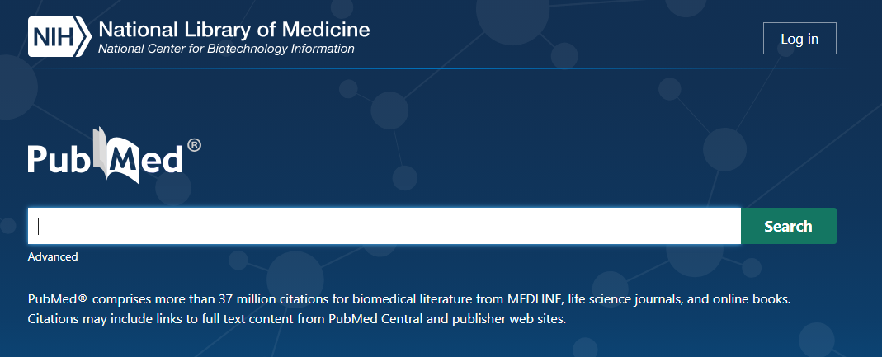
PubMed Hints & Tips
Use this database for searching on medical topics
Go to PubMed from either the Desktop Library or your VA Library’s LibLynx portal, so that you’re linked to the full-text subscriptions for your VA
Use a NCBI account (top right) to save searches, create collections, etc.
Search for each concept individually
Combine them using the “Advanced” link under the search bar
Notes:
So, let’s focus on PubMed to start.
PubMed is best used to see if there is literature on a wide variety of medical topics, including diagnosis, treatment, etiology, drug studies and so on.
When you get to PubMed, I want to encourage you to login to an NCBI account. [CLICK]
This will let you save your searches, created collections of citations for different projects, and personalize how your results appear.
When you start searching, you’ll enter your search terms in that google-like bar in the middle of the screen.
I encourage you to search for each of your concepts individually to begin with.
This lets you see how much is out there on just that concept.
If there’s not very much, then you’re going to find even less once you combine it with other concepts.
So you might need to think of another way to phrase what you’re looking for.
Once you’ve searched for your different concepts, you’ll combine them using the Advanced link under the search bar [CLICK]

Slide 22
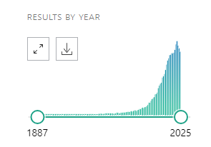
More PubMed Hints
Advanced Search Builder shows your history (most recent at the top) for the last 8 hours. You can download, delete, and create new searches. Boolean operators are in the “Actions” column.
Use the buttons near the top of your results screen! The “Display Options” button allows you to switch to “abstract” view so that you can see everything at a glance.
Use the slider on the left-hand side of the results page to view the year distribution, and to limit the years of your results.
Notes:
When you click on Advanced, it will bring you to the Advanced Search Builder. This thing is great.
It will show you all of your searches for the last 8 hours. The most recent search will be at the top.
Off to the right, in the blue, you can see how many results there were for each of your searches.
Then, you can combine them using the ellipses in the actions column [CLICK]
I’m going to do a live demo in a moment and I’ll show it to you.
When you run a search in PubMed, there are buttons near the top of the results screen. I want to encourage you to use those to your advantage. The Display Options button lets you change the way your results are shown, which is great.
PubMed also has a visual representation on each results page of when literature on that topic was published. [CLICK] You can adjust how far back in the literature you want to look using the little circles under the bar graph, but I suggest holding off on that until you’ve combined your search terms. However, this will let you see that perhaps the literature on using formula to feed infants peaked in 2019.

Slide 23
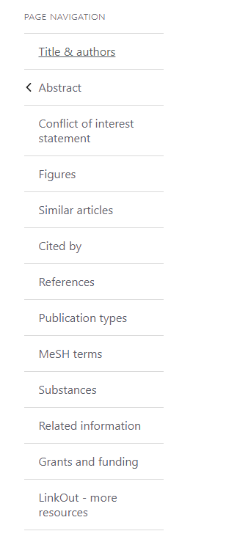
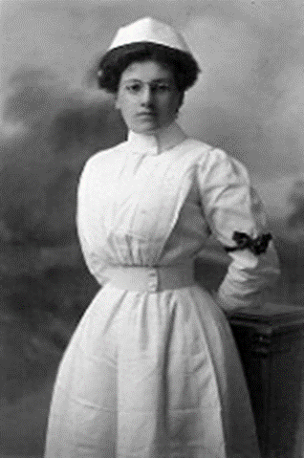
PubMed continued
Most entries have a “similar articles” feature in the Page Navigation – be sure to look there too! This shows up AFTER you click on a title and get to the full entry.
MeSH terms identify concepts represented in that entry. They are a great way to identify additional search terms that really describe the thing you’re looking for. (English uses words to mean a variety of things – MeSH terms have specific definitions to get to the correct concept.)
Notes:
When you click on a title in PubMed, you see the full information for that entry. At that point, almost every citation will have a menu on the right-hand side that looks like the screenshot to the right on this slide.
The “similar articles” feature will bring you a list of citations that touch on similar concepts.
You should also check out the MeSH terms list.
MeSH terms identify the concepts that are assigned to that article. Because English uses similar words to mean different things, the Medical Subject Headings, or MeSH, are a controlled list with specific definitions.
For example, when you say “nursing”, do you mean the act of being a nurse? Or do you mean breastfeeding? PubMed won’t know the difference. However, you can do a search for nursing, find a good entry, and then look at the MeSH terms. When you click on the MeSH terms, you can build a search that uses that particular definition.

Slide 24
Boolean Operators
AND, OR, NOT
Notes:
Let’s talk briefly about the three Boolean operators, which are And, Or, and Not.
These will let you build stronger searches.

Slide 25
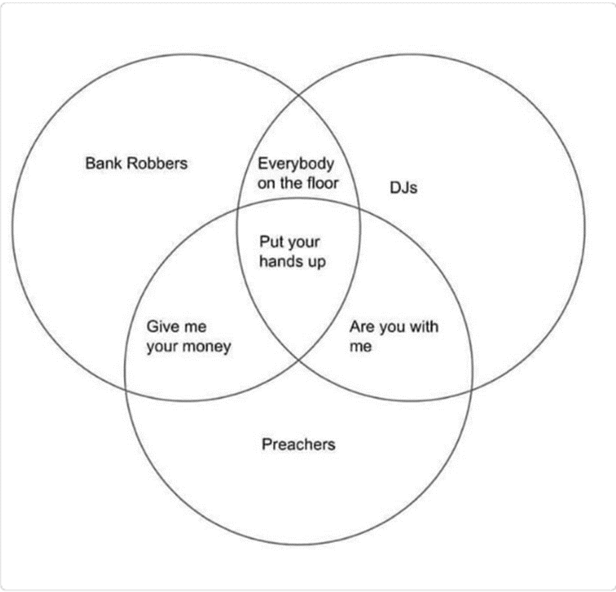
AND
LIMITS your results, because each of your terms must be there. You are telling the database it must include this AND this AND this….
Notes:
AND limits your results, because you’re telling the database that results must have all of the things that you AND together.
AND finds the overlapping sections of a Venn diagram, such as results about women who have diabetes AND get pregnant.
It’s finding results that have your various concepts in common.

Slide 26
OR
BROADENS your results, so that you cast a wider net. You are telling the databases to give you everything with this OR that OR the other.
Sedated
Non-verbal
Pain assessment in non-verbal OR sedated patients
Notes:
OR broadens your results. If you care about patients in long-term care or nursing homes, you’d use OR to combine those two concepts.

Slide 27
Not
ELIMINATES some concept that is not useful for you. You are telling the database that you want this, but NOT that other, related thing.
Notes:
If there’s some concept that you don’t care about, but it shows up a lot with a concept you DO care about, that’s when you use NOT.

Slide 28
PICO Questions – how to combine?
P – Patient or Population: Adults OR Inpatients OR Parkinson’s Patients
AND
I – Intervention or Indication: Exercise Program OR Gait Stability Training
AND
C – Comparison (might be standard care): Physical Therapy OR Standard Care
AND
O – Outcome: Improved gait stability OR reduce fall risk
In general, you’ll use OR within a category for synonyms
Use AND between categories to get results to that reflect all of your components
Start small and build your search
Notes:
The PICO Question format is used a lot in evidence-based practice. If you are doing a project that requires you to create a PICO question, think of it as a way to identify and organize your search terms.
The PICO question is the foundation for searching the literature.
You’ll use OR for the synonyms that are within a category – Adults OR inpatients OR Alzheimer’s disease
You’ll use AND between the categories.
So search first for the components within the P, or the I, and so on.
You’ll use your toolbox to build the search by doing the components first, and then putting them together with AND. I also suggest adding them together one category at a time.

Slide 29
General Steps to a Strong Search
Identify Search Concepts
Select a database
Search for each concept INDIVIDUALLY
Begin combining search terms with Boolean operators
Add filters (e.g., limit to English, last 5 years, Systematic Reviews, etc.)
Notes:
The general steps for doing a strong search are laid out here.
(list off 1-5_)
I hope that so far, this all makes sense, and that you’re not feeling like I’ve asked you to Jet ski across the pacific ocean at any point. I’ll do a brief pause for questions.

Slide 30
PubMed Live Demo
Start at your Library’s portal, or the National Desktop Library website:
www.va.gov/library
Notes:
Let’s go explore my suggestions in PubMed.
I’m going to start us from the Desktop Library website. You can also go there from LibLynx. I recommend either of these two paths, rather than googling PubMed, because going this route will connect you to VA full-text subscriptions.

Slide 31
CINAHL
Use this database to search for literature focused on nursing and allied health topics. Note that there’s a fair amount of overlap with PubMed.
Create a personal EBSCO account to save searches & results, organize into folders, etc.
Search for each concept individually
Use the “CINAHL Subject Headings” link at the very top of the screen to find applicable subject headings
Combine terms using the “Search History” link under the search bar
Use * for various endings –> Nurs*= nurse, nurses, nursing
Notes:
OK, let’s talk about CINAHL.
It is focused on nursing and allied health topics.
There’s a fair amount of overlap with PubMed, but it’s not 100%. If you have questions about what has been published on nursing PRACTICE for example, you’ll definitely want to look here.
Once again, I recommend that you create a personal account, and login as your first step [CLICK].
Search for each concept individually. I do recognize there are three search boxes there, so you can go wild immediately. But I consider it best practice to look at how much shows up for each concept before you start combining.
Rather than MeSH terms, CINAHL uses CINAHL Subject Headings [CLICK].
To combine your search terms, you’ll use the search history link [CLICK].
Also, in both PubMed and CINAHL, the asterisk serves as a truncation tool. This will let you find every possible ending without brainstorming it yourself.

Slide 32
CINAHL Cont’d
Notes:
When you click on Search History, you’ll get something that looks like this.
Off to the right [CLICK] you can see how many results you got for that concept.
Here, I did a search for patient handoff, and then I search for the CINAHL Subject Heading for that concept, and they put it under “Hand Off, Patient Safety”
Select the searches that you want to combine using the checkboxes on the left [CLICK]
Then combine them using the buttons [CLICK] at the top of the search history.

Slide 33
CINAHL Live Demo
Start at your Library’s portal, or the National Desktop Library website:
www.va.gov/library
Notes:
Let’s do a live CINAHL demo

Slide 34
Google Scholar
A useful tool, but shouldn’t be your only tool
Great place to search if you’re striking out elsewhere or terms are eluding you
Try lots of variations on your theme(s)
Search cannot be replicated (by others, or by you at a different time) and may be different from location to location
It’s never clear exactly what Google Scholar is searching, and may include some unreliable or predatory journals
Notes:
Let’s talk about a few potential elephants in the room. First: Google Scholar.
I’m not going to tell you to not use Google Scholar. It’s a useful tool. It just shouldn’t be your only tool.
Google Scholar is a great place to search if you feel like you can’t think of the right search terms. Try lots of variations of your themes or concepts.
Find some useful results, and then look at what words they use to cover the concepts. Then go search in PubMed or CINAHL using those terms.
One of the challenges of Google Scholar is that the search can’t be replicated (by you, later, or by others). Results might be different depending on where you are. So it shouldn’t be your only source for the basis of evidence-based practice.
We also don’t know exactly what Google Scholar is searching, and it may be looking at sources that are unreliable or predatory.

Slide 35
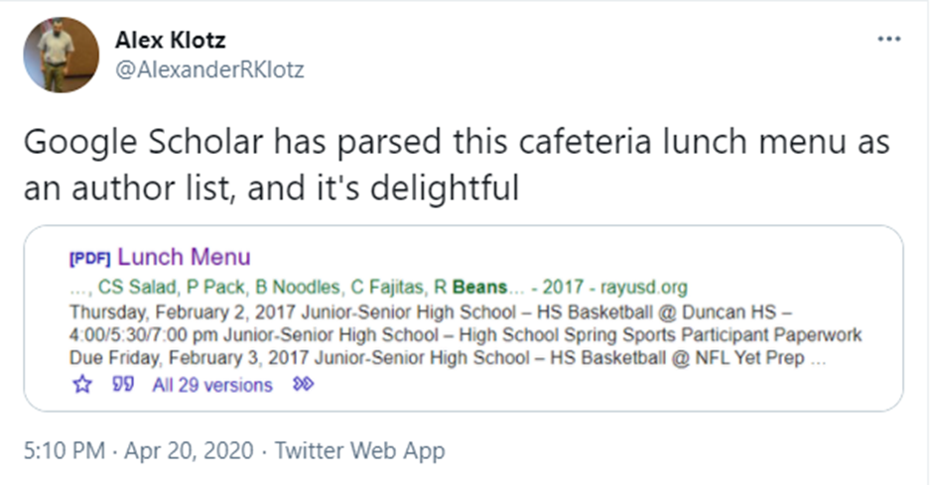
Notes:
In fact, on at least one occasion, it interpreted a cafeteria lunch menu as scientific literature, and I just think it’s amazing that Refried Beans are now on an author list.

Slide 36
AI Tools join the toolbox
When using a generative AI resource, consider how you craft your prompt:
Concise, specific instructions that identify the AI’s role, goal, context, audience, format, and/or expectations. You’re telling the tool a story to explain what you want.
NOT Boolean – it’s an iterative conversation
AI responses are not specifically reproduceable
AI is another tool (but shouldn’t be your only tool.)
Use an appropriate AI that doesn’t hallucinate citations.
Requires human intelligence as well. It should be used as an assistant – not as a replacement.
Consider AI tools that use the scientific literature:
Elicit Perplexity
OpenEvidence Research Rabbit
Many more being introduced every day!
Notes:
Of course, we also need to touch on AI.
This is another tool that can be a valuable addition to your toolbox. But again, I encourage you to not make it your ONLY tool.
When using AI, one of the most important parts to think about is how you tell it what you want. This is called “prompt engineering”, and you don’t need to worry so much about Boolean operators here. It’s an iterative “conversation” where you are giving it instructions on what you want, including ideally a goal, the format, and so on.
AI should be considered as an assistant, but it’s not a replacement for human intelligence. Make sure that you’re looking at the results and evaluating them critically.
Also, please check on what kind of AI tool to use. There are many, and more every day. You want to use one that uses the scientific literatur as a base, and does not hallucinate citations. There are some to consider on this slide, but please don’t consider this an endorsement of any particular AI tools. Also – individual AI tools can be blocked by the VA at any time without warning. Please make sure that you’re never entering any PII, PHI, or VA sensitive information into an AI tool.

Slide 37
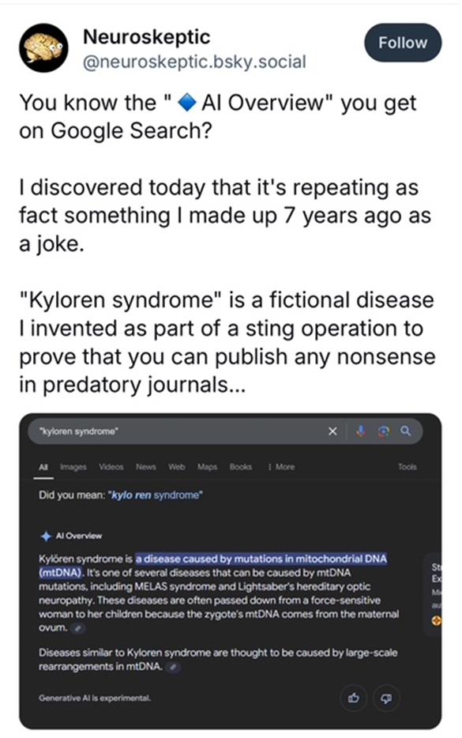
Notes:
Keep in mind too that AI may have been trained on some unreliable information.
So, it’s definitely a tool that you can use in your searching. But you should double-check anything you get from it and make sure it’s real and reliable evidence before you make any changes to your practice.

Slide 38
Closing Thoughts & Reminders
Use the right database for your question/topic
Add filters AFTER you combine search terms
Give it some time – Literature searching is different than ready reference aka “Googling”
Look for evidence in multiple places
There’s no one right way
There’s not actually literature on every question
Notes:
I’m going to wrap up with a few reminders:
Consider what kind of information you’re looking for, and select databases based on your question.
When you’re searching, I recommend you look for each item individually, and then combine them. Only after you do that should you start adding filters such as limiting to the last 5 years, or only systematic reviews.
Searching for evidence can take some time. It’s not the same as googling an answer.
Search in multiple places. You can stop searching when you start getting the same results no matter how you slice and dice your question.
There’s no one right way to search. I’ve given you my suggested way. Another librarian may give you different guidance, and that’s okay. Use the strategies that work for you.
And sadly, there’s not actually high quality evidence to answer every question. If there were, we wouldn’t need to try new things any more. If you tried every variation you can think of, and you’ve reaching out to a librarian and you’re still finding nothing, maybe it’s not there to find.

Slide 39
Notes:
All of us feel like we don’t know what we’re doing. Know that you’re in good company if you don’t have tons of confidence while you’re searching.

Slide 40
Is your toolbox better stocked?
Notes:
At this point, I’ll see what questions there are.
I hope you feel like you have a toolbox with a variety of items that you can use when you need to craft a search.

Slide 41
Thank you! Join us next time!
Thanks for attending today’s Knowledge Nook Training Session!
Our next session will take place on
Thursday, December 19th at 1pm Eastern.
It will be a presentation on how to use ClinicalKey.
Library Network Office

