Slide 1
Update on VA Health Professions Trainee Background Checks and Security Vetting
Presenter: Dr. Edward Walton, Office of Academic Affiliations
Audience: Academic Affiliate Organizations
Date: xx

Slide 2
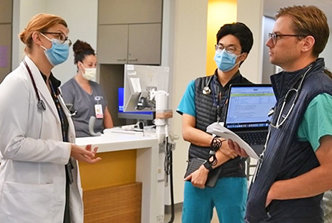
VA Goals for Health Professions Trainee (HPT) Onboarding
Day One Readiness
Every Health Professions Trainee
Fully onboarded
Trained and provisioned
Ready to care for Veterans on day one of their VA experience
Integrated Onboarding Process
Streamlined onboarding for HPTs
Process is being augmented for security purposes
Continuous improvements to ensure ease/efficiency
Future enhancements to integrate systems

Slide 3
VA’s Commitment
To protect the security of Veterans, visitors, employees, and any other person in the VA system. By upholding our core values, we emphasize the importance of support and the intrinsic value of every person we serve.
Federal information security best practices and compliance with legal requirements mandated by the Federal Information Systems Modernization Act (FISMA). VA is proud to be in step with these important guidelines.
Alignment with government-wide standards to reduce risks to VA’s systems, facilities, and stakeholders, including Veterans, employees, health professions trainees, volunteers, visitors, and contractors.
For those transitioning to full-time roles, the streamlined process will facilitate a smoother transition from trainee to staff and between different sites or agencies, fostering increased confidence and trust in VA.
Why are there changes to security vetting?

Slide 4
Changes in Requirements for Screening HPTs
Previous Requirements | Changes to Requirements
Special Agreement Check (SAC) Majority of Health Professions Trainees were exempt from a Tier 1 and therefore in this category Fingerprint check, FBI database check, no special form needed Approximately 48 hours turnaround time Trainees were issued a PIV-I card for three years | US Citizens and lawful permanent residents in the country for > 3 years Tier 1 Background Check 3-year PIV card
Tier 1 Background Check Very limited number of HPTs (>180 aggregate days or >1 year of continuous service), i.e. medical students on longitudinal integrated clerkships of over 6 months duration, VA-based chief residents SAC plus FBI investigation (interviews, etc.), requires trainees to fill out a form to list their relatives, residences, etc. (estimated time 2 hours) Highly variable, weeks to months, must be completed within the first year of service Trainees were issued a PIV card for three years | Non-US Citizens Foreign National Federal Records Check PIV-I card with six-month certificates

Slide 5
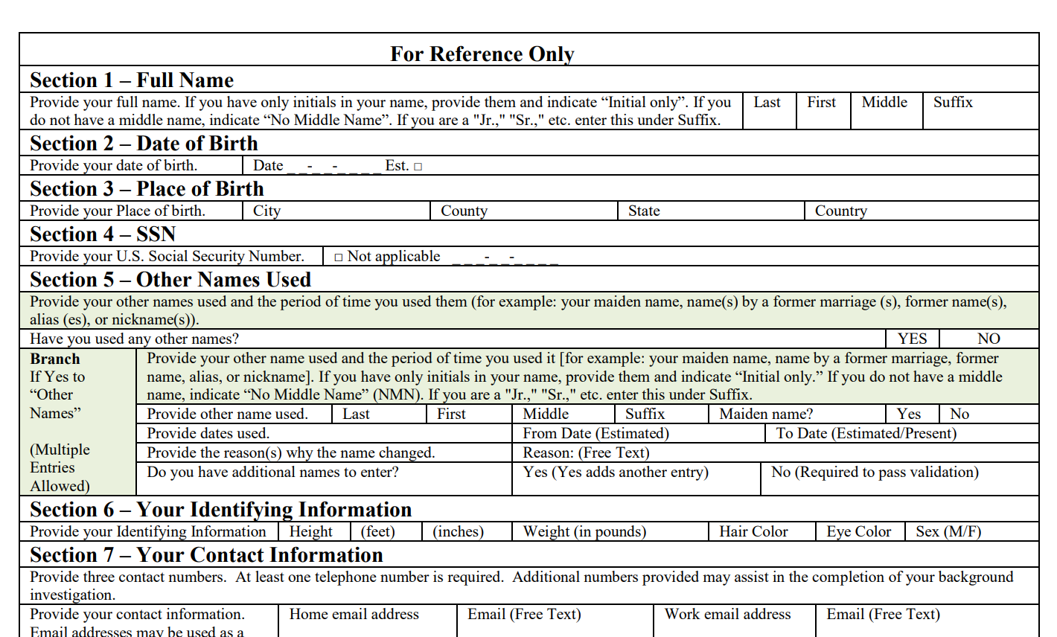
US Citizen Security Vetting
Tier-1 Background Check
Requires fingerprints and Special Agreement Check
Online SF-85 Questionnaire for Non-Sensitive Positions
Sent by electronic invitation
Record of Arrest and Prosecution Back (RAP BACK)
Component of Trusted Workforce 2.0
Continuous FBI database check

Slide 6
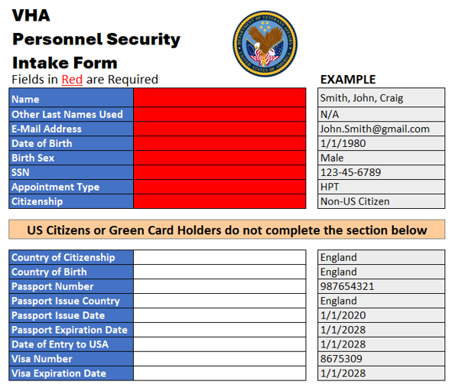
Non-US Citizen Security Vetting
Foreign National Federal Records Check
Managed by VA Counterintelligence
Personally identifiable information
Passport information
Visa information
SAC check and fingerprints can be scheduled
Note: The Intake Form will be used until updates are made that allow submission electronically through the existing Account Provisioning/Deprovisioning System.

Slide 7
Non-US Citizen Security Vetting
Required Data

Slide 8
Security Vetting Updates
A project team is working to implement all enhanced security vetting updates across VA. Phases 1, 2, and 3 will have an impact on HPT onboarding.
1
All Education Personnel Security Offices are being trained in processing Non-US Citizen checks
2
All new Non-US Citizens will be processed through the Federal Name Check while onboarding
Previously onboarded Non-US Citizens will be processed through the Federal Name Check
3
All Education and Personnel Security Offices will be trained in processing Tier 1 Background Investigations for HPTs
Requirements for Tier 1 Background Investigations will be Implemented for new and onboard HPTs

Slide 9
Project Timeline
Key:
Training / Implementation
Sustainment
*Initiate within 5 days of labor notification completion
¹Staff – includes employees, HPTs, Volunteers, and Contractors
 | OCT 2024 | NOV 2024 | DEC 2024 | JAN 2025 | FEB 2025 | MAR 2025 | APR 2025 | MAY 2025 | JUN 2025 | JUL 2025 | AUG 2025 | SEP 2025
Phase 1 New Non-US Citizen Vetting
Phase 2 New Non-US Citizen (New and Onboard Staff)
Phase 3 Without Compensation HPTs appointed >180 days
Phase 4 Volunteers appointed > 180 days
Training
All VHA Sites Conduct Non-US Citizen Vetting for New Staff¹
Labor Notification
Tasker: Onboard Staff -Data Available*​
Tasker: Onboard Staff Requiring Data Collection
Training for New
All VHA Sites Conduct Tier 1 BI as Required​
Tasker for Onboard HPTs Requiring Tier 1 BI
Training for New
All VHA Sites Conduct Tier 1 BI as Required​
Tasker for Onboard Volunteers Requiring
Tier 1 BI

Slide 10
Questions

Slide 11
Previous Requirements for Screening HPTs
Special Agreement Check (SAC)
Tier 1 Background Check
Majority of Health Professions Trainees were exempt from a Tier 1 and therefore in this category
Fingerprint check, FBI database check, no special form needed
Approximately 48 hours turnaround time
Trainees were issued a PIV-I card for three years
Very limited number of HPTs (>180 aggregate days or >1 year of continuous service), i.e. medical students on longitudinal integrated clerkships of over 6 months duration, VA-based chief residents
SAC plus FBI investigation (interviews, etc.), requires trainees to fill out a form to list their relatives, residences, etc. (estimated time 2 hours)
Highly variable, weeks to months, must be completed within the first year of service
Trainees were issued a PIV card for three years

Slide 12
New Requirements for Screening HPTs
US Citizens and lawful permanent residents in the country for > 3 years
Tier 1 Background Check
3-year PIV card
Non-US Citizens
Foreign National Federal Records Check
PIV-I card with six-month certificates

