Slide 1
Electronic Subcontracting Reporting System (eSRS):
Overview & Summary Subcontract Report (SSR) Guide
Presented by: Lydia McKay, Procurement & Resources Specialist
Contracting Support Division (CSD), VA FSS
September 10, 2024

Slide 2
Housekeeping
This session is being recorded and will be made available on our Subcontracting and Training web pages.
This PowerPoint (and one on the ISR) will be included in our upcoming reminder notices.
Type your questions in the chat​.
If you have question(s) that are not submitted/addressed during this session, please send to SubcontractingVAFSS@va.gov.

Slide 3
Agenda
eSRS Overview
Summary Subcontract Report (SSR) Step-by-Step
Review Process
Technical Tips & Common Issues
Resources & eSRS Help Contacts

Slide 4
eSRS Overview
eSRS Overview

Slide 5
eSRS
WHAT?
Electronic Subcontracting Reporting System (eSRS) is a web-based system that streamlines the process of reporting on subcontracting plan achievements (reporting actual spend data).
WHO?
All contractors that are required to maintain a small business subcontracting plan must report their achievements in eSRS.
WHY?
Report provides insight/transparency on how contracting dollars are being distributed among all small business concerns
Assists Contract Officers with reviewing subcontracting plan compliance and level of good faith effort
SBA reports annual subcontract achievement data to the President and Congress

Slide 6
Types of Reports
SSR: Summary Subcontracting Report
Required by all plan holders.
ISR: Individual Subcontracting Report
Additional report only filed by individual plan holders.

Slide 7
Submission Timeframe
WHEN?
The report is submitted annually, within thirty days after the end of the Government's fiscal year. FAR 52.219-9(l)(2)(ii)(B)
Report Type | Reporting Period | Due Date
SSR | October 1 – September 30 | October 30th (extended to 11/14/24)
ISR | Plan Start – March 31 & Plan Start – September 30 | April 30th & October 30th (extended to 11/14/24)
Notes:
The SBA granted a 15-day extension; so, reports are due no later than Nov 14th this year.
*ISR should NEVER by completed by commercial planholders.

Slide 8
eSRS.gov Login
  https://www.esrs.gov/
  All eSRS users must have a login.gov account
  Create an account at login.gov with the following:
    Single email address
    Secure password with no common words or phrases
    Additional authentication method
  Site navigation guides are found on the eSRS home page
Notes:
If you have a Login.gov account, use your existing eSRS email address to connect to your profile

Slide 9
SSR
Summary Subcontract Report (SSR)
Step-by-Step
Note: In this presentation the numbering sequence for the questions may differ when submitting an SSR for commercial plans vs. an SSR for individual plans.

Slide 10

Plan Type
Select “Commercial” for a company-wide or division-wide commercial plan and “Individual” for individual plan types
If unsure of your plan type, do not proceed any further and contact the agency that approved your plan
Notes:
The type of plan chosen determines which questions will populate in the SSR; therefore, it is important that the correct type of plan is selected

Slide 11
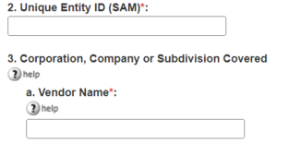
UEI and #3 - Company Info
UEI: Enter the UEI number associated with the plan
  Important: UEI must be that of the planholder, not an associated contract or subsidiary/affiliate
Company Info: You have the option to choose to auto-fill from the UEI or manually complete
Notes:
UEI’s for eSRS reports became mandatory on 4/4/22. They are the official government-wide identifier used for federal awards (formerly the DUNS number was used).

Slide 12

Date Submitted
Enter the date that you submit the report, not create as a draft
Update this field if you revise and resubmit your report

Slide 13
Contact Information
List the name and contact information for the individual we should contact if we have any questions about the report
It is important that you list the individual who has access to eSRS and can make any necessary corrections to the report

Slide 14
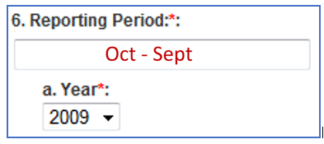
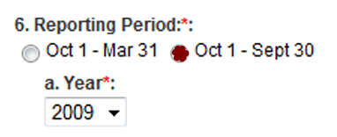
Reporting Period
Reporting Period: This will always be Oct 1st - Sep 30th (the Government’s fiscal year), regardless of your plan effective dates – FAR 52.219-9(l)(2)
Year: This reflects the Government’s fiscal year (FY 2024 refers to October 1, 2023 – September 30, 2024)
Commercial Plans Individual Plans

Slide 15

Report Submitted As
Always submit as the “prime contractor” because you are prime on the government contract.
Note: There are certain situations where a prime’s subcontractors must file eSRS reports; however, per the exception in 52.219-9(j), this is never required when the prime’s government contract contains clause 52.212-5, as with all FSS & NCS contracts.
Notes:
52.219-9(j): Subcontracting plans are not required from subcontractors when the prime contract contains the clause at FAR 52.212-5, Contract Terms and Conditions Required to Implement Statutes or Executive Orders-Commercial Products and Commercial Services, or when the subcontractor provides a commercial product or commercial service subject to the clause at FAR 52.244-6, Subcontracts for Commercial Products and Commercial Services, under a prime contract.

Slide 16
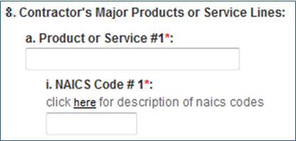
Major Products and NAICS
Major Products/Service Lines: Enter a general description of your major product or service line(s), e.g., pharmaceuticals, surgical instruments, etc.
NAICS Code(s): List the six-digit associated NAICS code(s)
Notes:
Do not list FSS SINs or product names/numbers
Can list up to two product/service and NAICS Codes
Make sure to double check your NAICS code as we frequently see incorrect codes (Google NAICS, and you will find the Census.gov website)

Slide 17
What spend should be reported?
Spend Period: Regardless of the plan effective period, the actual dollar achievements must be entered for spend that occurred Oct 1st - Sep 30th
(the government’s fiscal year) - FAR 52.219-9(l)(2)
Spend Tiers: Only immediate next-tier spend can be included - FAR 52.219-9(l)
Direct & Indirect Costs
  Commercial Plans: Include all direct and indirect spend – FAR 52.219-9(g) and 52.219-9(l)(2)(ii)(A)
  Individual Plans: Include all direct spend; include indirect spend on a pro-rated basis - 52.219-9(l)(2)(i)(A)
Exclusions: Categories listed on next slide - 52.219-9(g)
Notes:
Spend Period: Don’t file prior to 10/1 as the period you are reporting spend against hasn’t ended yet. Any reports filed early will be rejected.
Spend Tiers: Credit cannot be taken for awards made to lower tier subcontractors
Indirect costs: i.e. G&A, overhead, etc.

Slide 18
Excluded Spend Categories
Intercompany/affiliate spend - FAR 52.219-9(l)
Spend outside of the US or its outlying areas - FAR 52.219-9(l)
Employee salaries and benefits; payments for petty cash; depreciation; interest; income taxes; property taxes; lease payments; bank fees; fines, claims, and dues; original equipment manufacturer relationships during warranty periods (negotiated up front with the product); utilities and other services purchased from a municipality or an entity solely authorized by the municipality to provide those services in a particular geographical region; and philanthropic contributions - FAR 52.219-9(g)

Slide 19
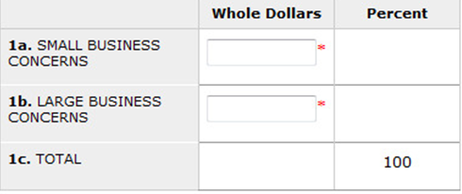
Cumulative Fiscal Year Spend
Small Business (SB) Concerns: Include total SB spend, regardless of socio-economic category
Large Business (LB) Concerns: Also known as “other-than-small” business spend
The report will auto calculate the total dollars and percentages
Notes:
Remember when reporting overall SB spend that you should not add up the subcategories to arrive at this figure since SB spend can count in as many categories as it fits (e.g. $50K spent with a WOSB, VOSB counts in 3 places). This is meant to capture SB vs. LB spend, with the two adding up to all of your company spend.

Slide 20
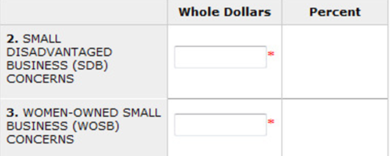
Subcategory Spend
  These are small business subcategories
  All small business (SB) subcontracting dollars count once under the SB category and can count multiple times under any subcategories (#2-#8) for which the business qualifies
Notes:
2 – SDB
3 – WOSB Concerns
4 – Historically Black Colleges and Universities (HBCU) & Minority Institutions (MI) – only NASA per FAR 52.219-9(d)(1)(iv)
5 – HUBZone SB Concerns
6 – VO SB Concerns
7 – SDVO SB Concerns
8 – Alaskan Native Corporations (ANCs) & Indian Tribes that have not been certified by the SBA as SDBs (certified SDBs are reported in #2 SDBs)
9 – ANCs & Indian Tribes that are not SBs – SBs get reported in #1a with SBs
8 & 9: Must be reported even though there are no goals established; note that ANCs & Indian Tribes that are certified by the SBA as SDBs will be reported in the SDB category and ANCs & Indian Tribes that are SBs will be reported under the SB category
52.219-9(d)(10)(iv): “The reports shall provide information on subcontract awards to small business concerns (including ANCs and Indian tribes that are not small businesses), veteran-owned small business concerns, service-disabled veteran-owned small business concerns, HUBZone small business concerns, small disadvantaged business concerns (including ANCs and Indian tribes that have not been certified by the Small Business Administration as small disadvantaged businesses)”

Slide 21
Proof of Business Size
Self-Certification: You are required to keep on file proof of self-certification from each small business type whose dollars you include as spend, either as a statement from the contractor or other proof of business size (Sam.gov, etc.) –
see also FAR 52.219-9(c)(2)
Exceptions to Self-Certification
  HUBZone: HUBZone small business concerns must be certified by SBA; validate at https://dsbs.sba.gov/search/dsp_dsbs.cfm
  VOSB & SDVOSB: Currently is self-certification except for contracts that contain VAAR clause 852.219-70; see next slide for details
Notes:
Contractor’s may be asked to produce self-certifications during a subcontracting compliance audit conducted by the SBA , VA representative or any of your federal customers.
DSBS – Dynamic Small Business Search – now includes SBA certifications for 8(a), 8(a) Joint Ventures, WOSB, EDWOSB, VOSB, & SDVOSB
FAR 52.219-9(c)(2)(i)
(2) (i) The Contractor may accept a subcontractor's written representations of its size and socioeconomic status as a small business, small disadvantaged business, veteran-owned small business, service-disabled veteran-owned small business, or a women-owned small business if the subcontractor represents that the size and socioeconomic status representations with its offer are current, accurate, and complete as of the date of the offer for the subcontract.
(ii) The Contractor may accept a subcontractor's representations of its size and socioeconomic status as a small business, small disadvantaged business, veteran-owned small business, service-disabled veteran-owned small business, or a women-owned small business in the System for Award Management (SAM) if–
(A) The subcontractor is registered in SAM; and
(B) The subcontractor represents that the size and socioeconomic status representations made in SAM are current, accurate and complete as of the date of the offer for the subcontract.

Slide 22
VOSB and SDVOSB Certification
VAAR 852.219-70
VA Small Business Subcontracting Plan Minimum Requirements (Nov 2022)
Note: If the only VA contract you have is a VA FSS contract, then clause 852.219-70 (formerly 852.219-9) is not in your contract and the below does not apply and self-certification is acceptable
To be credited toward goal achievements, SDVOSB/VOSBs must be verified as eligible in the VA's Vendor Information Pages (VIP) database at https://www.vetbiz.va.gov/vip/ (now certified by the SBA at https://dsbs.sba.gov/search/dsp_dsbs.cfm)
Annually submit to VA OSDBU (Office of Small and Disadvantaged Business Utilization) a list of all VOSB/SDVOSB spend reported in eSRS (VA Form 0896A)

Slide 23
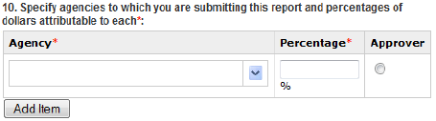

Agency Designations
Select all federal government agencies with which you have contracts covered by your subcontracting plan, including the Dept. of Veterans Affairs (3600)
Use “Add Item” to enter more than one agency
If an agency is not selected, then its representatives cannot see the report
Note: Federal Supply Service (4730) is NOT the VA FSS. It is a code used by GSA.
Commercial Plans
Individual Plans
Notes:
These next few slides are very important.
It isn’t just that we can’t click on the report and view it, we cannot even see it has been submitted if the 3600 code is not selected, which will cause us to continue to send you delinquency notices and consider the lack of filing as a past performance issue with your contract.

Slide 24
Agency Percentages
Only applicable for commercial plans
Enter the percentage of spend that can be "attributed to” each agency’s contract
Many Contractors choose to look at their Government vs. Commercial sales allocation to arrive at this percentage
The percentages allocated should not add up to 100% as this would indicate that all reported spend supports Government contracts with no spend supporting commercial business
Notes:
Similarly, a very high percentage attributed would also be a red flag to us.

Slide 25
Agency Approver
Only applicable for commercial plans
Choose the agency who will be the actual approver of the report.
The agency approver is the agency who approved your subcontracting plan for the period for which you are filing. – FAR 52.219-9(l)(2)(i)(F) & FAR 52.219-9(l)(2)(ii)(D)
Notes:
If you only have contracts with the VA (3600), then you must select the VA as the approver.
52.219-9(l)(2)(i)(F) – Individual Plans: The authority to acknowledge or reject SSRs in eSRS, including SSRs submitted by subcontractors with subcontracting plans, resides with the Government agency awarding the prime contracts unless stated otherwise in the contract.
52.219-9(l)(2)(ii)(D) – Commercial Plans: The authority to acknowledge or reject SSRs for commercial plans resides with the Contracting Officer who approved the commercial plan.
There have been ongoing issues of the wrong agency approving plans. So be sure when you are submitting your next proposed plan that the reviewer/approver is the agency/office with the latest expiration date (this does not include options not exercised). Due to options being exercised and short-term/temporary contract extensions, the expiration date of a contract can change, causing the approving agency/office to change as well.

Slide 26
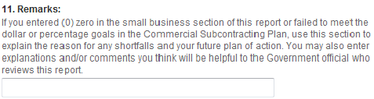
Remarks
Remarks/explanations & plan of action are required for each category …
If any actual percentage achievement falls short of your percentage goals
If you report a zero-dollar achievement
  Important: Be sure that remarks are category specific and address failure to meet approved percentage goals; do not reiterate your plan justification for low goals
Provide any other justifications and/or anomalies in your report …
You are reporting a partial period (i.e., your first subcontracting plan began after the start of an eSRS reporting cycle)
Your plan period (your FY) is different than the eSRS reporting period (gov’t FY), and that discrepancy has impacted your achievements
Notes:
Remarks should not be your initial plan justification for proposing low percentage goals (lower than the minimum suggested goals). It should be the reason why you failed to meet those lower, approved percentage goals.

Slide 27
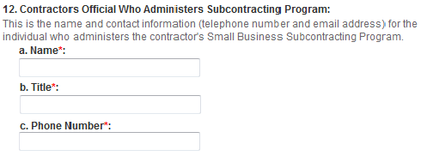
Subcontracting Program Administrator
This should match the Subcontracting Program Administrator listed on your approved plan as the “Plan Administrator”, unless you have updated this point of contact (POC) since that time.
Note: You would have already listed your eSRS point of contact in #5 Contact Information, which may differ from this contact.
Notes:
We recognize that some companies may have different individuals handling the subcontracting plan and the eSRS reports.
This entry is for your Subcontracting Program Administrator, which should be the Plan Administrator listed on you approved subK plan, unless you have updated this POC since that time.

Slide 28

Report Certification
The report must be certified.
If “Yes” is not selected, the report will be rejected.
Notes:
Selecting yes indicates that the data submitted is accurate.

Slide 29
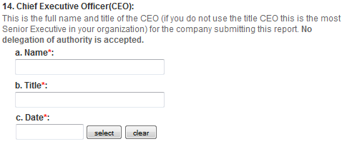
CEO Information
Enter the name and title of the CEO approving the report along with the approval date.

Slide 30

CEO Approval
The CEO’s approval is required before to submitting the report
Keep a signed copy of the approved SSR; this may be requested during a subcontracting compliance audit
It is not necessary for the Contractor to send a pdf of the signed copy to the approving VA Contracting Officer
Notes:
Note that #15 says that the CEO will sign a paper copy of the report and keep it on file. So, after the report is reviewed by the gov’t and any revisions are made, and then the report is accepted as final, then the CEO would print out, sign, and maintain that copy on file.

Slide 31
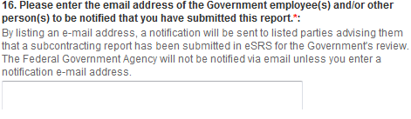
Notification
Enter the e-mail address of all Government personnel who will be reviewing their report so that they will receive an e-mail notification of the submission
If multiple agencies need to review the report, then you must list at least one e-mail contact for each agency
  VA FSS Subcontracting Plans: SubcontractingVAFSS@va.gov
  VA NCS Subcontracting Plans: NACSUBK@va.gov
  Other Agency eSRS Reviewer(s)
Notes:
Other eSRS Reviewer(s): Assigned Contracting Officer/Specialist; Subcontracting Plan approver

Slide 32
Review Process Flow
Review Process

Slide 33
Review Process
Create & Submit a Report in eSRS
Automated e-mail is sent to all listed reviewers
The approving agency rejects/accepts your report
Automated e-mail is sent notifying report submitter of status
Rejected:
Edit and resubmit your report
Approved:
Print a final copy for CEO signature to keep on file

Slide 34
Technical Tips
Technical Tips & Common Issues

Slide 35
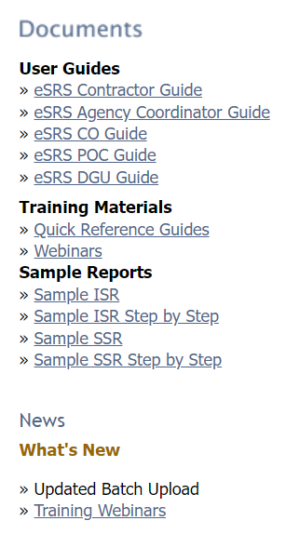
eSRS.gov Resources
eSRS.gov provides resources on the right-hand side of the web page at eSRS.gov prior to logging in to the site.
This includes technical user guides which help you navigate the site, training materials, sample reports, and training webinars
Notes:
Punch out to eSRS.gov to demo

Slide 36
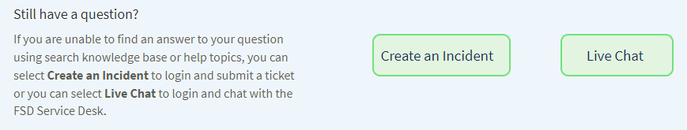
FAQs
FAQs at FSD.gov
The Federal Service Desk (FSD) provides a host of FAQs on various systems, including Login.gov and eSRS.
Help Topics (FAQs) are listed on the left-hand side of this web page. Click “Show More” to scroll down to the FAQs for eSRS.
If you can’t find an answer here or in the eSRS.gov guides, you can “Create an Incident” or start a “Live Chat”.
Notes:
Punch out to FSD.gov to demo

Slide 37
Account Setup
Trouble establishing Login.gov account
The most common issue with account set up is that the user is not authenticated
Users are authenticated when they receive an email indicating successful account set up
If e-mail is not received, or you encounter other account setup/login issues, view the FAQs www.fsd.gov or contact the Federal Service Desk (FSD) at 866-606-8220

Slide 38
Setting up New Account User
How does a new user file new reports and view existing/previous reports in eSRS?
Have the new user register in eSRS/Login.gov.
“Create an Incident” with the FSD helpdesk at FSD.gov; include the name and e-mail address of the new user and the former user, and request to have the historical data migrated to the new user’s account.
Example: Angela Johnson angela@abc.com is the new eSRS representative for ABC corporation. Pam Jones pjones@abc.com will no longer have the responsibility of filing reports in eSRS for ABC Corporation. Therefore, please migrate the historical data for ABC Corporation from Pam Jones’ eSRS account to Angela Terry’s account.

Slide 39
Duplicate Report Error
What if I get an error stating that a report has already been filed for a particular reporting period under my UEI number?
First, check your account under the report type, and select the tab that says “ALL”, which will allow you to view all reports of that type in draft, pending, accepted, and rejected status. You may find that have already submitted a report for that period or that it is in draft status.
It is possible that someone else in your company, or your predecessor, filed a report for that period. If prior user account reports have not been migrated to your account, you will not see the prior reports (as advised in the prior slide).

Slide 40
Agency Accessibility Issue
What if my reviewing Contracting Officer/Specialist can’t view my report in eSRS?
Check your account to make sure that the report is not in draft (DRT) status. You must submit the report for it to be viewed.
Check to see if you included the Contract Specialist’s agency code in #10 in the SSR.
Remember that the Department of Veterans Affairs’ code, including FSS and NCS, is 3600 (see next slide).

Slide 41
Agency Code Issue
What if I neglected to include the VA’s agency code (3600) in the SSR?
This will prohibit the VA from being able to see that you have submitted a report, even if you included a VA e-mail address in the notification section.
You will need to contact a representative from the agency you designated as the approver to request that they reject the report, after which you can add the VA code (3600) and percentage attributed.
If you don’t know who to contact at the designated approving agency, call the FSD help desk or “Create and Incident” at FSD.gov to have them reject the report.

Slide 42
2nd NAICS Issue
What if my SSR is requiring me to submit a 2nd NAICS code when I only have one?
You must completely skip this field or else you will receive this error
After you delete/remove the second NAICS code, it will allow you to proceed

Slide 43
Report Rejection
Top Reasons why an eSRS report is Rejected
Remarks Missing: Needed justification/explanation missing for
  $0 Reported
  Percentage Goals not Met
Spend Percentage Attributed to Agency too High: Entering 100% for a single agency or a combination of agencies would mean that the those listed are your only customers and that you have no commercial customers.
SDVO spend listed is higher than VO spend: Remember, SDVO is a subcategory of VO.
CEO did not Self-Certify Report: The report must indicate “Yes” for CEO approval, otherwise the report will be rejected.

Slide 44
Resources
Resources

Slide 45
Resources
VA FSS Subcontracting Program e-Mail: SubcontractingVAFSS@va.gov
NCS Subcontracting Program e-Mail: NACSUBK@va.gov
VA FSS Subcontracting Web Page: https://www.va.gov/opal/nac/fss/sbsp.asp
  Suggested minimum percentage goals
  Training/guides (eSRS & Plan Preparation)
  Subcontracting Plan template
VA FSS Training Web Page: https://www.va.gov/opal/nac/fss/training.asp
  Upcoming webinars
  Current and archived presentations
eSRS Home Page: https://www.esrs.gov
  Log-in
  User guides, Training materials, sample reports, and training webinars
eSRS Helpdesk: Federal Service Desk (FSD), https://www.fsd.gov, 866-606-8220
Includes FAQs
Provides ability to “Create and Incident” or start a “Live Chat”

Slide 46
Questions
Questions?

