Slide 1
Electronic Subcontracting Reporting System (eSRS):
Individual Subcontract Report (ISR) Guide
Presented by: Lydia McKay, Procurement & Resources Specialist
Contracting Support Division (CSD), VA FSS
September 24, 2024

Slide 2
Housekeeping
This session is being recorded and will be made available on our Subcontracting and Training web pages.
Type your questions in the chat​.
If you have question(s) that are not submitted/addressed during this session, please send to SubcontractingVAFSS@va.gov.

Slide 3
Agenda
Individual Subcontract Report (ISR) Due Dates & Step-by-Step
Review Process
Technical Tips & Common Issues
Resources & eSRS Help Contacts

Slide 4
SSR
Individual Subcontract Report (ISR)

Slide 5
Submission Timeframe
Semi-Annual: The report shall be submitted semi-annually during contract performance for the periods ending March 31 and September 30.
Contract Closeout: A report is also required for each contract within 30 days of contract completion.
^{FAR 52.219-9(l)(1)(i)}
Report Type | Reporting Period | Due Date
SSR | October 1 – September 30 | October 30th (extended to 11/14/24)
ISR | Plan Start – March 31 & Plan Start – September 30 (aka Year-End ISR) | April 30th & October 30th (extended to 11/14/24)
Notes:
The SBA granted a 15-day extension; so, reports are due no later than Nov 14th this year.
52.219-9(l)(1)(i): The report shall be submitted semi-annually during contract performance for the periods ending March 31 and September 30. A report is also required for each contract within 30 days of contract completion. Reports are due 30 days after the close of each reporting period, unless otherwise directed by the Contracting Officer. Reports are required when due, regardless of whether there has been any subcontracting activity since the inception of the contract or the previous reporting period. When the Contracting Officer rejects an ISR, the Contractor shall submit a corrected report within 30 days of receiving the notice of ISR rejection.

Slide 6
eSRS.gov Login
  https://www.esrs.gov/
  All eSRS users must have a login.gov account
  Create an account at login.gov with the following:
    Single email address
    Secure password with no common words or phrases
    Additional authentication method
  Site navigation guides are found on the eSRS home page

Slide 7
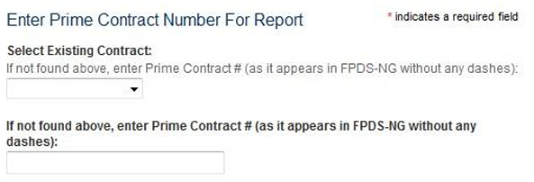
Prime Contract Number
Select the VA contract number for which you will be filling the report.
If your contract number does not appear in the drop-down box, don’t proceed any further. Email me at SubcontractingVAFSS@va.gov so that I can look into the issue.
Notes:
Your contract number should feed automatically from FPDS, but if certain data points weren’t completed correctly in FPDS at contract award, then the contract number might not feed to eSRS.

Slide 8
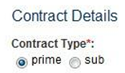
Contract Details
Always select prime as your company was awarded the contract by the Federal Government (i.e., you are not a subcontractor on the contract).

Slide 9
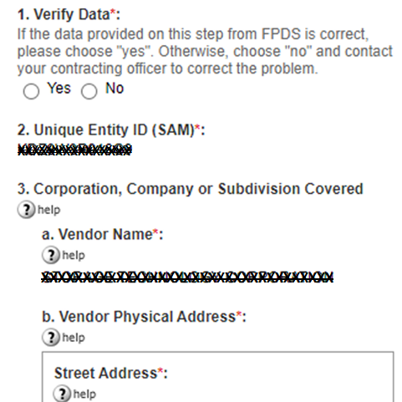
Contract Details – Cont’d
Verify that the UEI in #2 and associated name and address in #3 are correct. These pre-fill after your contract number is chosen in the prior menu.
If there is an issue with the data, do not choose “no” and submit. Please eMail me at SubcontractingVAFSS@va.gov so that I can look into the issue.

Slide 10
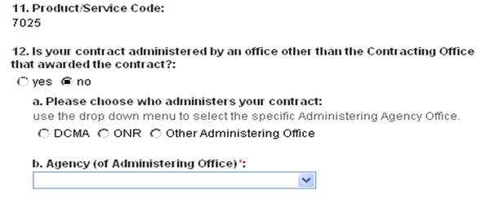
Contract Administration Office
#11 - Product/Service Code (PSC) – Auto-fills from contract award data
#12 - For VA FSS contracts, your contract is always administered by the Contract Office which awarded your contract; therefore, the answer to the question below will always be “no”.

Slide 11
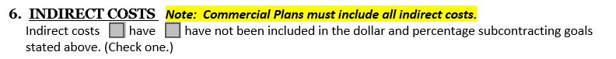
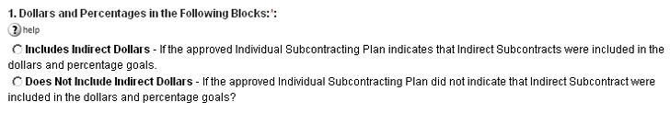
Indirect Spend
Consult # 6 on your approved Small Business Subcontracting Plan.
Prior to completing the goals and cumulative achievements table, you will be asked if your plan goals included indirect spend.

Slide 12
Indirect Spend: ISR vs. SSR
ISR: Include pro-rated indirect spend only if it was included in your approved plan goals (see #6 in plan). 52.219-9(l)(1)(iii)
SSR: For the SSR, you must include pro-rated indirect spend even if it was not included in your plan goals. 52.219-9(l)(2)(i)(A)
IMPORTANT: If you did include indirect costs in your plan goals, then your SSR would match the difference between the prior year and current year Sep 30 ISRs. If you did not include those costs in your plan goals, then your SSR would reflect a higher annual spend.
Notes:
For the ISR, 52.219-9(l)(1)(iii):
When a subcontracting plan includes indirect costs in the goals, these costs must be included in this report.”
SSR for Individual Planholders 52.219-9(l)(2)(i)(A):
“This report encompasses all subcontracting under prime contracts and subcontracts with an executive agency, regardless of the dollar value of the subcontracts. This report also includes indirect costs on a prorated basis when the indirect costs are excluded from the subcontracting goals.”

Slide 13
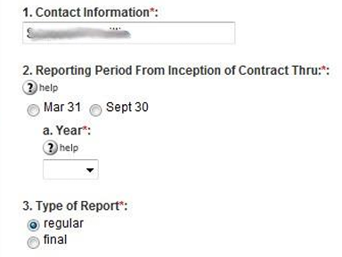
Reporting Period & Type
List the name and contact info for the individual we should contact if we have questions about the report.
Choose the appropriate semi-annual report and year. This year would be 2024, the government’s FY.
This will always be “regular” unless it is your final contract closeout report after contract expiration.

Slide 14
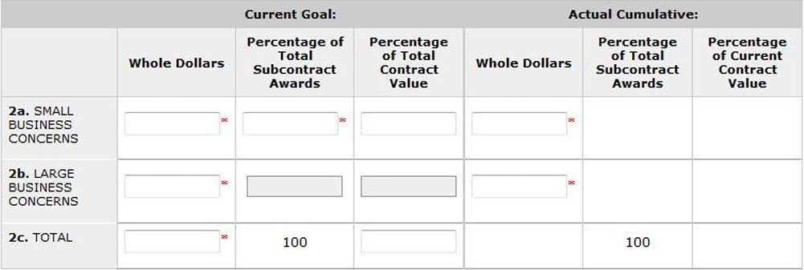
Goals & Achievements
The table below will ask for your current goals as well as your actual cumulative achievements from the time the contract was awarded.

Slide 15
Current Goals
Make sure that the goals you input match those approved under your current individual plan. The next slide will explain how to handle goals including option years.
Notes:
You’ll have to consult your approved plan for this.

Slide 16
Current Goals / Option Goals
5-Year Base Period: During the first 5 years of your contract (i.e. the base period), you will enter the 5-year base goals from your plan.
During Option Period(s): Once you are in an option period, you will combine the total spend and the dollar goals from the base and option period(s). This may require you to manually calculate the percentages of subcontract awards (dividing each category by total spend in 2c) as the percentages listed on your plan are specific to a 5-year period.

Slide 17
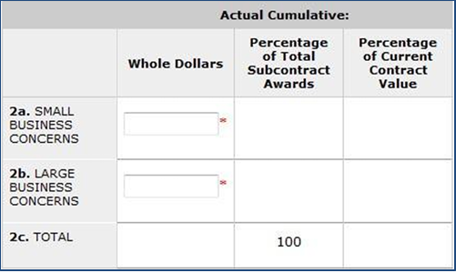
Actual Cumulative Achievements
The actual achievements you enter for all categories are a running total of your achievements since the start of your contract/plan. In other words, your dollar achievements for each 6-month period will be added to the prior report’s Actual Cumulative.
Notes:
Actual cumulative is a running total to include spend from the start of your contract through the end of the reporting period. Therefore, when we see this number go down in consecutive reports, rather than go up, we know something is wrong.

Slide 18
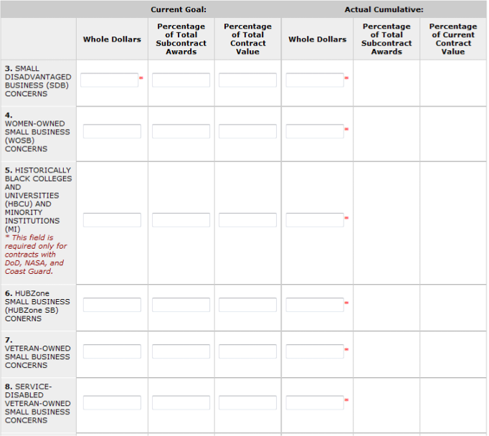
Subcategory Goals & Achievements
The instructions for the subcategories are the same as for your LB/SB goals and achievements.
Be reminded that all SB spend counts once in the SB category and as many times as it fits under each subcategory
Notes:
You are going to approach these the same way you do with the LB/SB goals/actual cumulative dollars.

Slide 19
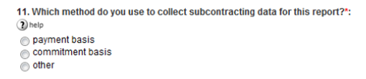
Basis for Spend Data
Whatever method you choose below as the basis for spend data should be the same method you use to report your quarterly sales under your FSS contract.
Notes:
The key here is consistency. If you aren’t sure, speak with your finance/accounting department.

Slide 20
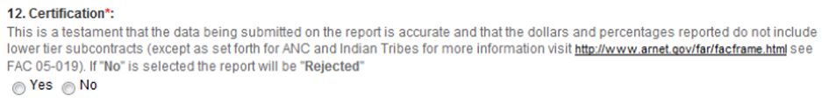
Report Certification
The report must be certified.
If “Yes” is not selected, the report will be rejected.

Slide 21
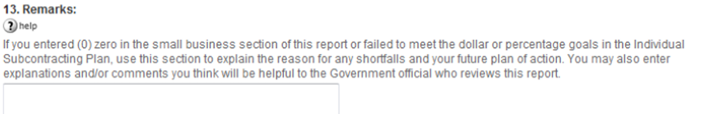
Remarks
Remarks/explanations & plan of action are required for each category …
If any actual percentage achievement falls short of your percentage goals
If you report a zero-dollar achievement
  Important: Be sure that remarks are category specific and address failure to meet approved percentage goals; do not reiterate your plan justification for low goals

Slide 22
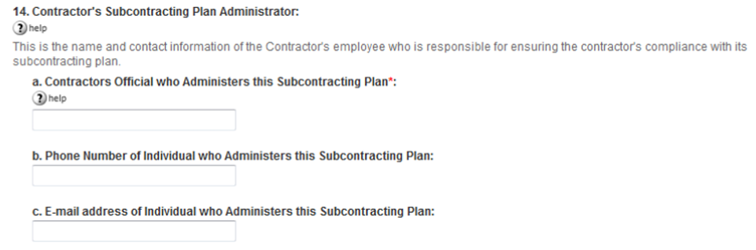
Subcontracting Program Administrator
This should match the Subcontracting Program Administrator listed on your approved plan in #7 as the “Plan Administrator”, unless you have updated this point of contact (POC) since that time.
Note: You would have already listed your eSRS point of contact earlier in the report under “Contact Information”, which may differ from this point of contact.

Slide 23
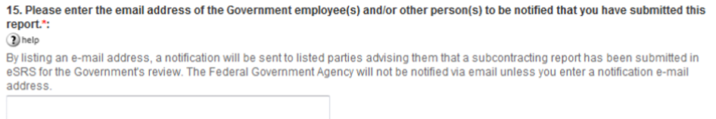
Notification
Enter the e-mail address of all Government personnel who will be reviewing their report so that they will receive an e-mail notification of the submission
For VA FSS, you must include SubcontractingVAFSS@va.gov
Also include your assigned Contract Specialist’s e-mail.

Slide 24
Review Process Flow
Review Process

Slide 25
Review Process
Create & Submit a Report in eSRS
Automated e-mail is sent to all listed reviewers
The approving agency rejects/accepts your report
Automated e-mail is sent notifying report submitter of status
Rejected: Edit and resubmit your report
Approved: Print a copy for CEO signature & keep on file

Slide 26
Technical Tips
Technical Tips & Common Issues

Slide 27
Report Rejection
Top Reasons why an ISR report is Rejected
Remarks Missing: Needed justification/explanation missing for
  $0 Reported
  Percentage Goals not Met
SDVO spend listed is higher than VO spend: Remember, SDVO is a subcategory of VO.
Annual Spend (two ISR cycles): Spend reported in the annual SSR does not match (if indirect spend is included in plan goals) or exceed (if indirect spend is not included in plan goals) the annual spend added during the last two Year-End ISRs (i.e. Sep 30 reports).
CEO did not Self-Certify Report: The report must indicate “Yes” for CEO approval, otherwise the report will be rejected.

Slide 28
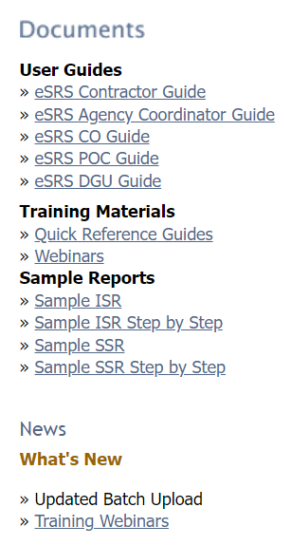
eSRS.gov Resources
eSRS.gov provides resources on the right-hand side of the web page at eSRS.gov prior to logging in to the site.
This includes technical user guides which help you navigate the site, training materials, sample reports, and training webinars.

Slide 29
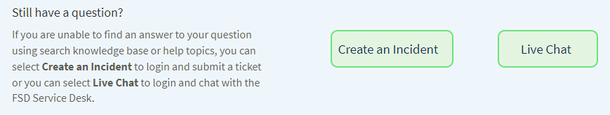
FAQs
FAQs at FSD.gov
The Federal Service Desk (FSD) provides a host of FAQs on various systems, including Login.gov and eSRS.
Help Topics (FAQs) are listed on the left-hand side of this web page. Click “Show More” to scroll down to the FAQs for eSRS.
If you can’t find an answer here or in the eSRS.gov guides, you can “Create an Incident” or start a “Live Chat”.

Slide 30
Account Setup
Trouble establishing Login.gov account
The most common issue with account set up is that the user is not authenticated.
Users are authenticated when they receive an email indicating successful account set up.
If e-mail is not received, or you encounter other account setup/login issues, view the FAQs www.fsd.gov or contact the Federal Service Desk (FSD) at 866-606-8220.

Slide 31
Setting up New Account User
How does a new user file new reports and view existing/previous reports in eSRS?
Have the new user register in eSRS/Login.gov.
“Create an Incident” with the FSD helpdesk at FSD.gov; include the name and e-mail address of the new user and the former user, and request to have the historical data migrated to the new user’s account.
Example: Angela Johnson angela@abc.com is the new eSRS representative for ABC corporation. Pam Jones pjones@abc.com will no longer have the responsibility of filing reports in eSRS for ABC Corporation. Therefore, please migrate the historical data for ABC Corporation from Pam Jones’ eSRS account to Angela Terry’s account.

Slide 32
Duplicate Report Error
What if I get an error stating that a report has already been filed for a particular reporting period under my UEI number?
First, check your account under the report type, and select the tab that says “ALL”, which will allow you to view all reports of that type in draft, pending, accepted, and rejected status. You may find that have already submitted a report for that period or that it is in draft status.
It is possible that someone else in your company, or your predecessor, filed a report for that period. If prior user account reports have not been migrated to your account, you will not see the prior reports (as advised in the prior slide).

Slide 33
Resources
Resources

Slide 34
Resources
VA FSS Subcontracting Program e-Mail: SubcontractingVAFSS@va.gov
NCS Subcontracting Program e-Mail: NACSUBK@va.gov
VA FSS Subcontracting Web Page: https://www.va.gov/opal/nac/fss/sbsp.asp
  Suggested minimum percentage goals
  Training/guides (eSRS & Plan Preparation)
  Subcontracting Plan template
VA FSS Training Web Page: https://www.va.gov/opal/nac/fss/training.asp
  Upcoming webinars
  Current and archived presentations
eSRS Home Page: https://www.esrs.gov
  Log-in
  User guides, Training materials, sample reports, and training webinars
eSRS Helpdesk: Federal Service Desk (FSD), https://www.fsd.gov, 866-606-8220
Includes FAQs
Provides ability to “Create and Incident” or start a “Live Chat”

Slide 35
Questions
Questions?

