Slide 1
Small Business Subcontracting Plan Overview & Preparation Guide for Offerors/Contractors
Presented by: Lydia McKay, Procurement & Resources Specialist
Contracting Support Division (CSD), VA Federal Supply Schedule (FSS)
November 5, 2024
1

Slide 2
Housekeeping
This session is being recorded and will be made available on our Subcontracting and Training web pages.
Type questions in the chat during the presentation.
If you have question(s) that are not submitted/addressed during this session, please send them to FSS.Subcontracting@va.gov.

Slide 3
Agenda
Plan Requirements Overview
Commercial vs. Individual Plans
Plan Elements (Step-by-Step)
Review Process
Checklist for Common Issues/Tips
Resources/Contacts

Slide 4
Overview
Plan Requirements Overview

Slide 5
Plan Requirement
Why am I required to maintain a subcontracting plan?
Per FAR 19.702, plans are required for all contracts
with an estimated value over $750,000 (for the full contract term, including the base and options),
with further subcontracting opportunities, and
when the contract holder is a classified as an “other than small business” concern.

Slide 6
Plan Elements/Template
What are the required components of an acceptable plan?
Elements: FAR clause 52.219-9(d) contains the elements required of an acceptable plan. Our template mirrors verbiage in the FAR and provides help text/instructions.
Template – FSS vs. Other
FSS Template is FAR compliant
Other templates must contain all FAR elements and verbatim assertions
Using other templates will delay review as we must verify FAR compliance
Notes:
We just posted a new version 10/24/24.

Slide 7
Plan Types
Commercial vs. Individual Plans

Slide 8
FAR Preference
52.219-9(g)
“A commercial plan is the preferred type of subcontracting plan for contractors furnishing commercial items. The commercial plan shall relate to the offeror’s planned subcontracting generally, for both commercial and Government business, rather than solely to the Government contract.“

Slide 9
Plan Type Comparisons
 | Commercial Plans (Division & Company-wide) | Individual Plans
 | Submitted annually Goals can be adjusted annually based upon your company’s current climate | Submitted once for the entire performance period with separate goals for base and each option period Tied to goals that may have been over-estimated initially
Plans (goals) | Includes all company spend, including indirect costs All dollars spent count towards goals | Includes only dollars spent in support of one contract and may include indirect costs on a pro-rated basis Must maintain documentation of how each pool of spend is allocated/attributed to supporting the specific VA contract.
 | One signed plan for all government contracts 52.219-9(g) | Must have an individual plan for each government contract May have to maintain multiple plans simultaneously
eSRS Reports | Submit annual SSR | Submit annual SSR to include pro-rated indirect costs (usually due by Oct 30th; extended by SBA to Nov 14th)
 | (usually due by Oct 30th; extended by SBA to Nov 14th) | Also submit biannual ISR (due by March 30th and Oct 30th - extended to Nov 14th) Two extra reports & potentially for each order
(actual results)
2. Commercial vs. Individual Plans
Notes:
Effective 9/10/21, indirect costs must be included in commercial plans, you are no longer given the choice.
Individual plans may include them on a pro-rated basis in the plan, but they must include them on a pro-rated basis when reporting in the SSR in eSRS.

Slide 10
Step by Step
Plan Elements (Step by Step)

Slide 11
Plan Period - Commercial
Annual Commercial Plans: Plan period must coincide with the company’s fiscal year FAR 52.219-9(b)
Initial, Proposed Commercial Plans
Should reflect company’s entire fiscal year while the contract is negotiated.
Just prior to contract award
Plan start date will reflect contract start date
Plan end date will reflect end of company’s fiscal year
Dollars will be pro- rated to shorter or longer than a 12-month period, e.g. 10/1/22 – 12/31/23 (15-months) or 6/1/23– 12/31/23 ( 7-months)

Slide 12
Plan Period - Individual
Performance Period: Individual plans cover the entire contract performance period, including potential option years (i.e., 10-years for most FSS schedules).
Prior to Contract Award: When proposing/negotiating an Individual Plan, leave the effective dates blank as that will be determined just prior to contract award.

Slide 13
Date Submitted
Plans for Current Contractors & New Offerors
Date submitted should be when the plan/proposal was submitted to FSS
Plans Revisions
Date submitted should be revised with each re-submission

Slide 14
Planholder Name/UEI
Company Level: Name and UEI (used for eSRS filing) must reflect highest company level covering the plan; must be a single company only; division-wide plans must include company name and division.
FSS Contractor: If the planholder is different from the contract holder, it must be covered as a listed subsidiary

Slide 15
Subsidiaries
Complete Listing: Each subsidiary included must be clearly identified here or on a referenced attachment and must include the contract holder (if not the planholder)
No Subsidiaries: Indicate “none” or “N/A” if not including subsidiaries (don’t leave blank); division-wide plans would have none
Company Affiliation: Subsidiaries must fall under the plan holder; can’t be parallel or upper affiliates in company structure

Slide 16
Address
The address must be that of the planholder listed above on the template.

Slide 17
Item/Service Type
List the general type(s) of items/services covered by the plan (e.g. pharmaceuticals or temporary staffing)
Do not state brand names, item numbers, contract number, schedule, SIN category

Slide 18
Subcontract/Spend & Exclusions
“Subcontract” - Commercial: Refers to all external company domestic spend, including all indirect spend
“Subcontract” - Individual: Refers to external company domestic spend in support of the one specific government contract
Exclusions: Foreign spend, company affiliate spend, lower tier spend, and specific categories listed at FAR 52.219-9(g)
Notes:
Excluded spend also listed similarly in SBA regs at 13 CFR 125.3(a)(1)(iii)

Slide 19
Exclusions Cont’d – Lower Tier
“Subcontract award data reported by the Contractor and subcontractors shall be limited to awards made to their immediate next-tier subcontractors.” 52.219-9(l)
NOTE: Although the SBA’s regulations at 13 CFR 125.3(a)(1)(i)(C) permit individual planholders to receive credit for lower-tier spend, this change has not been incorporated into the FAR.
Contractors are bound by the FAR clauses in their contracts; therefore, you cannot receive credit for lower tier spend.

Slide 20
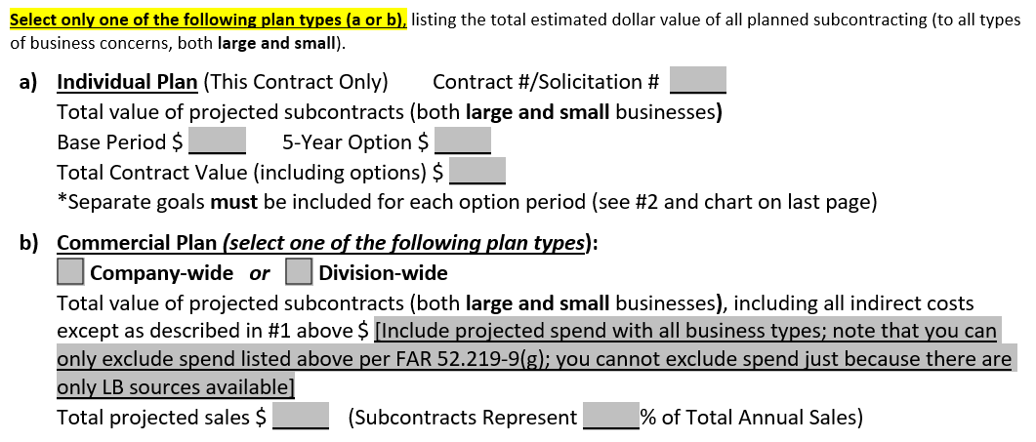
#1 - Type of Plan
Select either an individual or commercial plan.

Slide 21
#1a – Individual Type
Contract #/Solicitation #: List the solicitation number; will be revised with contract number prior to contract award
Total Value of Projected Subcontracts/Spend (Base & Option Periods): Provide total spend (both small and other-than-small) that supports the specific contract only; may include indirect costs on pro-rated basis
Total Contract Value: Include your estimated total contract value; will be revised prior to contract award with awarded value

Slide 22
#1b – Commercial Type
Company vs. Division-Wide: Select one; carefully consider your choice and your company structure; can’t include multiple divisions or subsidiaries in Division-wide
Total Value of Projected Subcontracts/Spend: Provide total spend (both small and other-than-small), including all indirect costs
Projected Sales: List total (government and commercial) projected sales for the 12-month period
Percentage of Total Annual Sales: Divide projected spend by total projected sales (e.g. $500,000 spend ÷ $2,000,000 sales = 25.0%)

Slide 23
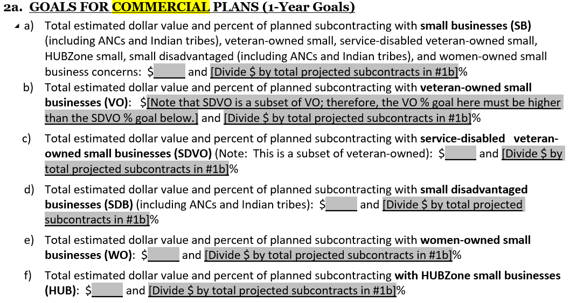
#2a – Commercial Goals

Slide 24
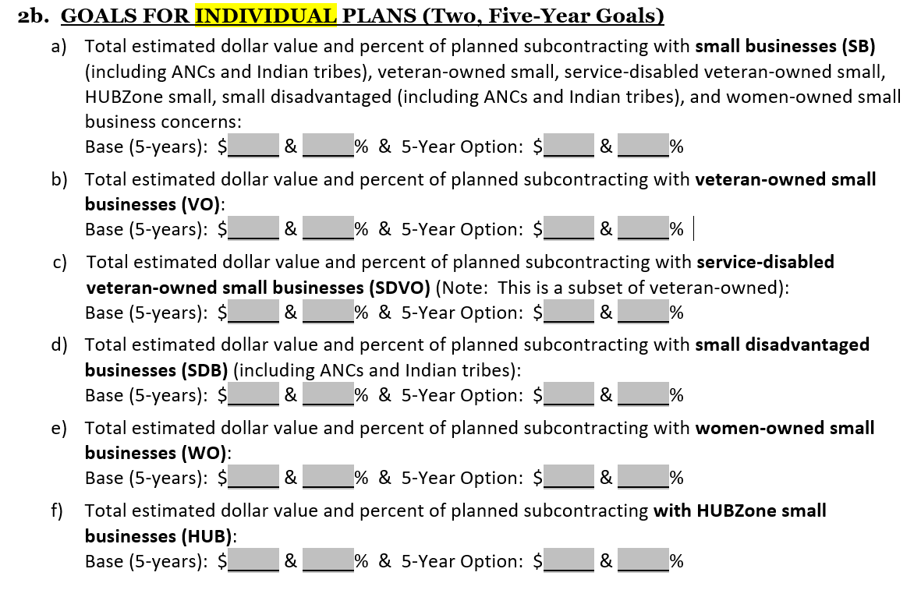
#2b – Goals Individual

Slide 25
#2 – Goal Calculations
Calculations: Percentage for each category is based upon the total value of projected subcontracting dollars (total “base” spend) in #1
Example:
HUBZone $400,000 ÷ Total Subcontracting/base spend $2,500,000 = 16%.
IMPORTANT! Calculations used the total “base” spend, not total SB spend.
No 0.0% Goals: Must propose goals for each category, no less than 0.1%
Rounding: Percentages must be rounded to one decimal place to mirror online reporting of achievements at eSRS.gov

Slide 26
#2 – Calculations Cont’d
Multiple Category Counting: All small business dollars count once in the Small Business category and can count multiple times in the subcategories
Example:
A $500,000 subcontract with a small, veteran, woman-owned business would count once in the SB category and again in the VOSB and WOSB categories.
VOSB vs. SDVOSB
SDVO is a subset of VO; therefore, VO percentage goal must always be higher than SDVO goal (Having the same goals means that you would not be seeking out any VO businesses, only SDVO)
SDVOSB spend counts in three places: SB, VOSB, and SDVOSB
Small Business (SB) Spend
Will always be higher than the subcategories as they are subsets of SB spend.
The subcategories will not add up to total SB spend due to multiple counting
Notes:
852.219-9 (now 852.219-70) VA Small Business Subcontracting Plan Minimum Requirements (Nov 2022): Needs to be revised to remove/revise references to VetBiz verification as well as to correct incomplete/contradictory information

Slide 27
#2 – Negotiated Percentages
IMPORTANT!
We negotiate, and you are held accountable for, percentage goals, not dollar goals.
Dollars listed in plan allow the percentage calculations to be made
If total actual spend goes up/down during the plan period, the percentage goals are applied to the actual total dollar spend

Slide 28
#3 - Products/Services
You must propose products/services to be purchased in every category.
Don’t list the same items for each category; examine each category independently.
Commercial plans must list indirect cost categories; individual plans must list if checked in #6 as included.
Don’t include excluded categories, foreign spend, or inter company spend
You must include spend categories regardless of whether you have control over the source of those products/services

Slide 29
#4 - Goal Development
This question asks for the method/how you arrived at the proposed goals.
Examples could include:
Historical data, previous spend history
Projected forecast based upon current year’s data
Projected goals based on experience, business forecasts, & commitment to improvement, etc.
Additionally, this section is used to provide any necessary justification for goals or other explanations, such as how you plan to overcome prior deficiencies or reach “stretch” goals, why major categories of spend are omitted (e.g. intercompany or foreign spend), etc.

Slide 30
#4 - Justification
Justification is required for two reasons:
If you propose any category percentage goal that is less than your actual percentage achievement during the prior plan period
If you propose a percentage goal that is lower than any VA suggested goal
VA suggested goals for FY 2024 are as follows:
Small Businesses: 17.5.%
Veteran-Owned Small Businesses: 7.0%
Service-Disabled Veteran-Owned Small Businesses: 5.0%
Disadvantaged Small Businesses: 5.0%
Women-Owned Small Businesses: 5.0%
HUBZone Small Businesses: 3.0%

Slide 31
#4 - Justification Cont’d
IMPORTANT! Be specific in explaining the challenges faced in meeting the VA’s suggested goals and address specific subcategories (i.e., don’t “broad stroke” justification; address each category independently as applicable).
Examples for proposing lower than the VA suggested goals include:
FDA registration/approval
Strict and/or unusual quality control/technical requirements
Buyer specifications
Proximity/Logistics – rural companies with few local SBs to meet needs
Examples for proposing % goals lower than prior year achieved % include:
Prior SBs are now LBs; must search for new SBs
Moved to new location and lost local SBs
Eliminated a product line that supported WOSB spend

Slide 32
#5 – Identifying Potential Sources
This question is asking about specific resources planned to be used to find small businesses, such as
SBA Dynamic Small Business Search (DSBS, http://dsbs.sba.gov)
Sam.gov
Women’s Business Enterprise National Council (www.wbenc.org)
National Minority Business Council (www.nmbc.org)
Generic responses, such as “internet sources” or “small business groups”, are not sufficient and do not show a good faith effort or a concrete way forward.
Don’t just copy the list from the FAR, these slides, or other sources; list sources you actually intend to use; keep records of sources used.

Slide 33
#6 – Indirect Costs – Comm. Plans
Check “have” been included; all indirect costs (i.e., G&A, overhead) must be included
Do not complete the last fill-in
Notes:
Effective 9/10/21 Commercial contractors must include indirect costs and are no longer given the choice.

Slide 34
#6 – Indirect Costs – Indiv. Plans
Individual Plans: Check either “have” or “have not” been included.
If including, you must provide an explanation of how you are arriving at the proportionate share allocated for various pools of spend
You must examine each pool of spend independently (e.g. accounting, landscaping, marketing, attorney fees, etc.)
Do not apply same percentage across all pools of indirect spend since the portion of support to the specific VA FSS contract could vary greatly from one pool of spend to the next
For overarching spend categories (e.g. janitorial services), a good way to apply a percentage for individual plan holders is to compare the sales dollars generated by the specific contract vs. all other company sales
Important: Even if you choose not to include pro-rated indirect spend in your plan, you must track and report pro-rated indirect spend in the SSR in eSRS.

Slide 35
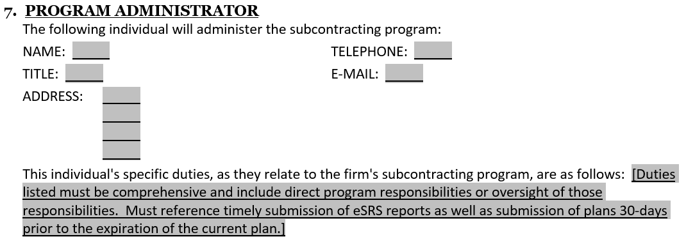
#7 – Program Administrator
List the individual responsible for oversight of the program; this individual will be contacted by us for all subcontracting plan and eSRS issues, reminders, webinars, etc.
Be sure to be specific and comprehensive when listing duties, including direct involvement with or oversight of various aspects of your program
Duties listed must include submission or oversight of timely proposed plan submission (30 days prior to prior plan expiration) and timely filing of eSRS reports
Notes:
Be prepared to provide proof the duties are/were carried out.

Slide 36
#8 – Equitable Opportunity
Provide both internal and external proactive efforts as a demonstration of your company’s “good faith effort” toward meeting your goals.
External Efforts – Examples: 1) Contacts w/ SB, minority, WO, etc. trade associations & business development organizations and 2) Attendance at/sponsorship of SB conferences, trade shows, seminars, training programs, etc.
IMPORTANT! You must identify specific examples. The examples above are only provided to demonstrate general areas for consideration.
Internal Efforts – Examples: Training for purchasing staff to ensure consideration of SBs for all procurements, instituting self-certification (52.219-9(c)(2)) documentation protocol with accounting department to properly classify spend etc.

Slide 37
#8 – Good Faith Effort
19.701 and 19.705-7(b): The end of the plan template contains FAR language regarding “Good Faith Effort”; below is a partial screenshot of this language.
52.219-16 Liquidated Damages – Subcontracting Plan
(a) Failure to make a good faith effort to comply with the subcontracting plan," as used in this clause, means a willful or intentional failure to perform in accordance with the requirements of the subcontracting plan approved under the clause in this contract entitled "Small Business Subcontracting Plan," or willful or intentional action to frustrate the plan.

Slide 38
#9 – Flow-Down Clause
Requirements of Flow-Down Clause
Flow-down of 52.219-8 to all your subcontractors, and
Requirement for your subcontractors (when listed criteria are met) to have a plan
Exception to Flow-Down Requirements – 52.219-9(j):
Plans aren’t required from subcontractors when the prime contract contains 52.212-5, which is included in all FSS contracts
VA FSS planholders only have to flow-down 52.219-8 and won’t have to require subcontractors to have a plan unless your plan also covers another government contract which does not have clause 52.212-5

Slide 39
Sections #9 - #15
These are the assurances/agreement sections, verbatim from FAR 52.219-9(d).
By signing the plan, you agree to abide by the verbiage in these sections.
You cannot paraphrase or deviate from the language in these sections such that it changes the intent of the FAR, as these sections are FAR required components of an acceptable plan
Notes:
#9 Flow-Down
#10 – Reporting & Cooperation: Includes responsibilities re. submitting actual achievements in eSRS
#11 – Recordkeeping: Describes the types of records you have to maintain (self-certifications, spend allocations, good faith efforts, etc.)
#12 & 13 – Is about Utilization of SB Concerns Used in Bid/Proposal
#14 - Subcontractor Discussions with CO: Requires that you agree not to prohibit a subcontractor from discussing with the CO any material matter pertaining to payment to or utilization of a subcontractor.
#15 – Prompt Payment: Requires you to pay SB subcontractors on time and in accordance with the Ts & Cs of the subcontract and to notify the CO if you make a reduced/untimely payment

Slide 40
Signature
You must provide a signed, pdf copy of the plan via e-mail (do not mail original copies)
We accept scanned copies of wet signatures and “digital” signatures
We do not accept dropped images/jpegs of signatures or signature-like Word font

Slide 41
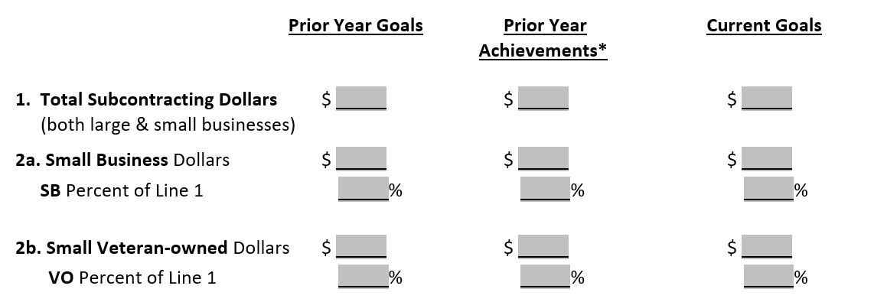
Summary of Goals – Comm. Plans
Commercial Plan holders (except for initial plans) must complete this table.
This serves as a comparative table of …
Prior Year Goals: What you proposed that your company would spend in the prior year’s plan (must match last year’s approved plan)
Prior Year Achievements: What you actually spent/achieved last year (should approximate eSRS reported spend)
Current Goals: What you propose to spend in the coming year (must match total spend in #1 and goals in #2)
Notes:
Prior year $ achievements listed (if you had a prior plan) may be based on the most recent SSR in eSRS or be based on your actual plan period.

Slide 42
Review
Review Process

Slide 43
Plan Approver
Plan Approver
Per FAR 19.704(d)(1), “Submit the commercial plan to either the first contracting officer awarding a contract subject to the plan during the contractor’s fiscal year, or, if the contractor has ongoing contracts with commercial plans, to the contracting officer responsible for the contract with the latest completion date.
The “latest completion date” means the current expiration date and does not include options not yet exercised.
Due to options and extensions, the plan approver may vary from year to year; so, be sure to check the expiration date of each applicable contract. We may ask for this.
Submission Protocol
Ensure the all offices/agencies with contracts covered by your plan are copied on your initial plan submission e-mail to the approving agency.
Each office/Contract officer must have proof of the date of submission to document contract compliance or non-compliance (timely/untimely submission) with this contract deliverable.

Slide 44
Review Process
Plan is acceptable
Submit proposed plan to the FSS centralized Subcontracting e-mail box at FSS.Subcontracting@va.gov
Plan is assigned to and reviewed by Contract Specialist
Approved plan is included with contract award or added to existing contract(s) by modification.
Revisions Requested: Revise and resubmit your plan

Slide 45
Checklist
Checklist for Common Issues/Tips

Slide 46
Checklist - 1
Template: Are you using the most recent template or other FAR compliant template? Current template is dated 10/4/2024.
Don’t remove/paraphrase FAR language.
Plan Period - Commercial: Does this reflect your company’s fiscal year?
Date Submitted: If resubmitting, did you revise the submission date?
Planholder Name/UEI/Address
Do these all match?
Does the UEI belong to the Planholder (unique to that company)?
Is only one company listed as the Planholder?
If the plan is division-wide, is the division identified?

Slide 47
Checklist - 2
Subsidiaries Included (if applicable)
Are all covered subsidiaries included (only for company-wide commercial plans)?
Does each listed company fall under the named planholder in the company structure?
Are all applicable contract holders covered by the plan listed?
#1 Total Projected Subcontracts/Spend
Do the dollars listed reflect spend and not sales?
Does the total include all spend (both small and large/other-than-small)?
Did you make sure to only include domestic spend?
Did you make sure not to include intercompany spend or any excluded category spend?

Slide 48
Checklist -3
#2 Goal Calculations
Are all goals rounded correctly to one tenth of a percent (i.e. 0.3%)?
Are all goals at least 0.1% (no 0.0% goals)?
Are percentages calculated against the total projected subcontracts/spend in #1 (not the SB spend in #2)?
Did you count subcategory spend once under SB spend and in as many subcategories as it applies?
Is your SB goal higher than the subcategory goals (to include businesses that are only SBs)?
Is your VOSB percentage goal higher than your SDVOSB goal?
Do you understand that the SDB category does not mean “minority” spend?

Slide 49
Checklist - 4
#3 Products and/or Services
Did you propose something for each category?
Is your list comprehensive, including areas of spend for which you have no choice/control?
Did you examine each category independently, not repeating the same list?
Did you make sure that you aren’t listing any excluded categories?
Did you make sure to list indirect spend categories (required for commercial plans, optional for individual plans per #6)
#4 Goal Development
Did you provide the method/rationale you used to arrive at your goals?
Did you provide any necessary justification for your goals (proposing lower than the VA suggested goals or lower percentages than last year’s achievements)?
Do your explanations address categories specifically?
Do you address how you will overcome prior deficiencies or reach “stretch” goals?

Slide 50
Checklist - 5
#5 Identifying Potential Sources: Did you list specific resources that you are using (no generic/general references)?
#6 Indirect Costs
Did you select “have” or “have not” (you must choose one, and commercial planholders must check “have”)?
If you selected “have” included and are filing an individual plan, did you properly answer the question re. your method for allocating spend by individual category?
#7 Program Administrator
Did you list the individual responsible for oversight of the program?
Were you specific and comprehensive in listing the administrator’s duties?
Did you specifically list submission or oversight of timely proposed plan and eSRS submissions?

Slide 51
Checklist - 6
#8 Equitable Opportunity
Did you list internal and external proactive efforts to demonstrate a “good faith effort”?
Did you list specific examples?
Signature
Did you provide a signed copy of the plan?
Is your signature compliant, meaning a scanned copy of a wet signed document or a true digital signature (no dropped images/jpegs)?
If you are submitting a revised plan, did you resign the pdf?
Goals/Achievements Table (for commercial plans only)
Do your prior year goals match last year’s plan?
Do your actual achievements mirror/approximate your SSR at eSRS.gov?
Do your current year goals match the goals listed in #2?

Slide 52
Resources/Contacts
Resources & Contacts

Slide 53
Contacts/Resources
VA FSS Subcontracting Program e-Mail: FSS.Subcontracting@va.gov
NCS Subcontracting Program e-Mail: NACSUBK@va.gov
VA FSS Subcontracting Web Page: https://www.va.gov/opal/nac/fss/sbsp.asp
Suggested minimum percentage goals
Training/guides (eSRS & Plan Preparation)
Subcontracting Plan template
VA FSS Training Web Page: https://www.va.gov/opal/nac/fss/training.asp
Upcoming webinars
Current and archived presentations
eSRS Home Page: https://www.esrs.gov
Log-in
User guides, Training materials, sample reports, and training webinars
eSRS Helpdesk: Federal Service Desk (FSD), https://www.fsd.gov, 866-606-8220
Includes FAQs
Provides ability to “Create and Incident” or start a “Live Chat”

Slide 54
SBA Area Offices
AREA I: Janette Fasano, janette.fasano@sba.gov, (617)990-2645 - Connecticut, Maine, Massachusetts, New Hampshire, New Jersey, New York, Rhode Island and Vermont and the Commonwealth of Puerto Rico & Virgin Islands
AREA II: Rosetta Rodwell, rosetta.rodwell@sba.gov, (202)941-8067 - Delaware, Maryland, Pennsylvania, Virginia and West Virginia, and the Washington, DC Metropolitan Area
Area III: Carol Thompson, carol.thompson@sba.gov, (404)331-0139 - Alabama, Florida, Georgia, Kentucky, Mississippi, North Carolina, South Carolina, and Tennessee
AREA IV: Pamela Beavers, pamela.beavers@sba.gov, (312)353-7381 - Illinois, Indiana, Iowa, Kansas, Michigan, Minnesota, Missouri, Nebraska, Ohio, & Wisconsin
AREA V: Tanika L. Pierce, tanika.pierce@sba.gov, (817)684-5302 - Arkansas, Colorado, Louisiana, Montana, New Mexico, North Dakota, Oklahoma, South Dakota, Texas, Utah and Wyoming
AREA VI: Nicholas Manalisay, nicholas.manalisay@sba.gov, (213)634-3804 - Alaska, Arizona, California, Hawaii, Idaho, Nevada, Oregon, Washington, and Guam

Slide 55
Regulatory Resources
FAR 52.219-8: Utilization of Small Business Concerns (including definitions of
SB Concern, HUBZone, SDB, SDVOSB, and WOSB
FAR 52.219-9: Small Business Subcontracting Plan
FAR 52.219-16: Liquidated Damages – Subcontracting Plans
FAR 19.7: The Small Business Subcontracting Program
Public Law 95-507: Amendments to the Small Business Investment Act of 1958
13 USC 121: Small Business Size Regulations
13 USC 125: Government Contracting Programs

Slide 56
Questions
Questions?

