Slide 1
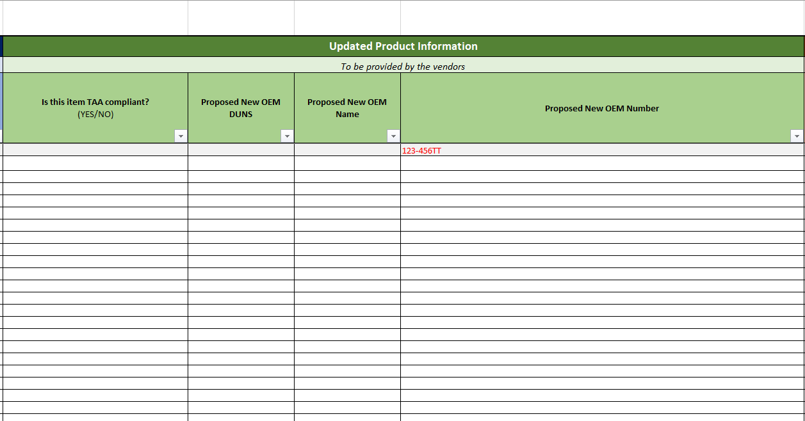
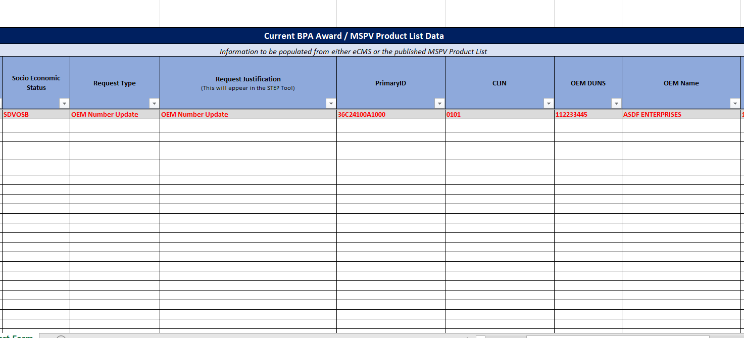
OEM Revision Request Form Vendor User Guide
As of November 9, 2022

Slide 2
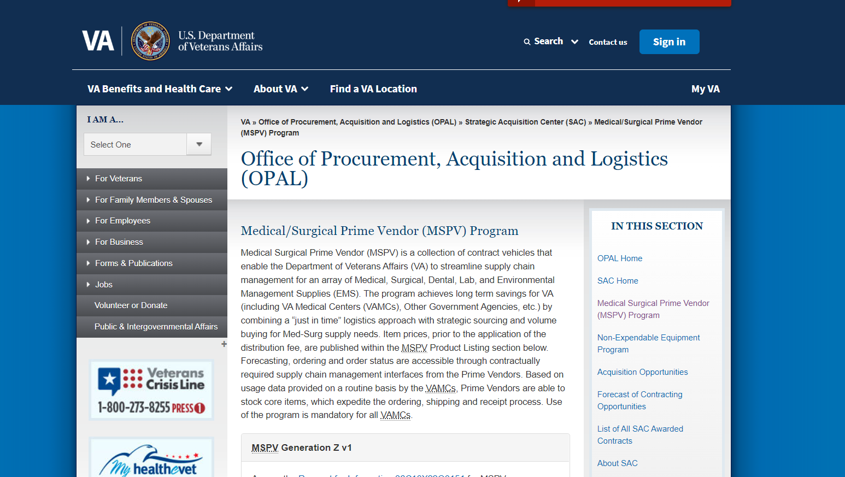
OEM Revision Request Step 1
1a. Assigned Contracting Officer (CO) or Vendor will go to the Medical/Surgical Prime Vendor (MSPV) Program page on the va.gov site
1b. Next, the CO or Vendor will scroll down to the MSPV Product List section and find the link for the Change Request Form. From there the user will and download it and fill it out or send it to the necessary stakeholder.

Slide 3
OEM Revision Request Step 2
2a. Once the Change Request Form is in the possession of the vendor, they will be responsible for filling out the Current BPA Award / MSPV Product List Data and Updated Product Information portion of the form.
2b. With the Updated Product Section complete, the vendor will submit the Change Request Form back to the MSPV Product List Management Team at VHAMSPVCorrection@va.gov .
For changes regarding price, supply description, OEM/UOM description, items per OEM/UOM, country of origin, and supplier part number, please reach out to your assigned contracting officer directly to receive a BPA Maintenance Request Form.

