Slide 1

U.S. Department of Veterans Affairs
Center for Minority Veterans (CMV)

Slide 2


Organization Chart
Secretary
Deputy Secretary
Chief of Staff
Deputy Chief of Staff
Dennis May
Acting CMV Director
GoldWilmyasberry
Data Analyst
Carl McPherson
Program Assistant
Denise Wright
Acting CMV Deputy Director
Denise Wright,
Sr. Program Analyst,
African American Veterans Liaison Minority Veterans Program Manager
Juanita J. Mullen
Program Analyst
American Indian Veterans Liaison
Dwayne E. Campbell
Program Analyst
Hispanic Veterans Liaison
Ron M. Sagudan, Program Analyst, Native Hawaiian, Asian American, Pacific Islander, Veterans Liaison
D’Andrea Jacobs
Program Analyst
Hispanic Veterans Liaison

Slide 3
Center for Minority Veterans
Background
The Department of Veterans Affairs, Center for Minority Veterans office is in Washington, DC.
Rep. Montgomery, G. V. (Sonny) [D-MS-3] (Introduced 10/07/1994) Veterans' Benefits Improvements Act of 1994 which on 11/02/1994 Became Public Law No: 103-446.
November 1994, Public Law 103-446 required SECVA to create Center for Minority Veterans (CMV) and established the Advisory Committee on Minority Veterans (ACMV).
(Sec. 509) Establishes in the VA a Center for Minority Veterans and a Center for Women Veterans. Requires the Secretary to include in annual budget documents detailed information on each Center's budget and a report on each Center's activities and accomplishments.
(Sec. 510) Directs the Secretary to establish the Advisory Committee on Minority Veterans with respect to the administration of VA benefits for veterans who are minority group members. Requires an annual report from the Advisory Committee on its programs and activities. Defines "minority group members" as Asian Americans and Pacific-Islander Americans, African Americans, Hispanics, and Native Americans (American Indians, Alaska Natives, Native Hawaiians).
Background
  “Are there special benefits only for minority Veterans?
  Aren’t all Veterans created equal?”
  “Why does the VA have a Center for Minority Veterans?”
  The Center for Minority Veterans was established in response to lagging utilization by minority Veterans in VA benefits and services. Other than the Native American Direct Loan program, there are no benefits that accrue to Veterans simply based on their race or ethnicity.
  In FY2019 over 900,000 Veterans were contacted through CMV's outreach efforts. 330,000 of them were minority Veterans (37%)
  In FY2020 during COVID -19 over 600,000 Veterans were contacted through CMV's outreach efforts. 223,000 of them were minority Veterans (37%)
  CMV assists all Veterans and Family members.

Slide 4
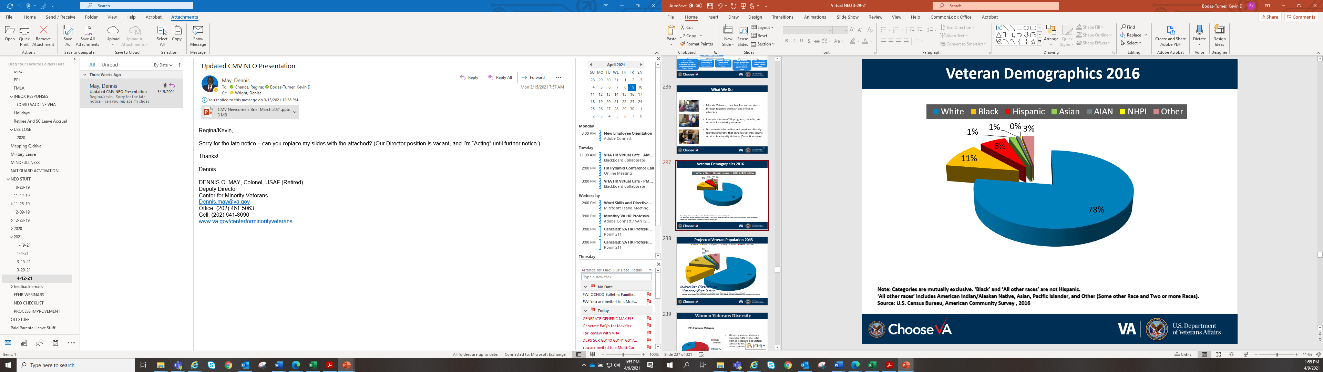
VHD
Note: Categories are mutually exclusive. ‘Black’ and ‘All other races’ are not Hispanic.
‘All other races’ includes American Indian/Alaskan Native, Asian, Pacific Islander, and Other (Some other Race and Two or more Races).
Source: U.S. Census Bureau, American Community Survey , 2016

Slide 5
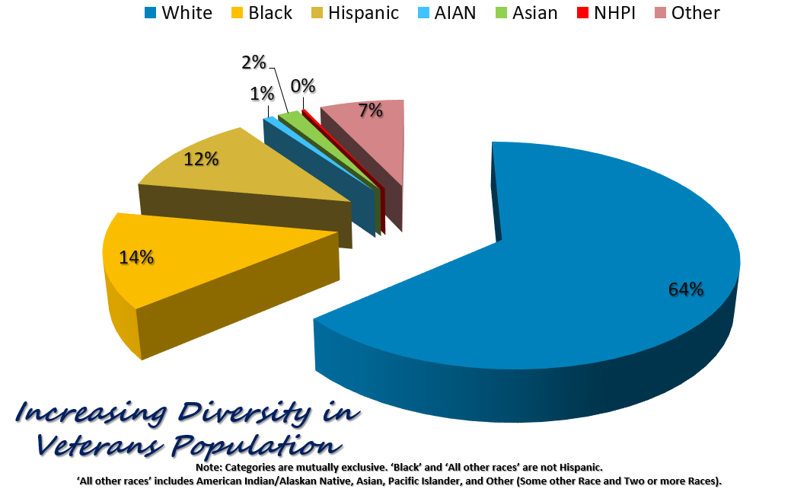
PVP
Note: Categories are mutually exclusive. ‘Black’ and ‘All other races’ are not Hispanic.
‘All other races’ includes American Indian/Alaskan Native, Asian, Pacific Islander, and Other (Some other Race and Two or more Races).

Slide 6
Women Veterans Diversity
Minority women Veterans comprise 34% of the total women Veterans population compared to 21.9 percent minority men Veterans

Slide 7
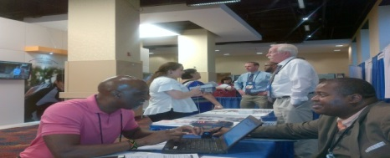
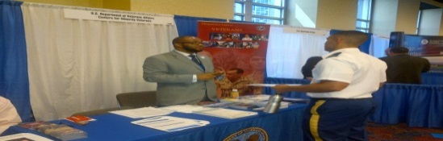
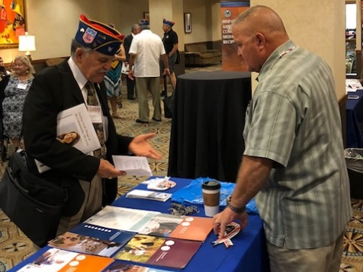
What We Do
Assists eligible Veterans in their efforts to receive benefits and services from the VA. CMV acts only as a mediator and facilitator. *As such the Center does not process claims, handle equal employment complaints, or employee relations problems.
Identifying barriers to service and health care access
Educate Veterans, their families and survivors through targeted outreach and effective advocacy.
Promote the use of VA programs, benefits, and services for minority Veterans.
Disseminate information and provide culturally relevant programs that enhance Veteran-centric services to minority Veterans.

Slide 8
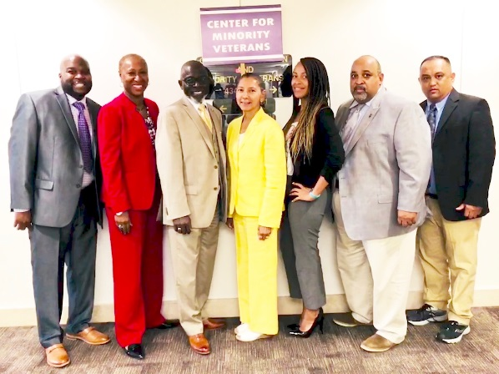
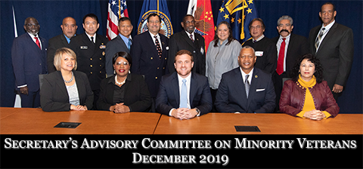
Increasing Awareness of VA Benefits
Staff/Minority Veteran Liaisons collaboration with internal/external organizations and other closely aligned non-government minority organizations (CMV)
Secretary’s Advisory Committee on Minority Veterans (ACMV)
Minority Veterans Program Coordinators (MVPC)

Slide 9
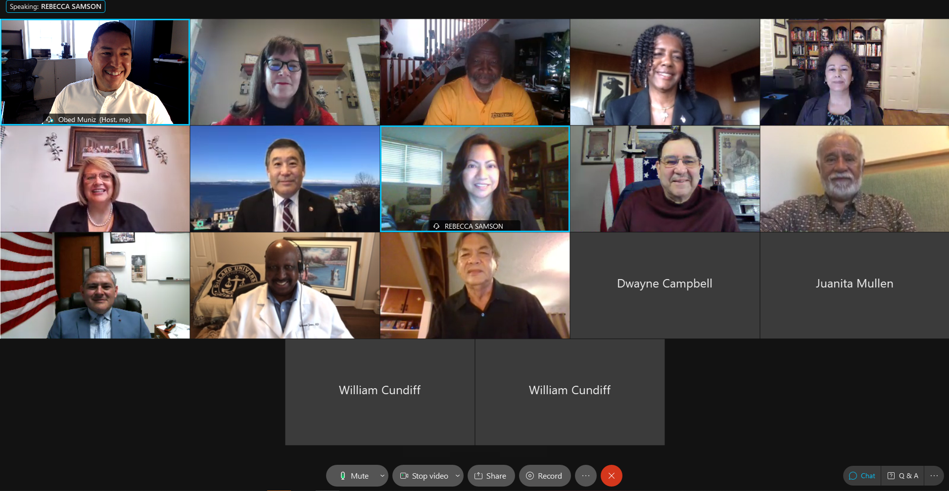
Advisory Committee on Minority Veterans (ACMV)
Advise the Secretary on VA’s administration of benefits and provision of health care benefits and services to minority Veterans
Provide annual report to the Secretary outlining recommendations, concerns, and observations on VA’s delivery of services to minority Veterans
Meet with VA officials, Veteran Service Organizations and stakeholders to assess the VA’s efforts in providing benefits and services to minority Veterans
Make periodic site visits and hold Veterans Town Hall meetings
Advisory Committee on Minority Veterans

Slide 10
Administration MVPC Liaison
NCA, VBA and VHA
Coordinate and manage the Minority Veterans Program (MVP) for their Administration.
Work directly with CMV and Facility Minority Veterans Program Coordinator (FMVPC) on initiatives having regional or national scope and impact.
Analyze, evaluate, and implement programs to improve the MVPC program.
Serve as an expert analyst on program and advise senior management officials on issues affecting minority Veterans.
Conducts quarterly Ensure that FMVPC are properly trained in the areas of reporting outreach.
Serve as the principal liaison between the CMV and FMVPC.
Participate in conference calls with the CMV and FMVPC.
Facilitate collaboration by FMVPC on outreach efforts in their geographic area.
Assist the CMV MVPC Program Manager by facilitating the submission of their facility MVPC Quarterly Reports.
Provide quarterly updated MVPC rosters to CMV MVPC Program Manager.
Keep management officials abreast with timely, comprehensive information that reflects the effectiveness of the MVPC.
Conduct meetings with FMVPC within their jurisdiction as appropriate to disseminate program direction and information.

Slide 11
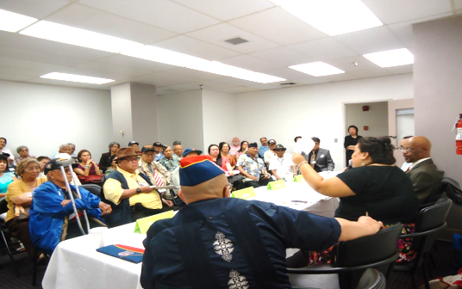
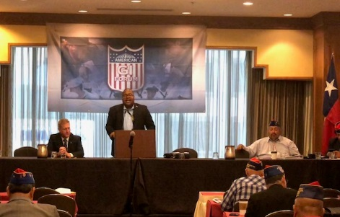
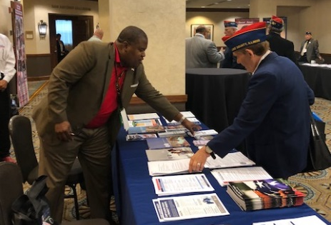
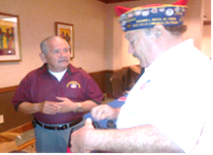
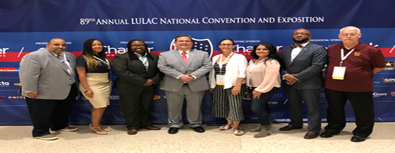
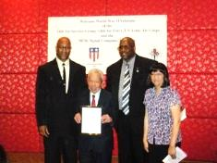
Who are the Minority Veterans Program Coordinators (MVPC)?
MVPCs: VA employees who have full time jobs and are appointed to served as their Facility MVPC
as a collateral duty.
Interdepartmental program 276 coordinators collaterally assigned within VHA, VBA, and NCA
Support and initiate activities that educate and sensitize internal staff to the unique needs of minority veterans
Target and participate in outreach activities and educational forums utilizing community networks
Assist the CMV in disseminating information

Slide 12
Minority Veterans Program Coordinators (MVPC) Role
Advocate on behalf of minority Veterans by making recommendations to improve service delivery within their facilities.
Submit their web based Quarterly MVPC Report within the identified time frames.
Participate in conference calls with CMV MVPC Program Manager and VACO MVPC Liaison.
Develop each Fiscal Year an Operation Plan outlining outreach and activities to be conducted targeting minority Veterans for the year.
Develop a Track and Trending Report by conducting trend analyses of minority Veterans’ concerns or issues at events and facility.
Recommend proactive initiatives and corrective actions to resolve recurrent challenges to the facility Director.
Distribute and use culturally sensitive materials to inform minority Veterans and their families of the availability of VA services and benefits.
Collaborate with other Administrations FMVPCs to increase targeted outreach opportunities and efforts.
Establish and maintain contact with minority organizations within the local area(s) served by the facility to present information concerning benefits, to hear their concerns, and to answer questions.
Work with the facility staff to formulate and communicate program objectives that increase the awareness of the Minority Veteran Program.
Support and initiate activities that inform and sensitize facility staff to the unique needs of minority Veterans.
Provide appropriate educational and outreach materials to targeted outreach groups
Serve as CMV primary contact on issues pertaining to minority Veterans visiting their facility.
Keep abreast of VA benefits programs, current policies, and regulations and their impact on minority Veterans.
Meet with the Director periodically (suggest at a minimum, twice per year) to discuss the operation plan, initiatives and issues of interest and concern.

Slide 13
CMV Strategies
Biennial National Minority Veterans Summit (Projected 2022)
Initiatives/ Campaigns- Million Veteran Program/PREVENTS
Collaborate on Research Projects with Office of Health Equity, Center for Health Equity, and Research Promotions
Host Lunch and Learn Sessions – Federal Agencies
Weekly GovDelivery Email
Develop MOUs with national organizations (i.e. NAACP, Women Veterans Interactive, LULAC, Veterans Employment Service Office etc.)
Encourage minority Veterans to self-identify

Slide 14


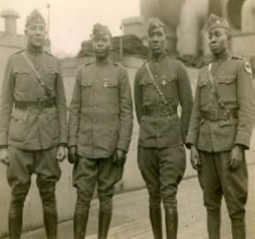
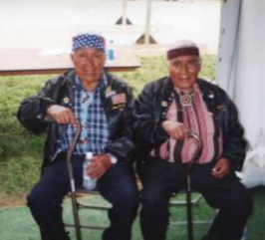
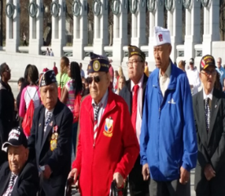
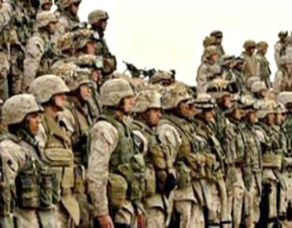
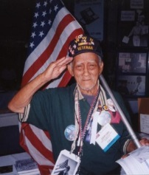

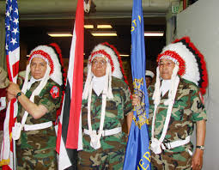
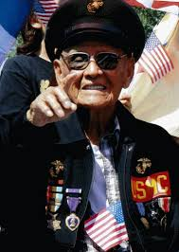
POC
Point Contact Information
U.S. Department of Veterans Affairs
Center for Minority Veterans
202-461-6191
https://www.va.gov/centerforminorityveterans/
tp://www1.va.gov/CENTERFORMINORITYVETERANS/index.asp
Center for Minority Veterans

Slide 15

questions
  Questions?

