Slide 1
Mobilizing Social Support for Veterans
Susan Kerber
Partnership Outreach
CaringBridge

Slide 2
Agenda
Who We Are
How We Support Veterans on a Health Journey and Family Caregivers
How to Start a CaringBridge Site and Activate a Community for Support

Slide 3
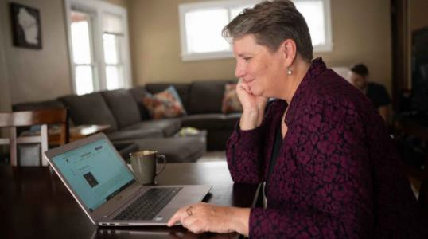
CaringBridge –A Communications Platform
CaringBridge is a free online tool for anyone to share health news and updates with their family and friends to reduce chaos, isolation and loneliness.
It is an easy way to communicate health news to everyone all in one place.
CaringBridge provides the emotional and instrumental support people need to feel loved and find relief from their immediate and military families and their community.

Slide 4
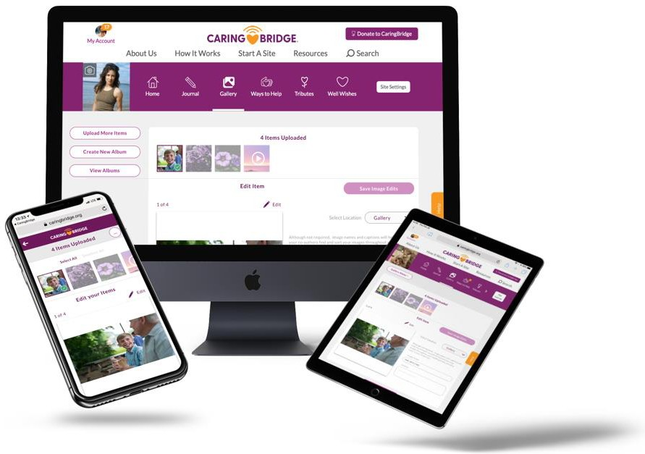
Why CaringBridge?
Private, ad-free community
Personal data is never sold
Secure platform
Easy to create and invite others to join on your site Everyone receives the same information at the same time
24-year-old nonprofit that is 90% funded by the people using the sites
Available via responsive website and iPhone/Android apps.

Slide 5
ItsValue is in the Numbers
The CaringBridge Community Since 1997
1 in 7 people in the U.S. turned to CaringBridge in 2020
Reach of 236 countries & territories around the world
Every 12 minutes a new site is created (890,000 + personal sites created)
1,900 cumulative messages are posted every hour
65% of sites are started by a family caregiver and most of these are women
“I felt relief and hope all at the same time. CaringBridge was a big help,” said Greta after her fight against Hodgkin’s Lymphoma came to a close.

Slide 6
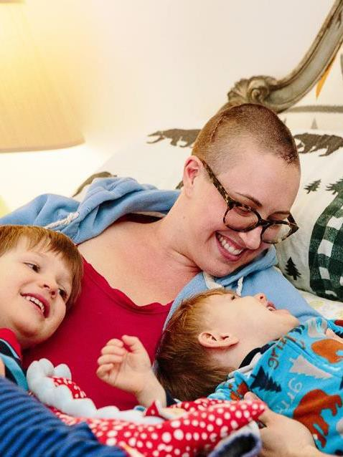
CaringBridge Users
Sites are either created by the person on a health journey or a family caregiver.
A recipient of a site can always add a co-author who can help journal on the site and inform family and friends of the health status of the user.
Co-authors can also take on more “helper” roles through the Ways to Help page which is where you can ask your visitors for meals, rides, errands and more.

Slide 7
Health Conditions
Identified health conditions self-reported by CaringBridge users:
Cancer
Surgery/Transplant/Amputations
Cardiovascular/Stroke
Injury
PTSD
Neurological
Infant/Childbirth
Congenital/Immune
Loneliness and Isolation
Covid-19
Brian Muller, husband of Amie Muller, U.S. Airforce and National Guard Veteran, diagnosed with Stage III pancreatic cancer. “When Amie got sick, it was hard to have people around. But she did want people to know what was going on.”

Slide 8
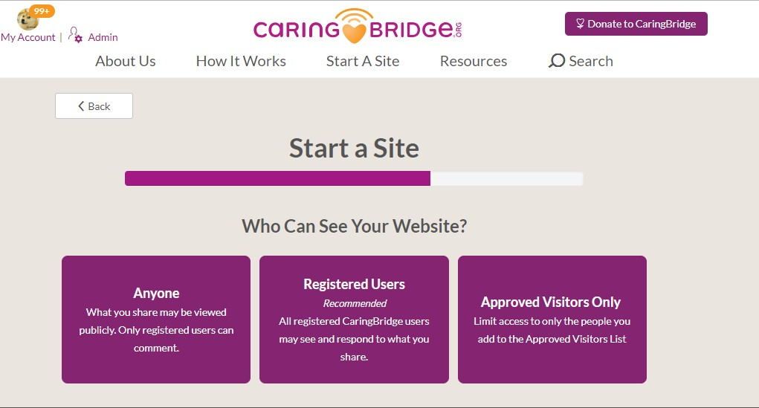
How CaringBridge Works
It takes about 5 minutes or less to
set up a site
Users select one of three customizable security settings (settings may be changed by the user throughout use)
Data is secure and protected, never sold
No advertising within platform

Slide 9
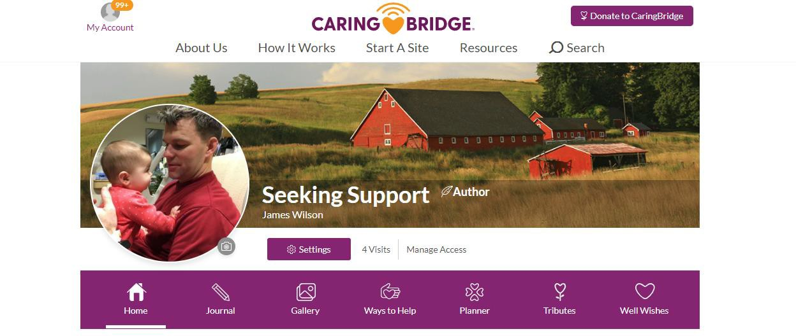
Communication and Connection All in One Platform
The home page can be customized with personal photos and/or meaningful graphics.
Visitors can follow and receive notifications that an update has been posted.
The navigation bar guides users through the
various features of a site.
Share the reason for starting a CaringBridge site in the “Story” section (always visible on your home page).

Slide 10
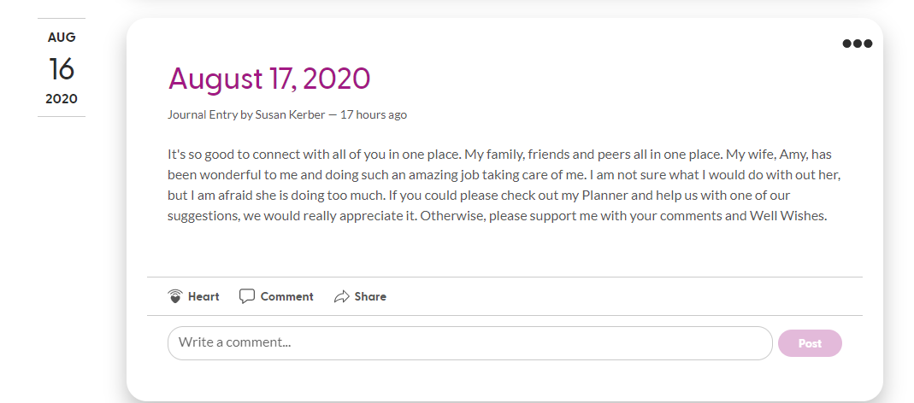
Journaling for Communication, Connection and Healing
Post regular health updates to keep everyone informed and connected – photos and videos can also be posted.
Both the person on the health journey and/or their family caregiver can provide updates and manage the site.
Visitors can use the heart “amplifier,” emojis, comment feature or Well Wishes to let the person on a health journey know they’re thinking of them.

Slide 11
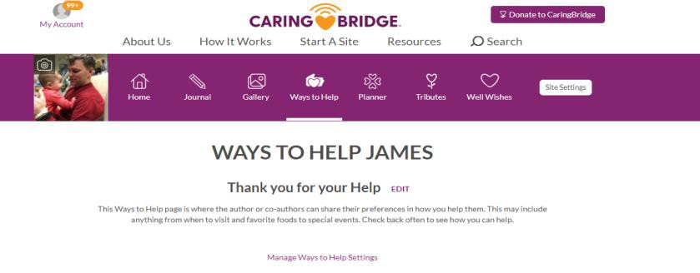
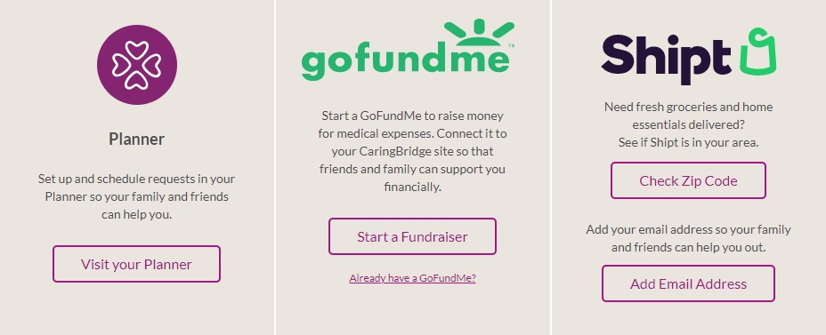
Ways to Help Page – Mobilizing Support in One Place
Planner, Meal Train, Shipt & Zoom
Schedule and coordinate support like meals, rides to appointments, visits, ask your community to purchase groceries and more and schedule Zoom meetings with family and friends.
Personal Fundraiser
Start a personal fundraiser to help cover the cost of health expenses.
Support Links
Add personal links that help you feel supported by your community such as a link to a condition-specific support group, etc.

Slide 12
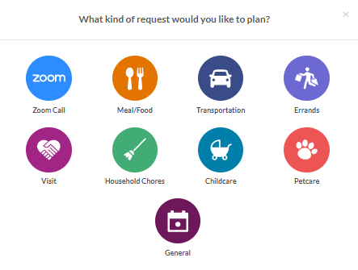
The Planner - Digital Care Coordination

Slide 13
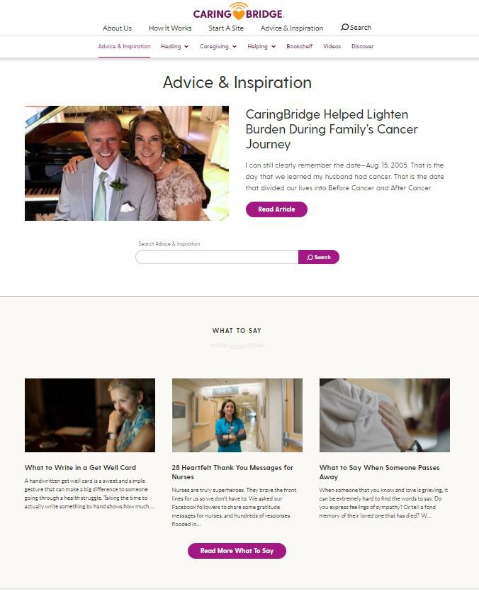
Advice and Inspiration
This section of CaringBridge provides helpful articles and
videos for users to better understand healing and caregiving
Healing: Helping patients and their caregivers understand how healing is always possible, even when cure is elusive. Family health journeys across a variety of conditions shared in stories and vidoes.
Caregiving: Helping family caregivers accelerate learning and create
connectedness.
Helping: Practical and reflective content, informed by experts and CaringBridge families, that are relevant to those on a health journey, and those supporting loved ones.
Veterans and Military: Stories and videos of Veterans and Military personnel using CaringBridge
Bookshelf: Books written by CaringBridge authors, visitors, supporters.

Slide 14
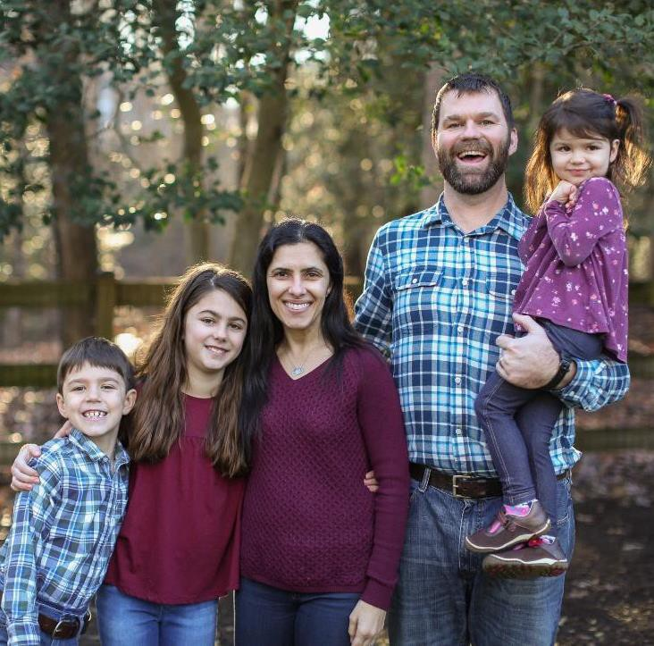
Please Share CaringBridge
If you know of a Veteran or a Family Caregiver who can use CaringBridge, please encourage them to check out www.caringbridge.org/military
A lot of veterans hear about CaringBridge from a doctor, nurse, social worker, family member or another veteran.
If you have a way to share brochures with Veterans, they can be ordered and shared at: www.caringbridge.org/partnerships
Reach out to me for additional information:
“It helped me to stay in the positive, hopeful space I wanted to inhabit for my husband Brian.” For Gina.
CaringBridge became her anchor.” Brian was U. S. Army Special Forces officer in Germany when he was severely injured.
Susan Kerber skerber@caringbridge.org

Slide 15
Contact
ThankYou
Susan Kerber
612-384-0326
skerber@caringbridge.org
www.caringbridge.org

