Slide 1
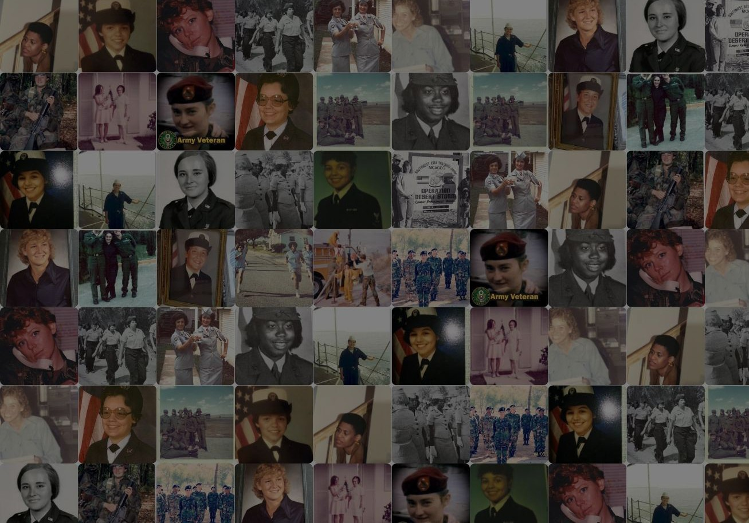
The Military Sisterhood Initiative
A national peer support network of and for women of the military
Maggie Tolan Director
Challenge America

Slide 2
About Challenge America
Challenge America is a national Veteran non-profit that leverages technology and the creative arts to improve the lives of Veterans and their families.
www.challengeamerica.com
CAVARTS
Challenge America Veteran Arts Community (CAVARTS): your Veteran community for connecting, learning, and growing through the creative arts
CAMVETS
Challenge America Makers for Veterans (CAMVETS): a program that develops innovative solutions to the unmet needs of injured Veterans
MSI
Military Sisterhood Initiative (MSI): a national peer support community of women Veterans and service members.

Slide 3
Military Sisterhood Initiative

Slide 4
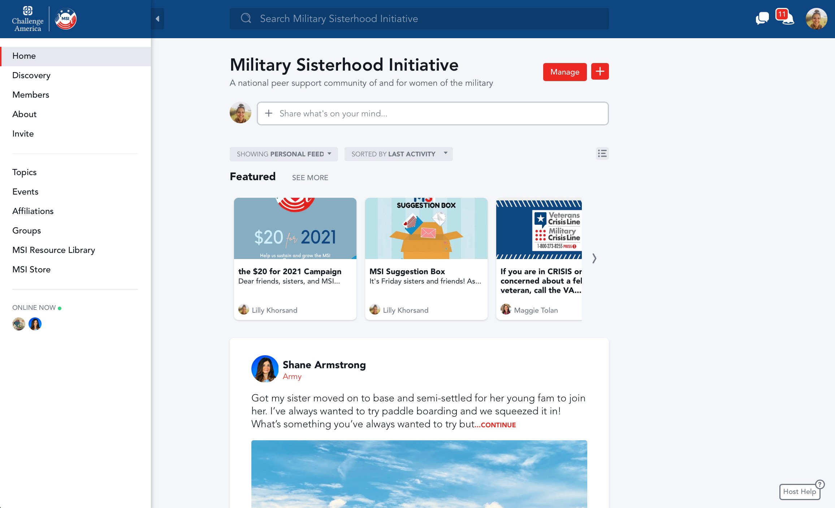
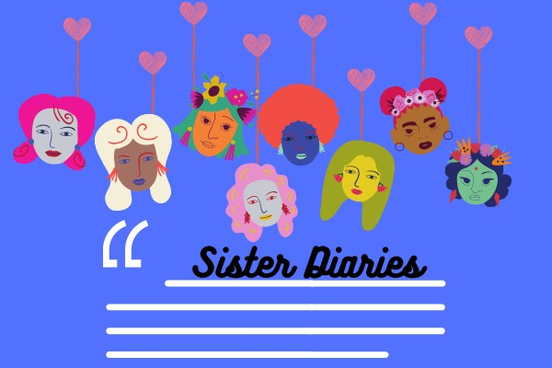
Topics, Posts, & Discussions

Slide 5
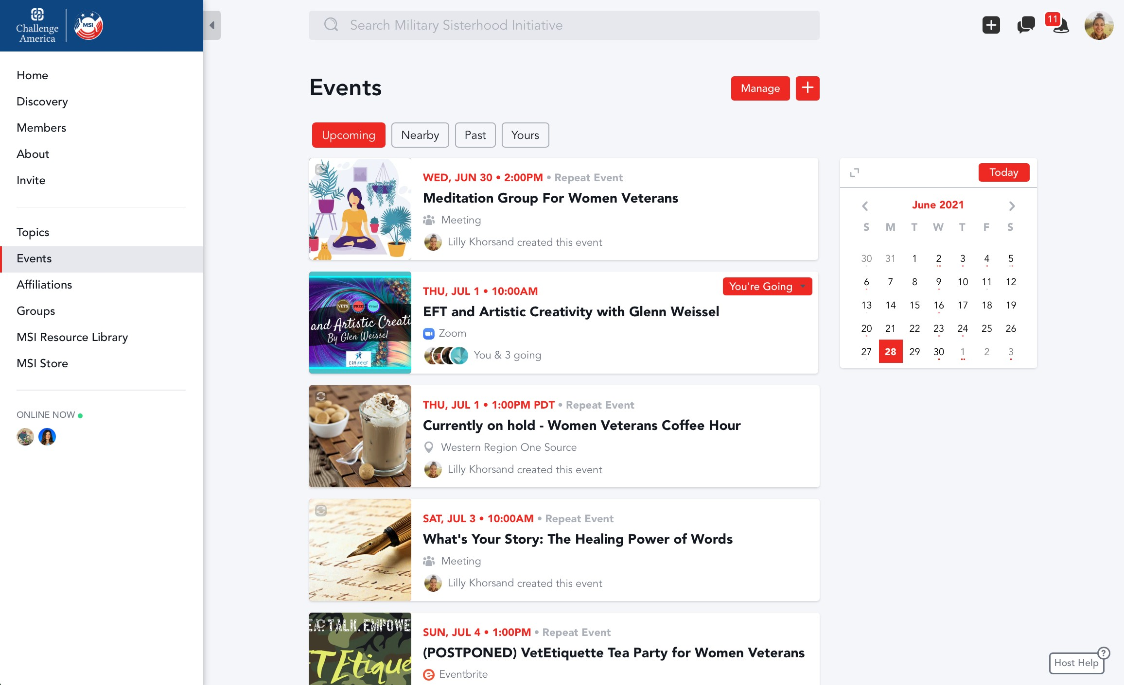
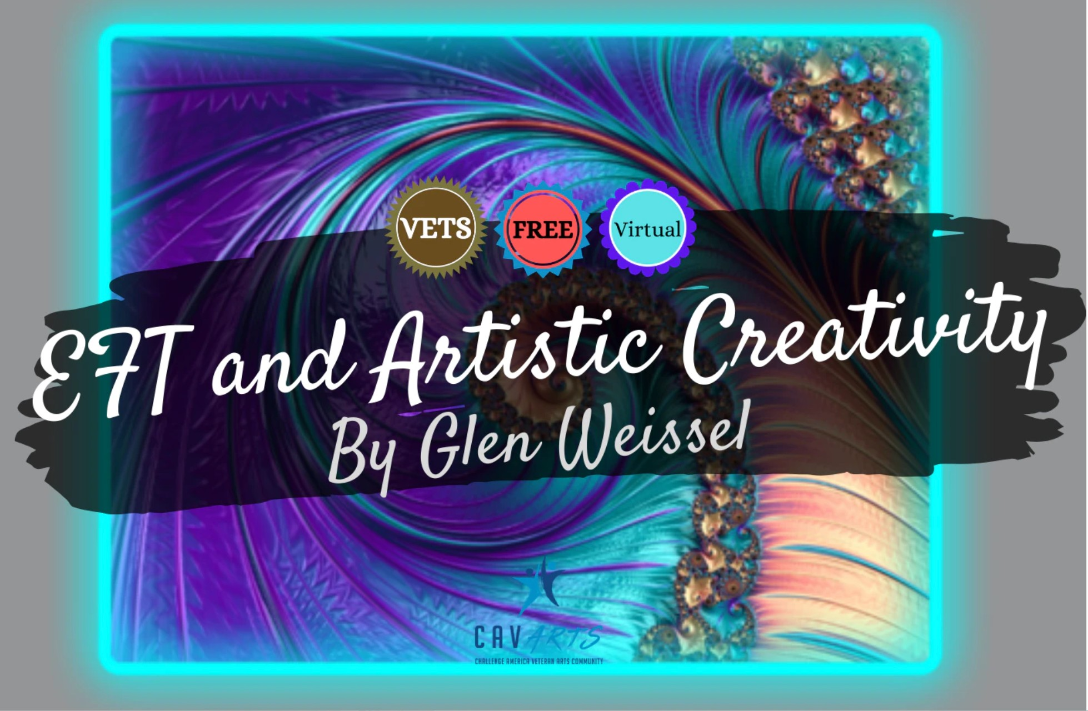
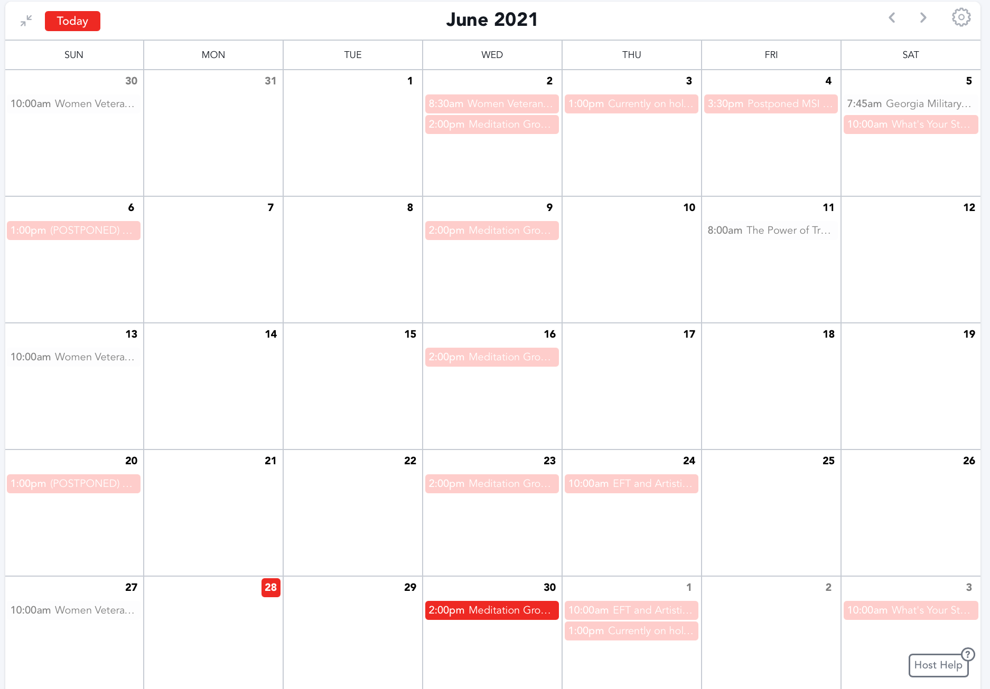
Events Calendar

Slide 6
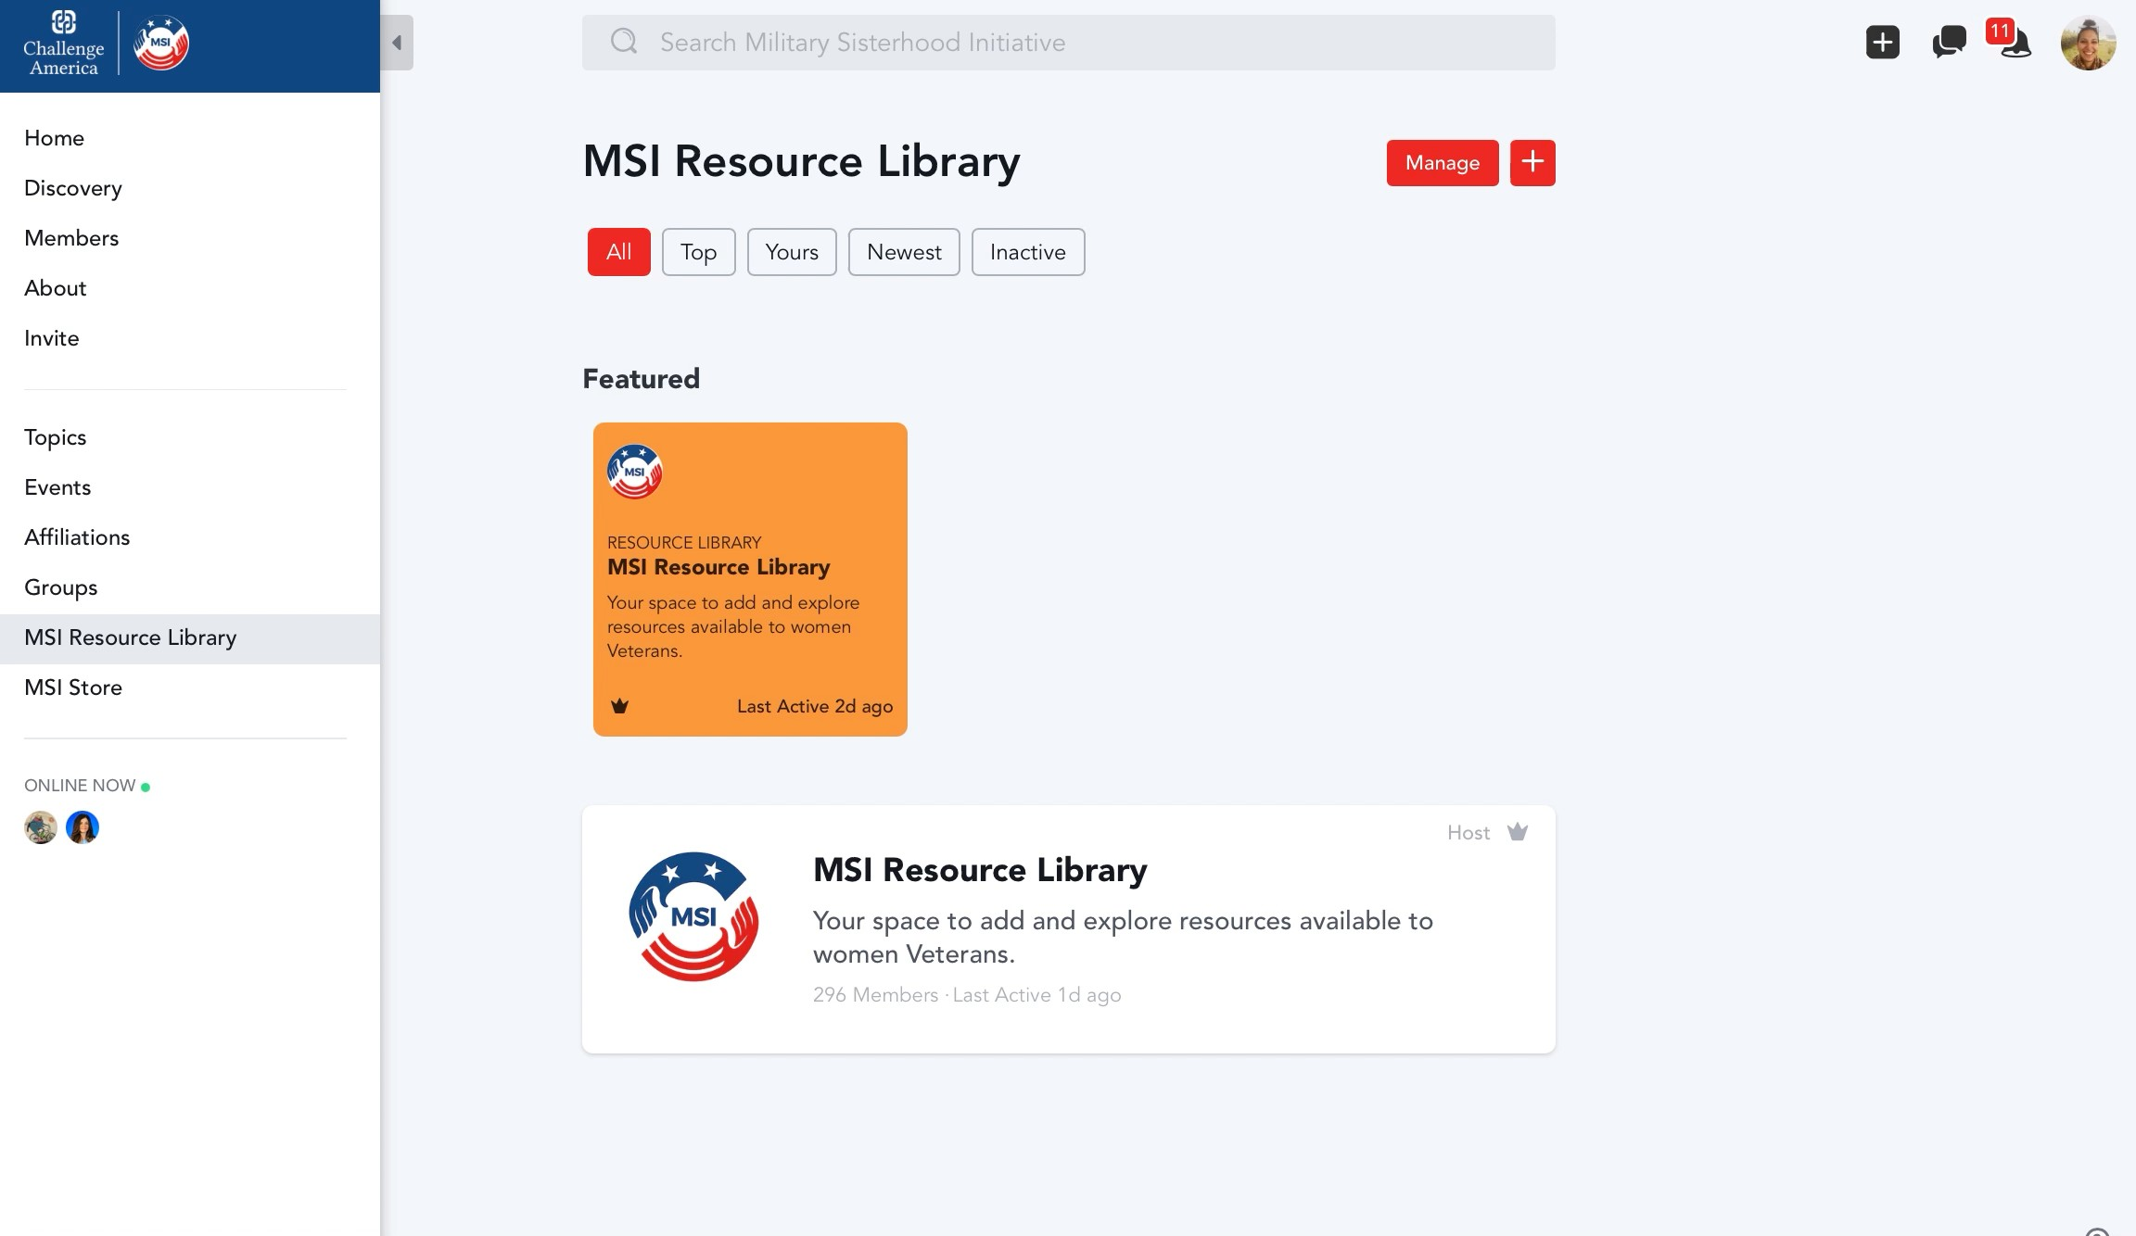
Resource Library

Slide 7
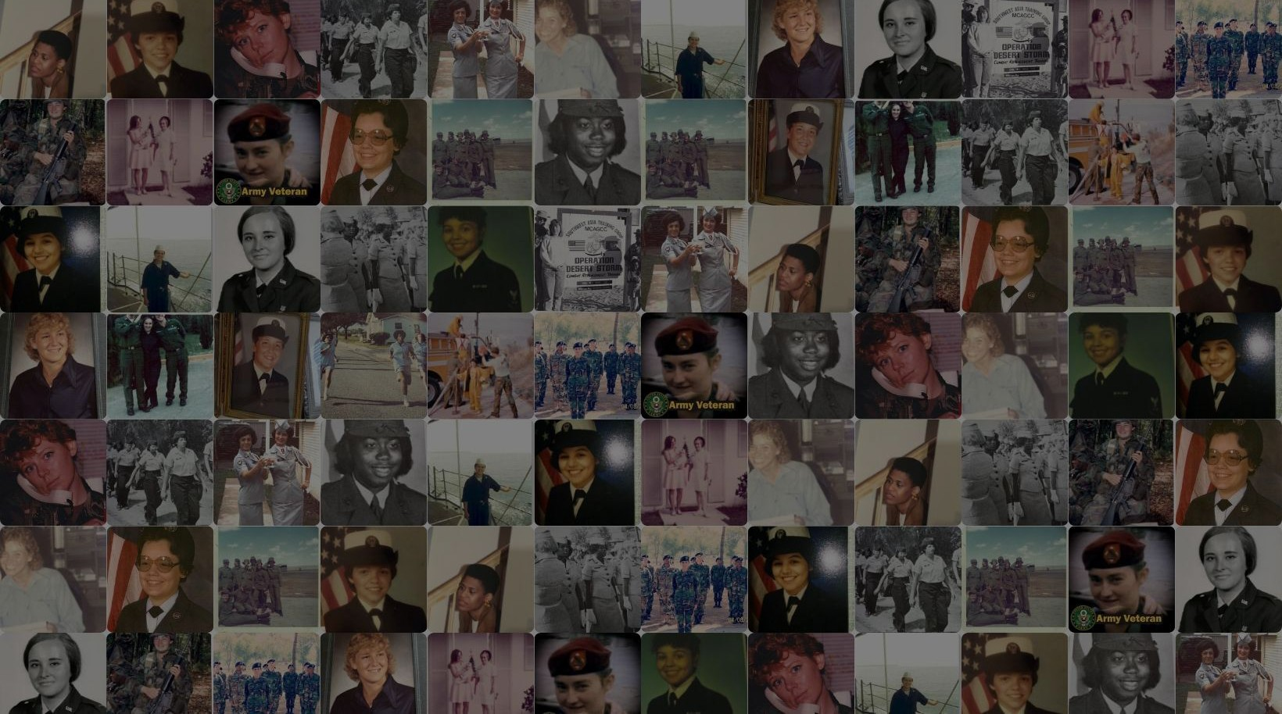
Thank you
ThankYou
Maggie Tolan
970-279-1661
Maggie@challengeamerica.com
www.challengeamerica.com

