Slide 1
MVAA’S SERVICE TO VETERANS
Director Zaneta Adams, J.D.

Slide 2
Michigan Veterans - Demographics
2
California
Texas
Florida
Pennsylvania
Ohio
North Carolina
Michigan’s veteran population is one of the largest in the United States, ranking 11th in 2019 with over 550,000 veterans
New York
Virginia
Georgia
Illinois
Michigan
Washington
Tennessee
Missouri
South Carolina
Source: U.S. Dept. of Veterans Affairs
Notes:
Presenter
2021-02-01 13:21:11
--------------------------------------------
Michigan is the only state depicted on this slide that does not have an active duty military installation.

Slide 3
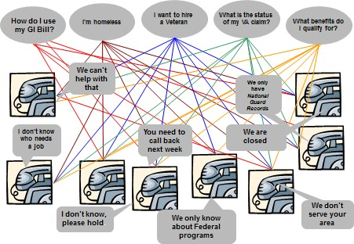
Challenge: Where do veterans turn for assistance?
3
Notes:
Presenter
2021-02-01 13:21:11
--------------------------------------------
No single federal or state definition of “veteran” covers all the types of military service nor the variety of benefits eligibility. State government has 14 different departments and agencies that do something for vets
Over 600 local community organizations that work for vets and several other philanthropic supporters

Slide 4
Solution: MVAA
6
Am I eligible for benefits?
Where is my DD- 214?
Where is my claim?
Federal
I can’t pay my bills!
State
We want to hire vets.
Local
How can I get a job with my skills?
How can I use my GI Bill®?
Notes:
Presenter
2021-02-01 13:21:11
--------------------------------------------
Most times, the challenge isn’t that a solution does not exist, it’s a matter of finding it and properly connecting the veteran and the service provider

Slide 5
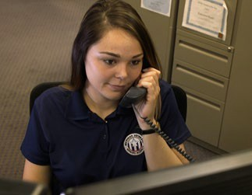
How Veterans Connect to Benefits
5
Michigan Veteran Resource Service Center
□ 800-MICH-VET (800-642-4838)
□ MichiganVeterans.com
24/7 access for veterans and their families
Notes:
Presenter
2021-02-01 13:21:11
--------------------------------------------
Michigan Veteran Resource Service Center 800-MICH-VET
24-7-365 Call Center
Over 93,000 cases completed since Sept. 2014
Resource Center offers the fastest turnaround for DD214 retrievals. Staffed by veterans, veteran family members & veteran resource experts Partnered with Michigan 211 (Nights, Weekends, Holidays)
Crisis-trained
Coordinates with VCATs, County Veteran Service Offices and C.O.R.E. members Interfaces with VSOs for Federal Benefits
Resource center maintains a Critical resources list for veterans from the Federal, State and Local levels.

Slide 6
COVID-19 – Protect Michigan Commission
6
The MVAA has been asked to lead a stakeholder group of veterans and organizations across Michigan to identify barriers and resources within the veteran community in response to the COVID-19 vaccination.
The group will disseminate accurate research and information to veteran stakeholders and provide feedback from these groups to the Governor and the Michigan Department of Health and Human Services.

Slide 7
MVAA’s “She Is A Veteran” Initiative
7
Women veterans make up nearly 10 percent of the veteran population in the United States and are the fastest growing veteran group at 2 million and rising.
In Michigan, there are about 47,717 women veterans.
These patriots face many challenges including:
High rate of homelessness, PTSD and suicide;
Military sexual trauma; and
Being overlooked as veterans

Slide 8
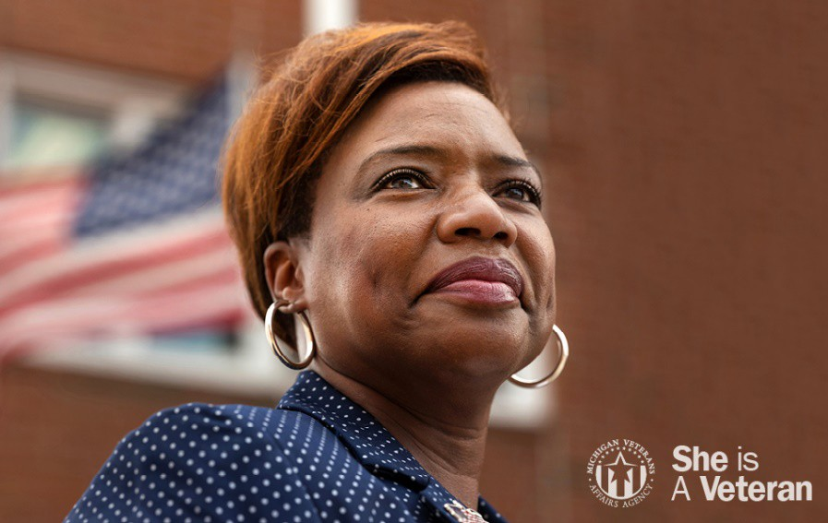
MVAA’s “She Is A Veteran” Initiative 2
8
The “She Is a Veteran” initiative is a three-year campaign that serves as the building blocks of an enduring statewide program to recognize women veterans for their service, help them tell their unique stories and ultimately connect them to the benefits and services they earned for serving their country.

Slide 9
MST Facility
9
The MVAA is actively advocating for support and legislation to obtain a MST facility for women in Michigan and surrounding states to attend. Women veterans make up at least 60% of MST claims (DAV), and have very few women- only facilities for inpatient care programs.
Michigan has 47,717 identified women veterans (14 in the nation for population of women veterans) yet has no women-only veterans’ facility in any of the surrounding states.
Providing female-only inpatient/residential programs for women who have served in the military and are survivors of MST, intimate partner violence (IPV), Post-Traumatic Stress Disorder (PTSD), childhood trauma, Substance Use Disorder (SUD), or associated experiences will ensure a shorter wait list for Michigan veterans, a closer place for women with children to get the help they need while also staying close to family and increase the amount of federal investment dollars spent in our state.
Sources
Veteran Population - National Center for Veterans Analysis and Statistics (va.gov)
https://www.dav.org/veterans/resources/military-sexual-trauma- mst/#:~:text=How%20common%20is%20MST%3F,MST%20to%20VA%20are%20men.

Slide 10
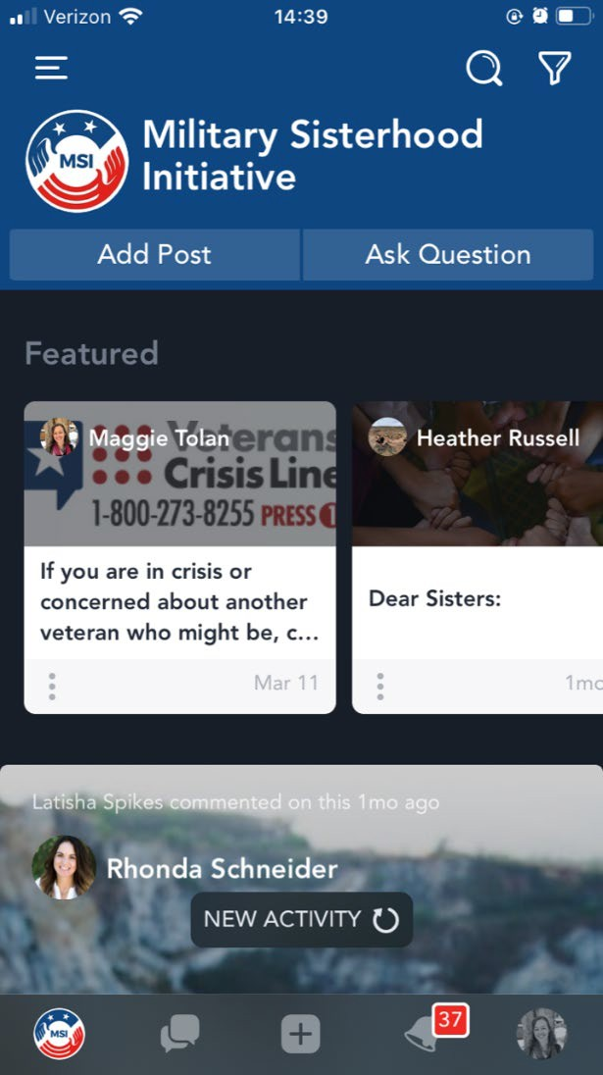
Military Sisterhood Initiative
10

Slide 11
Contact Info
1-800-MICH-VET (1-800-642-4838)
MichiganVeterans.com Facebook: /MIVeterans Twitter: @MIVeteran LinkedIn: /MIVeteran

