Slide 1
National Association of state women veteran coordinators
Laura McKee, Senior Advisor
April 7, 2021

Slide 2
About NASWVC
Non Profit
State Government
Training Conferences for members throughout the U.S.
Members- approx. 72% of states have a woman veteran coordinator

Slide 3
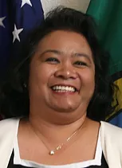
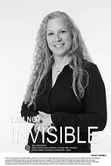
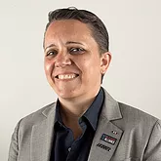
About NASWVC 1
Board of Directors
President Liza Narciso-WA
First Vice President Kelly McCartney-ID
Second Vice President Kristen Rouse-NY

Slide 4
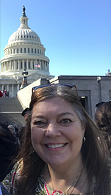
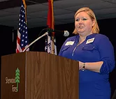
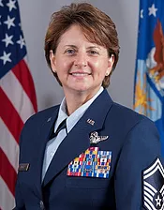
About NASWVC 2
2
Board of Directors
Secretary Pam Beale-AK
Treasurer Elesha Grannis-AR
Senior Advisor Laura McKee-IN

Slide 5
Mission & Vision
To advocate for women veterans through partnerships, training, and the exchange of information, identify barriers to successful transition of women veterans and military women to the civilian community, and recommend solutions through legislative, programmatic and outreach activities.
Women veterans receive equitable access to healthcare and services, are knowledgeable of the benefits earned through their military service and have an advocate to serve on their behalf.

Slide 6
NASWVC Pillars
Military Sexual Trauma (MST)
Homelessness
Suicide and Suicide Prevention
Access to VA Health Care

Slide 7
NASWVC Website
You can find your women veteran coordinator in your state at:
https://www.naswvc.org/state-coordinators
NASWVC website is:
https://www.naswvc.org/

