Slide 1


Intimate Partner Violence: A Research Overview and Implications for Care
Katherine (Kate) Iverson, PhD^{1,2} & Elizabeth (Becky) Yano, PhD, MSPH^{3,4,5}
¹Women’s Health Sciences Division of the National Center for PTSD at the VA Boston Healthcare System
²Department of Psychiatry, Boston University School of Medicine
³VA HSR&D Center for the Study of Healthcare Innovation, Implementation, & Policy
⁴VA HSR&D Women’s Health Research Network
⁵UCLA Schools of Public Health and Medicine

Slide 2

TODAY’S AGENDA
Scope of the problem of intimate partner violence (IPV) among women Veterans
  Prevalence, health effects, and health care utilization
  Patient and provider perspectives inform clinical practice
Clinical programming addressing IPV in VHA
  National VHA IPV Assistance Program
  Screening and Psychosocial Treatments
Ongoing research and evaluation
  Including work supporting VA response to the Deborah Sampson Act

Slide 3
Background on Women Veterans and Veterans Health Administration (VHA)

Slide 4


WOMEN VETERANS
There are 2,059,805 living women Veterans, with the population projected to surpass 2,156,000 by 2030
Women Veterans are fastest growing demographic of Veterans, currently accounting for 12% of the total Veteran population
Comprise 17% of current Active Duty enlisted members of the military
US Department of Veterans Affairs. VetPop2018 National Data. July 2022. https://www.data.va.gov/dataset/VetPop2018-National-Data2020 Demographics Profile of the Military Community (militaryonesource.mil)

Slide 5
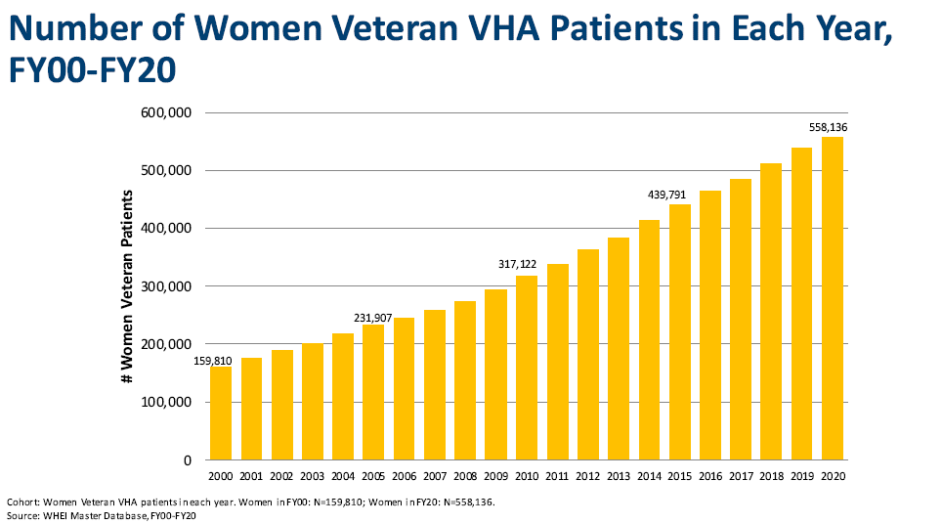
WOMEN VETERAN VHA PATIENT GROWTH
Over 880,000 women enrolled in VHA
Over 600,000 used VHA care in Fiscal Year 2022
  > 175% increase in women Veterans using VHA care in recent years
About 350,000 Veterans of child-bearing age using VHA
Notes:
Over 880,000 women enrolled in VHA, of whom over 600,000 used VHA healthcare in Fiscal Year 2022

Slide 6
IPV Prevalence and Risk Factors

Slide 7
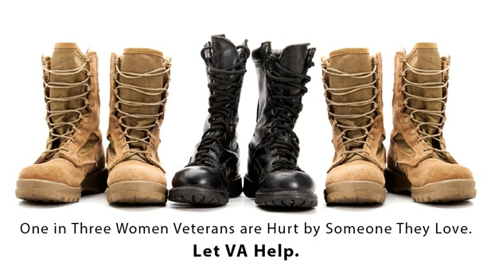
IPV IS COMMON AMONG WOMEN VETERANS
1.6 times more likely to experience IPV during their lifetime compared to women who never served in the military
Dichter, Cerulli, & Bossarte (2016). General Hospital Psychiatry.
Notes:
Here you see an analysis of population-based data collected by the CDC in which VA researchers demonstrated that women Veterans have particularly high rates of IPV during their lifetime.
As you see in this figure, a third of women veterans reported lifetime IPV compared to under a quarter of women who never served in the military.
Even when adjusting for other factors that can increase risk for IPV, such as age, Women veterans were 1.6 times more likely to experience IPV during their lifetime compared to non-Veteran women.
This study was important because it established IPV as a particular problem among the women veteran population. But, this study only included a couple of items assessing IPV and didn’t speak to the various types of IPV women experienced or to recency of IPV experiences.
[CDC telephone survey – 21k women in the analysis - Veteran status was measured by an affirmative response to the following question: “Have you ever served on active duty in the United States Armed Forces, either in the regular military or in a National Guard or military reserve unit?” Lifetime IPV was defined as having reported ever experiencing actual or threatened physical violence, or unwanted sex, from an intimate partner (defined as a current or former spouse, boyfriend, or girlfriend)

Slide 8
LIFETIME AND PAST-YEAR IPV
National sample of women Veterans (N = 411) who completed an anonymous web-based survey (75% participation rate)
55% Any Lifetime IPV:
30% Any Past-year IPV:
28% psychological violence
14% physical violence
11% sexual violence
Iverson, Wiltsey-Stirman, Street, Gerber, Carpenter, Dichter, Bair-Merritt & Vogt (2016). General Hospital Psychiatry.
Notes:
This led us to conduct an online survey a national sample of women Veterans – On the left, you see that 55% of the sample reported having experienced one or more types of IPV during their lifetime – note that this percentage is higher than what we saw on the prior slide and that is likely because this study included a wider array of IPV experiences--with psychological IPV being particularly prevalent – We also see 35% of women reported intimate partner stalking, nearly 30% sexual IPV and 21% physical IPV. -- these are higher than what we’d typically see in
On the right side of the slide you see the past-year IPV rates in this sample, with 30% reporting past-year IPV. You see that more than a quarter experienced past-year psychological IPV and more than 1 in 10 women experienced sexual violence by an intimate partner within the prior year.
The fact that psychological and sexual IPV was quite common is important because research has shown that these types of IPV are particularly damaging to women’s health…

Slide 9
WOMEN VETERAN VHA PATIENTS: PAST-YEAR PREVALENCE BY AGE
About 1 in 5 women VHA primary care patients experienced past-year IPV
Rates remain similarly high up through age 64 – importance of attending to IPV among women of all ages
Age (years)
Kimerling, Iverson, Dichter, Rodriguez, Wong, & Pavao (2016). Journal of General Internal Medicine
Notes:
So far we’ve been focusing on the general population of women Veterans, this histogram displays the prevalence of past-year IPV by age among nationally representative sample of more than 6,000 women veterans using VHA primary care.
Overall, nearly 1 in 5 women Veteran VA primary care patients experienced past-year IPV. [That is about 115,000 women seen within VA. ]
Not surprisingly, younger women had highest risk, with 25.5% of women 30 and younger experiencing past-year IPV. This proportion was similarly high for women up to age 55 years of age, at which point it drops down to about 16% and then drops down to only 5% for women 65+.
[The other thing I’ll note is that while the highest prevalence was seen among those less than 30, the age range of those that disclosed IPV was 21 to 79 years.]
These data complement and extend what we’ve been seeing in the prior research I’ve shared with you today.
[Note: Among IPV+ women: 45.2% endorsed multiple items; 79.7% endorsed psychological violence and 53.6% endorsed fear; In addition, 12.0% endorsed sexual violence and 26.6% endorsed physical violence]
4-item HARK screening tool assess past-year IPV: Psychological violence: Emotionally mistreated (e.g., called names, criticized, not allowed to see family or friends, put on an allowance); Fear: Afraid of partner or ex-partner; Sexual violence : Forced or threatened into having any kind of sexual activity; Physical violence: Kicked, hit, slapped, or otherwise physically hurt

Slide 10
Factors Associated with increased risk for IPV
FACTORS ASSOCIATED WITH INCREASED RISK FOR IPV AMONG WOMEN VETERANS
Younger age¹⁻⁴
Lesbian or bisexual orientation^{3,4}
Financial hardship³
Homelessness^{3,5}
Military sexual trauma^{2,3,6}
Childhood sexual abuse⁶
PTSD and depression symptoms^{7,8}
Low self-efficacy and personal empowerment^{8,9}
¹ Iverson, King, Resick, Gerber, Kimerling & Vogt (2013). J. of General Internal Medicine; ²Dichter, Haywood, Butler, Bellamy, & Iverson (2017). American J. of Preventative Medicine; ³Kimerling, Iverson, Dichter, Rodriguez, Wong, & Pavao (2016) J. of General Internal Medicine; ⁴ Dardis, Shipherd, & Iverson (2016) Women & Health; ⁵Iverson, Sayer, Meterko, Stolzmann, Suri, Gormley, Nealon Seibert, Yan, & Pogoda (2020). J. of Interpersonal Violence ⁶Iverson, Mercado, Carpenter, & Street (2013) J. of Traumatic Stress; ⁷Iverson, Rossi, Nillni, Fox, & Galovski (2022). International J. of Environmental Research and Public Health; ⁸Webermann, Dardis & Iverson (2022). J. of Traumatic Stress (2022); ⁹Dardis, Dichter, & Iverson (2018). Psychiatry Research.
Notes:
We also have a number of studies, including some of those I just discussed, that provided opportunities to identify factors that are associated with increased risk for IPV.
We know that younger women are at higher risk
A couple of studies suggest that identifying as lesbian or bisexual orientation is associated with higher likelihood of experiencing IPV - for example in that national sample of women Veteran VHA primary care patient- we observed that 25% of lesbian and bisexual women endorsed past-year IPV compared to18% of heterosexual women. [Tina Dardis study - In the past year, Lesbian and Bisexual-identified veterans were twice as likely to endorse emotional mistreatment and physical IPV, and three times more likely to endorse sexual IPV, than were heterosexual-identified women veterans.]
Research has also found indicators of financial hardship, such as lower rates of employment and lower income, as well as recent homelessness to be associated with IPV.
Several researchers have documented that military sexual trauma greatly increases risk – in fact there is about a 2.3-fold increased risk.
We’ve seen similar findings for childhood sexual abuse, such that it doubles the risk of experiencing past-year IPV among women Veterans.
We’ve also found that mental health symptoms, namely PTSD and depression symptoms, both contribute to risk for future IPV…In a survey study of women veterans we found that higher PTSD was associated with lower self-efficacy over time, which in turn increased risk for IPV experiences.
Bisexual Veterans are 2– 3 times more likely to experience past-year and lifetime IPV compared to heterosexual Veterans
Bisexual Veterans are 3-6 times more likely to experience lifetime IPV than gay/ lesbian Veterans

Slide 11
IPV AND VETERANS
VETERAN-CENTRIC FACTORS:
Post-Traumatic Stress
Military Family Life Stress
Separation & Isolation
Mental Health Concerns
Alcohol and/or Drug Use
Loss of Trust/Moral Distress
Traumatic Brain Injury
Increased Anger
Decreased Frustration Tolerance

Slide 12
IPV Health and Social Impacts

Slide 13
VETERAN HEALTH OUTCOMES FROM IPV EXPERIENCE
Injury and physical impairment^{1,2}
Chronic injury and pain^{3,4}
Mental health and substance use disorders^{5,6}
Reproductive health problems⁷
Work impairment and housing instability^{2,8,9}
Suicidal ideation and behavior^{10,11}
IPV use¹²
¹Iverson & Pogoda (2015). Medical Care; ²Iverson, Vogt, Maskin et al., (2017). Medical Care; ³Dichter, True, Marcus et al., (2013). Military Behavioral Health; ⁴Mahoney, C. T., Shayani, D. R., & Iverson, K. M. (2022). Longing for sleep after violence: The impact of PTSD symptoms, avoidance, and pain on insomnia among female veterans. Psychiatry Research, 313, 114641; ⁵Dichter, Sorrentino, Bellamy et al., (2017). J. Traumatic Stress; ⁶Kim, Currao, Fonda et al., (2022). J. Aggression, Maltreatment & Trauma; ⁷Rosenfeld, Miller, Zhao et al., (2018). American J. Obstetrics and Gynecology; ⁸Maskin, Iverson, Vogt et al., (2019). Psychological Trauma; ⁹Montgomery, Cusak, Sorrentino et al., (2018). American J. of Preventive Medicine; ¹⁰Cerulli, Stephens & Bossarte (2014). American J. Men’s Health; ¹¹Brignone, Sorrentino, Roberts et al., (2018). General Hospital Psychiatry; ¹²Portnoy, Relyea, Street et al., (2020). Journal of Family Violence.
Notes:
We have VA-funded research linking IPV experiences to each of the health domains on this slide. I’m just going to highlight a few of these on these area on the next few slides.

Slide 14
MENTAL HEALTH CONDITIONS, PAST-YEAR IPV AMONG WOMEN VETERANS
Percentages of Mental Health Diagnoses by Past-Year IPV Status (N=8,888 women VHA patients)
IPV is not a mental health diagnosis; but IPV does impact mental health
Dichter, Sorrentino, Bellamy, Medvedeva, Roberts, & Iverson (2017). Journal of Traumatic Stress.
Notes:
Here you see data from a study led my Dr. Melissa Dichter where we used VHA medical records to compare women who screened positive for past-year IPV in the context of routine clinical care to those who screened negative for IPV on mental health diagnoses in the six months following the IPV screening.
Here we see that
Over half of those with past-year IPV have any mental health disorder, compared with less than one-third of those screening negative for past-year IPV
More than ¼ (28.7%) of those with past-year IPV have two or more MH dx following IPV screening
More than 1/3 of those with past-year IPV have a depression dx and nearly 1/3 have a PTSD diagnosis in the six months following IPV screening.
So, we always need to be mindful that IPV is not a mental health disorder, it is an experience. But IPV does strongly contribute to women Veterans’ mental health.

Slide 15
SCREENING IPV+ IS ALSO ASSOCIATED WITH…
Services intersection – consider IPV and IPV-related needs
¹Montgomery, Sorrentino, Cusack, Bellamy, Medvedeva, Roberts, & Dichter (2018) American Journal of Preventative Medicine; ²Brignone Sorrentino, Roberts, & Dichter (2018) General Hospital Pyshiatry; ³Dichter, Sorrentino, Haywood, Bellamy, Medvedeva, Roberts, & Iverson (2018). JGIM
Notes:
From this same data source, Dr. Dichter and her colleagues also demonstrated the associations between past-year IPV and intersecting issues of housing instability, suicidal ideation, and VHA Emergency Department utilization.
These data also remind us when thinking about services for housing instability and suicide prevention, it is important to consider IPV and IPV-related health needs.

Slide 16
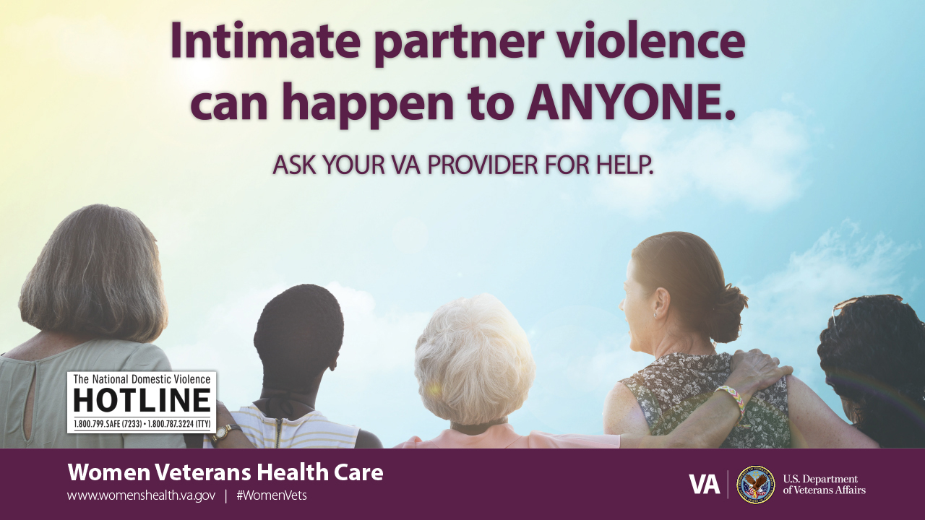
IPV AND HEALTH SERVICES USE
Women who experience IPV use a higher volume of VHA care across a range of services, for example:
  Primary care^{1,2}
  Emergency room care² (both for medical problems and mental health care for women with severe physical IPV)³
  Mental health visits²⁻⁴
Opportunities for IPV inquiry and intervention
¹Kimerling, Iverson, Dichter, Rodriguez, Wong & Pavao (2016). JGIM; ²Dichter, Sorrentino, Haywood, Bellamy, Medvedeva, Roberts, & Iverson (2018). JGIM; ³Iverson & Pogoda (2015) Medical Care. ¹Creech, Pulverman, Kroll-Desrosiers, Kinney, Dichter, & Mattocks (2021). JGIM.
Notes:
And to drive this point home even more, we have several different VA studies that have shown that women VHA patients who experience IPV use a higher volume of VHA care across a range of services, including primary care, emergency care, and mental health care.
Thus, within VHA, we have lots of opportunities for IPV inquiry and intervention services

Slide 17
PATIENT AND PROVIDER PERSPECTIVES ON IPV SCREENING IN VA
Asking in a sensitive way for patient to feel comfortable to disclose
Need for concrete information and resources for patients & providers
Asking repeatedly is important—it takes time for patient to feel ready to disclose
Patients and providers need and want an in-house specialist as a resource
Individually tailored and flexible counseling
Empowerment-focused and trauma-informed counseling
Dichter, Wagner, Goldberg & Iverson (2015). Women’s Health Issues.
Grillo, Danitz, Dichter et al. (2021). J. of Interpersonal Violence.
Iverson, Huang, Wells, Wright, Gerber & Wiltsey-Stirman (2014). Research in Nursing & Health.
Iverson, Wiltsey-Stirman, Street, Gerber, Carpenter, Dichter, Bair-Merritt & Vogt (2016). General Hospital Psychiatry.
Dichter, Makaroun, Tuepker, True, Montgomery and Iverson (2020). J. of General Internal Medicine.
Dichter, Ogden, Tuepker, Iverson & True (2021). J. of Women’s Health.
Notes:
Several studies have elucidated women Veteran and VA provider perspectives on IPV screening and counseling preferences.
We know that it is important to ask about IPV repeatedly over time and in a sensitive way and that we should offer concrete information and resources and options.
Women Veterans and providers want, and benefit from, an in-house specialist – aka the IPV Assistance Program Coordinators that Tara will discuss.
And we also know that information and resources is not always enough – women Veterans would like the option of having individually tailored counseling that is empowerment and trauma-focused.

Slide 18
IPV-related Clinical Programming at VA

Slide 19


NATIONAL VHA IPV ASSISTANCE PROGRAM (IPVAP)
  Mission: To implement a comprehensive person-centered, recovery-oriented assistance program for Veterans, their families and caregivers and VHA employees who use or experience IPV
  IPV Assistance Program Coordinators at all VA Medical Centers
  Spectrum of holistic services and efforts
  One critical focus - developing and implementing a trauma-informed screening protocol
    Screen all women at least annually
    Provide support and education (regardless of disclosure)
    Focus on safety/assess for risk
    Offer referrals for psychosocial services
    Shared decision-making regarding documentation
VHA Directive 1198

Slide 20
The relationship health and safety screen
In the past 12 months, how often did a current or former intimate partner (e.g., boyfriend, girlfriend, husband, wife, sexual partner):
 | Never | Rarely | Sometimes | Often | Frequently
Scream or curse at you
Insult or talk down to you
Threaten you with harm
Physically hurt you
Force you to have sexual contact against your will (or when you were unable to say no)*
HITS: Copyright, Dr. Kevin Sherin (1996) Used with permission (1⁻4 questions).
*IPVAP added additional sexual abuse screening item

Slide 21
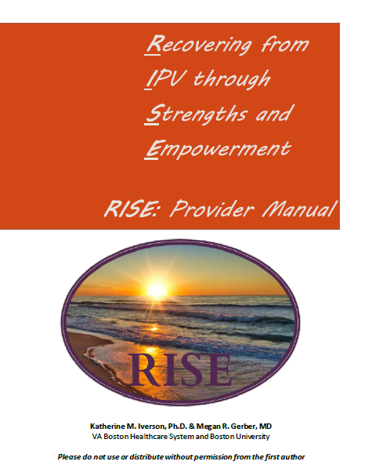
Recovering from IPV through strengths and empowerment
Recovering from IPV through Strengths and Empowerment (RISE)
RISE focuses on enhancing self-efficacy and empowerment while addressing individual needs and valued-driven goal setting
Trauma Informed
  Non-judgmental stance and empowerment-focused
  Sensitive to veterans trauma history and ongoing abuse
Individualized and Veteran-centered
  Recognition there is no “one-size fits all” protocol or intervention for IPV
  Developed specifically in VA for treating women veterans
  Collaborative, motivational, and non-confrontational

Slide 22
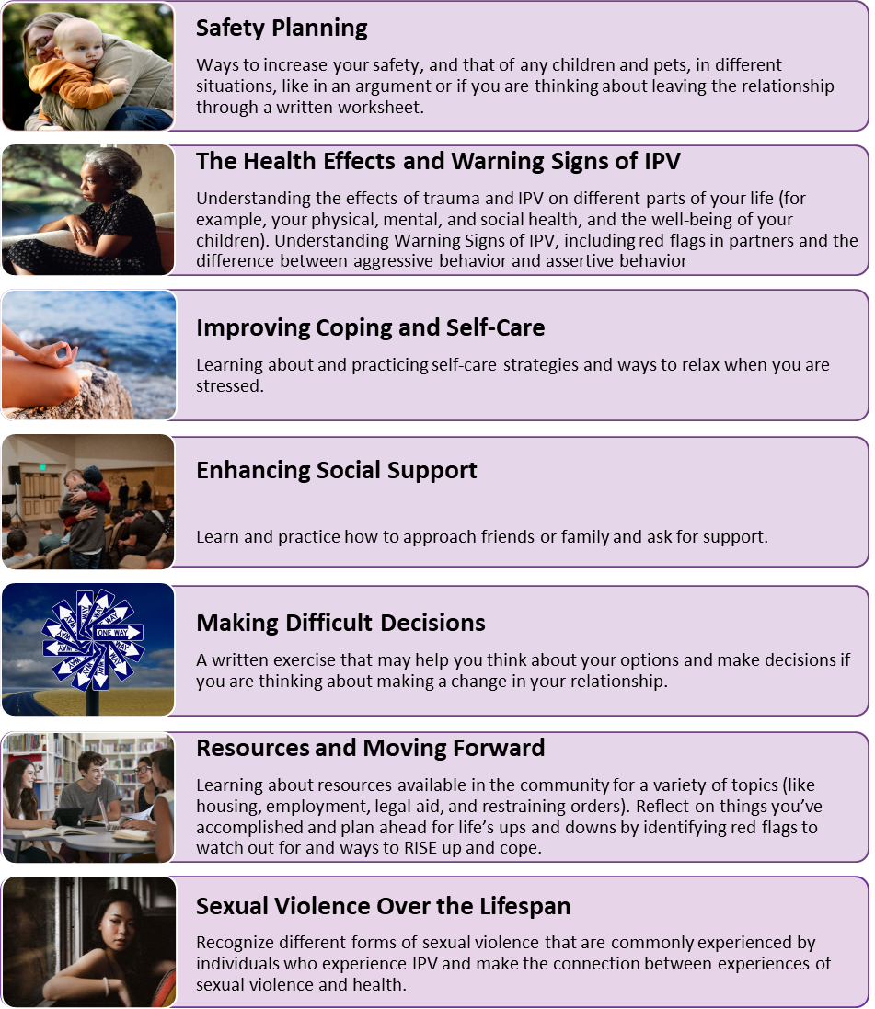
Recovering from IPV through strengths and empowerment 2
Recovering from IPV through Strengths and Empowerment (RISE)
Designed to the variable length, using a modular format
  1-8 sessions based on patient’s preferences and needs
  Literally giving the client control
    Veteran chooses module each week
Effective for improving women’s psychosocial health
  Increases self-efficacy and personal empowerment
  Decreases psychological distress (e.g., depression)
Iverson, Danitz, et al. (2022). Psychological Services.
Iverson, Dantiz et al. (2022). J. of Clinical Psychiatry.
Iverson, Dantiz et al. (2022). International J. of Environmental Research and Public Health

Slide 23
IPV USE INTERVENTION
Evidence-based, Trauma-informed, group treatment
For Veterans who use violence and aggression in intimate relationships
12-week therapeutic group intervention with follow-up
Use of Motivational Interviewing to enhance change process
Veterans Groups
Couples Strength at Home Groups
Taft, Macdonald, Creech, Monson, & Murphy. (2016). J. Clinical Psychiatry.

Slide 24
Ongoing Research & Evaluation
(including Deborah Sampson Act)

Slide 25
VA has a Robust Women’s Health Research Program
VA launched 1st VA women’s health research agenda nearly 20 years ago
Funded VA Women’s Health Research Network to help build capacity
Progress on a wide array of women Veterans’ research has followed
  Have increased size and diversity of women Veterans’ research portfolio
  Have increased knowledge of health and health care needs and interventions to improve quality, experience, and outcomes
  Have enhanced dissemination and partnerships to use research to inform evidence-based practice and policy
Partnered with Center for Women Veterans on Deborah Sampson Act’s mandated research on Veteran-related intimate partner violence (IPV)

Slide 26
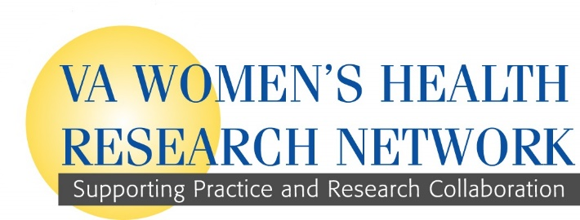
VA Women’s Health Research Network (WHRN)
(2010-present)
Women’s Health Research Consortium
Women’s Health Practice Based Research Network
Training/mentorship
↑ research development
↑ dissemination
↑ recruitment of women
↑ multisite research
Engage local clinicians, leaders
Multilevel Stakeholder Engagement
Accelerate implementation of research into practice and policy
Plus Women Veterans’ Improvement Network (WIN)

Slide 27
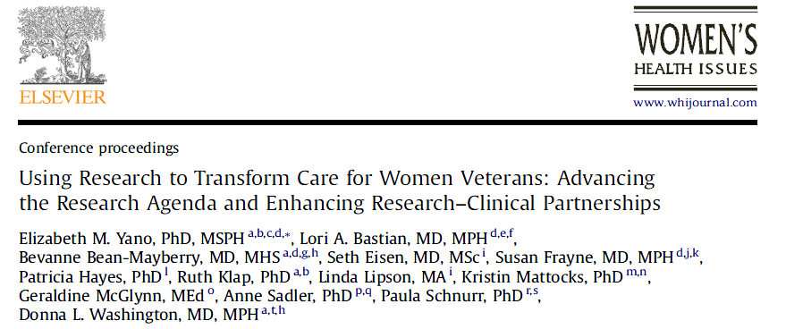
VA Women’s Health Research Agenda
CommunityCare
Cardiovascular risk reduction
Military sexual trauma
Harassment
Alcohol/ drug use
Access/rural health
Primary care/prevention
Mental health
Post-deployment health
Reproductive health
Complex chronic conditions/
long term care and aging
LGBTQ+
Intimate partner violence
Suicide
Perinatal mental health
Menopause

Slide 28
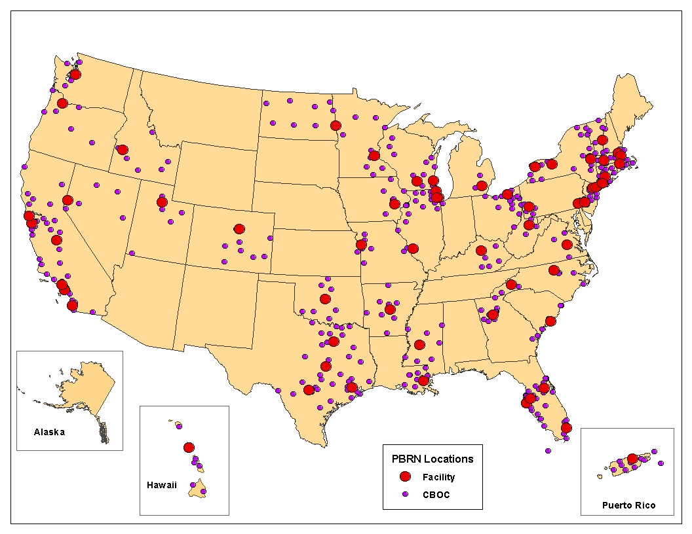
VA Women’s Health Practice Based Research Network
From 4 to 76 VAMCs
and >300 CBOCs
  Increase inclusion of women Veterans in VA research
  Facilitate women Veterans’ focused research
  Include the voices of frontline staff and women Veterans
Over 90
studies

Slide 29
Deborah Sampson Act (Section 5305)
Section 5305. Study and Task Force on Veterans Experiencing Intimate Partner Violence or Sexual Assault
  “…shall include a literature review of all relevant research on intimate partner violence and sexual assault among veterans and spouses and intimate partners of veterans…”
Resulting systematic review online
  Considerable variation in methods
  Psychological/emotional IPV most common form of experienced and perpetrated IPV followed by physical and sexual IPV/sexual assault
  Gaps in knowledge of IPV prevalence in subgroups (e.g., minority Veterans)
https://www.ncbi.nlm.nih.gov/books/NBK576986/
Source: Parr NJ, Young S, Ward R, Mackey K. Evidence Brief: Prevalence of intimate partner violence/sexual assault among Veterans. Washington DC: Department of Veterans Affairs (US): 2021 December. Integrated into Congressionally Mandated Report (March 2023).

Slide 30
Deborah Sampson Act (Section 5305) 1
Section 5305. Study and Task Force on Veterans Experiencing Intimate Partner Violence or Sexual Assault (continued)
  “…examine the prevalence of the experience of intimate partner violence among women veterans, veterans who are minority group members…, urban and rural veterans,…”
Veteran-related IPV prevalence study (secondary analyses) (Portnoy et al)
  Identified 90 data sources, 23 eligible, included 18 total → 25 datasets for analysis of IPV experience and use
  Prevalence rates of past year IPV among Veterans varied widely (27-45%)
  Limited data on IPV perpetration (use), IPV experience among minority groups (e.g., BIPOC Veterans, LGBTQ+ Veterans, Veterans with disability), bidirectional IPV (both partners engaging in and experiencing IPV), requiring more research
Source: Portnoy GA, et al. Prevalence of intimate partner violence (IPV) among Veterans: A secondary analysis study. [Unpublished report.] US Department of Veterans Affairs (2022) Integrated into Congressionally Mandated Report (March 2023).

Slide 31
Deborah Sampson Act (Section 5305) 2
Used expert panel methods to synthesize results from required literature review and prevalence study
  Included community representatives, decision-makers, health services providers, and researchers
  Reviewed prevalence, risk factors, consequences, and interventions in 2 days of virtual meetings to come to consensus on recommendations (July 2022)
    Example: Interventions on IPV use rated as most impactful (prevent IPV in 1st place)
    Example: Screening skills, training, and education needed for all healthcare staff (establish a “no wrong door” policy for Veterans seeking help related to IPV)
    Example: Expand research informing what works for whom and when
  Practice, policy, and research recommendations provide a roadmap and additional resource for Task Force that will be overseen by the Center for Women Veterans

Slide 32
Summary and Next Steps
VA has a national consortium of researchers dedicated to women Veterans’ health and health care
  Many are clinicians, know the system and the patients they serve
  Ongoing collaborations and partnerships with VA leaders, frontline providers, and women Veterans
Intimate partner violence (IPV) is a priority research area
  Growing area of research with increased focus on interventions and implementation of research evidence into practice and policy
  Research “snapshots” on topics like IPV now available online:
  https://www.research.va.gov/programs/womens_health/default.cfm

