Slide 1


Overview of LGBTQ+ Health
Jillian C. Shipherd, PhD
(she/her/hers)
Deputy Director, LGBTQ+ Health Program
Office of Patient Care Services, Veterans Health Administration
Presentation for VA Center For Women Veterans
National Partners and Stakeholders Meeting
June 7, 2023

Slide 2
What LGBTQ+ Means
LGBTQ+ = Lesbian, Gay, Bisexual, Transgender, and Queer identities.
The ‘+’ sign captures identities beyond LGBTQ; e.g., two-spirit, pansexual, nonbinary identities. Inclusive of people who are questioning.
Acronym for diverse groups of people with minoritized sexual and gender identities, with similar experiences of social stigma, victimization, and discrimination.
7.2% of American adults (~24M) identify as LGBTQ+.
Percentage is rising, mostly among younger people.
Bisexual is most common identity (58%), especially in women.
US Gallup Poll, 2023
Notes:
Let’s begin with the definition of LGBTQ+. This acronym stands for Lesbian, Gay, Bisexual, Transgender, and Queer identities. The ‘+’ sign captures identities beyond LGBTQ; e.g., two-spirit, pansexual, asexual, nonbinary identities. We also know that language is dynamic and constantly changing, so the plus also represents future terminology used within this community and Inclusive of people who are questioning of there sexual orientation or gender identity. LGBTQ+ represents a very diverse group of people with minoritized sexual and gender identities, who have similar experiences of social stigma, victimization, and discrimination.
What does this mean for LGBTQ+ People? Gender identity and sexual orientation identity are social determinants of health, like sex assigned at birth, age, race/ethnicity, education, and socioeconomic status minoritized people often experience poorer health outcomes.
LGBTQ+ people are at greater risk of:
Mental health conditions, Eating disorders
Alcohol, substance and tobacco use
And Increased prevalence of PTSD, MST, IPV
Subgroups are also at greater risk for certain conditions, diseases, and infections:
In a recent Gallup pole, 7.1% of American adults (23.6M) identify as LGBTQ+. Percentage is rising, mostly among younger people, with Bisexual as most common identity (57%), especially in women. If the Veterans using VA have a similar demographic, then of the 5 million Veterans currently using VA Healthcare 350K could identify as lgbtq+.
US Gallup Poll, 2022

Slide 3



VHA LGBTQ+ Health Program
  Mission
  To facilitate field-based policy recommendations, establish metrics, and develop clinical education to support personalized, pro-active, patient-driven healthcare for LGBTQ+ Veterans.
  Vision
  LGBTQ+ Veterans will choose VA and receive affirming care and services to achieve optimal health and well-being.
Policies and Programming
VHA Directives 1340 and 1341
Transgender and gender diverse provider-to-provider E-Consultation
Gender Affirming Program for Speech (GAPS) vocal coaching services via telehealth
VHA LGBTQ+ Veteran Care Coordinator Program
Education and resources
  SharePoint (internal to VA): VA LGBTQ+ Resources - Home (SharePoint.com)
  Public website: http://www.patientcare.va.gov/LGBT
  Contact us by email: VHALGBTQ+Health@va.gov
Notes:
The LGBTQ+ Health Program was established in VHA in 2012, following the repeal of Don’t Ask Don’t Tell- an era of DOD policy in which LGBQ Service members were required to keep silent about their sexual orientation under penalty of discharge and yet, 14,000 were discharged due to homosexuality. Transgender people were still barred from military service during this time. This History of discrimination explains concerns of LGBTQ+ Veterans in trusting VA and disclosing identities to healthcare providers. VA wants to ensure LGBTQ+ Veteran know they are welcome at VA and will receive personalized, patient centered care to meet their unique health care needs.
OUR program’s mission is to facilitate policies, establish metrics, and develop clinical education to support this goal and to create a VA that ALL LGBTQ Veterans will choose to receive affirming care and achieve optimal health and well-being. Policies and Programming
Our program manages 2 VHA Directives- 1340 and 1341
a Transgender and Gender Diverse Provider to Provider E-Consult Services
and a Gender Affirming Program for Speech (GAPS) Vocal Coaching Services
The VHA LGBTQ+ Veteran Care Coordinator Program
and educational material and Resources

Slide 4
National VHA Policies
National VHA Policies: LGBTQ+ Care
VHA Directive 1340: Provision of Health Care for Veterans Who Identify as Lesbian, Gay, Bisexual and Queer
  VHA employees will create an affirming environment for LGBQ+ Veterans.
  Inclusive definition of family.
  Access to a LGBTQ+ Veteran Care Coordinator.
  Inputting the Veteran’s sexual orientation in the health record.
  Annual sexual health assessment of all Veterans.
  Attempts to change sexual orientation (formal or informal) are harmful to health.
  VHA employees must create an affirming environment.
VHA Directive 1341: Providing Health Care for Transgender and Intersex Veterans
  VHA employees will create a welcoming environment for transgender and intersex Veterans.
  Access to a LGBTQ+ Veteran Care Coordinator.
  Veterans are treated based upon gender identity (with data entry driven by patient preferences):
    Room assignment and restroom use
    Hormone therapy
    Fertility evaluations (gamete storage up to 5 years)
    Mental health care
    Voice and communication coaching
    Gender affirming prosthetics
    Pre-operative evaluations and treatments including hair removal
    Medically necessary post-operative and long-term care following gender confirming/affirming surgery
    VA does not provide or fund gender affirming surgeries.* (next slide)
4
Notes:
VHA Directive 1340: Provision of Health Care for Veterans Who Identify as Lesbian, Gay, Bisexual, or Queer: https://www.va.gov/vhapublications/ViewPublication.asp?pub_ID=5438
Inclusive definition of family.
Access to a LGBTQ+ Veteran Care Coordinator.
Provides guidance on Inputting the Veteran’s sexual orientation in the health record.
Recommends Annual sexual health assessment of all Veterans.
Lets providers know Attempts to change sexual orientation (formal or informal) are harmful to health.
VHA employees must create an affirming environment.
VHA Directive 1341(2): Providing Health Care for Transgender and Intersex Veterans: https://www.va.gov/vhapublications/ViewPublication.asp?pub_ID=6431
All VHA employees will create an affirming environment for transgender and intersex Veterans. Use of Veteran’s preferred name and pronoun is required.
Room assignment and restroom use is determined by gender identity and not sex and birth and discusses available care such as
gender affirming Hormone therapy
Fertility evaluations
Mental health care
Vocal coaching
Gender affirming prosthetics
Pre-operative evaluations and treatments including hair removal
Medically necessary post-operative and long-term care following gender confirming/affirming surgery
VA does not provide or fund gender affirming/confirming surgeries.*

Slide 5
Transgender Care Policy at VA
Per the VA Secretary, VA has begun a rule change process to allow surgical procedures.
  Removal of the “gender alteration” exclusion to align with current Administration priorities, best medical practice, research, health insurers, DoD and professional health organizations.
  VA is not able to provide or pay for gender affirming surgical procedures until the final rule is published.
  The entire rulemaking process may take years and includes a period of public comment.
  This will allow VA to develop the framework to provide the full continuum of care in a way that is consistent with VA’s rigorous standards for quality health care.
Currently, VA provides or pays for corrective procedures after gender-affirming surgeries obtained by a Veteran outside VA, hormone therapy, and other gender-affirming care.

Slide 6
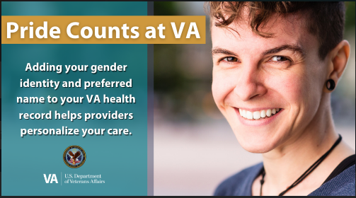

Gender Identity, Sexual Orientation, Sexual Health
Sexual orientation identity and gender identity are social determinants of health and should be discussed during a health care visit. Every Veteran should receive a sexual health assessment.
6

Slide 7
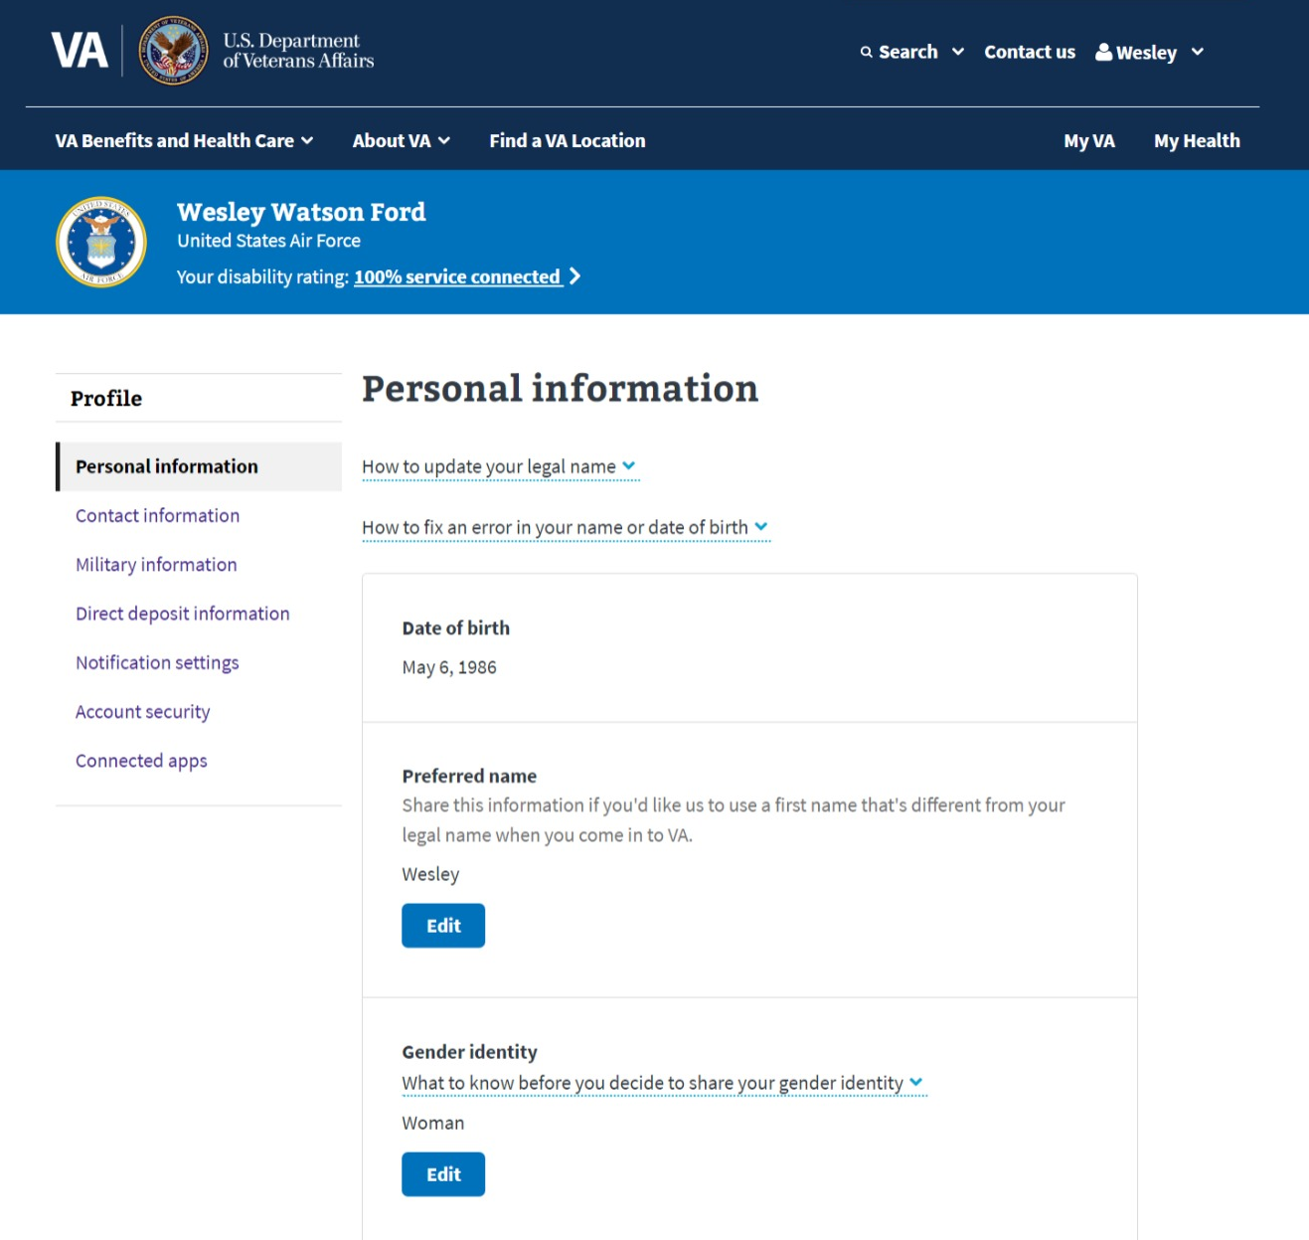
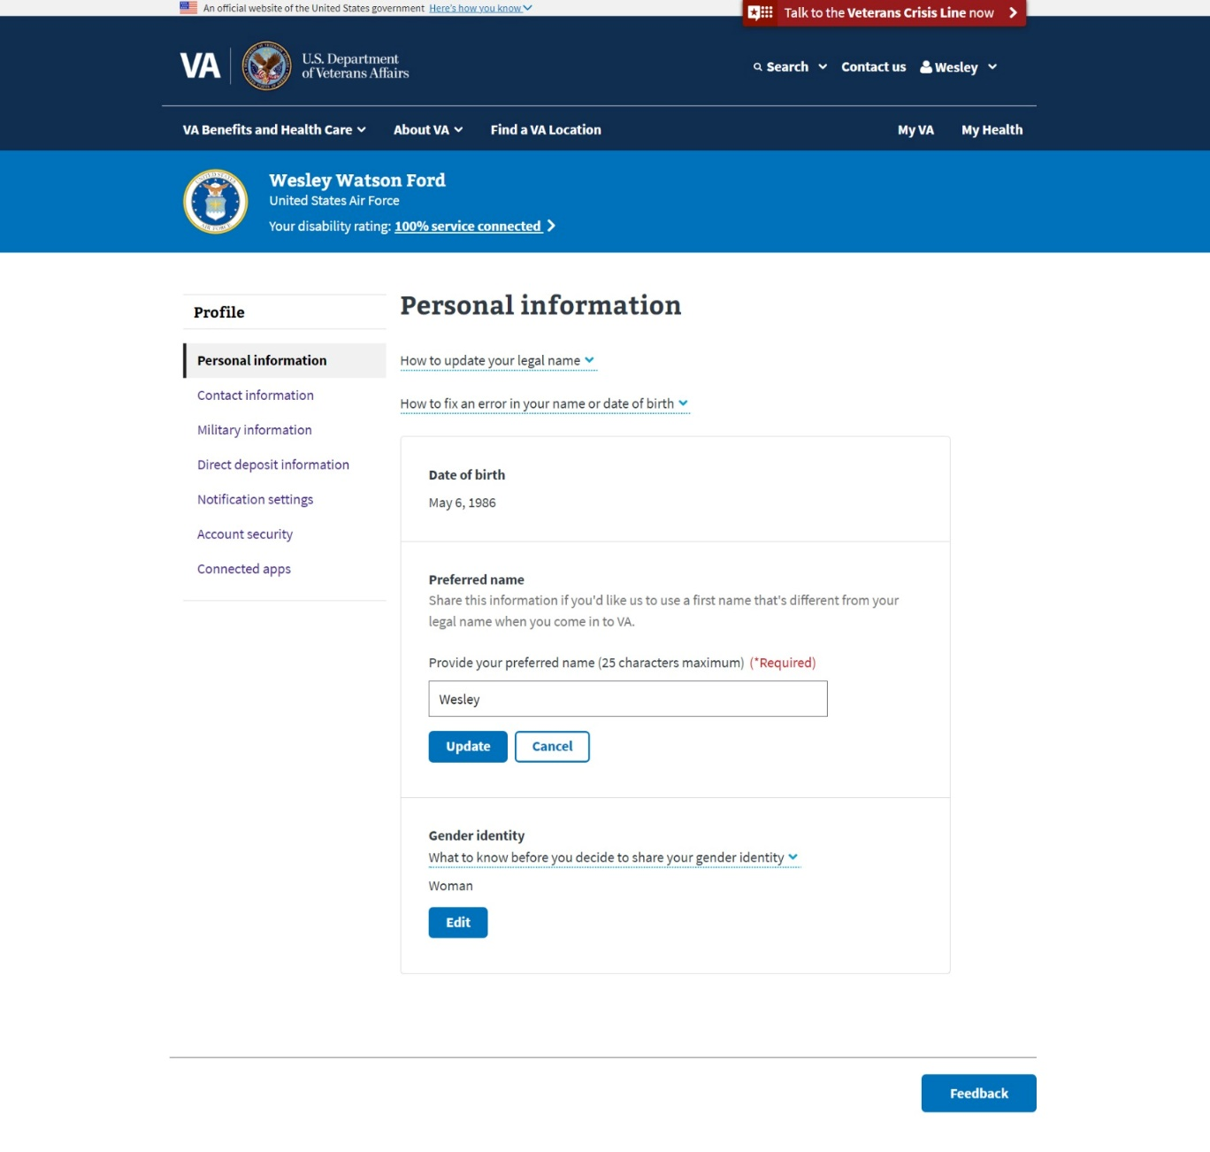
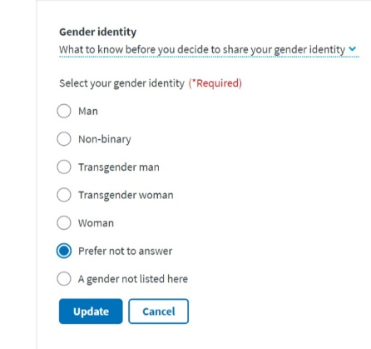

www.va.gov
www.va.gov
7
Notes:
All fake data

Slide 8
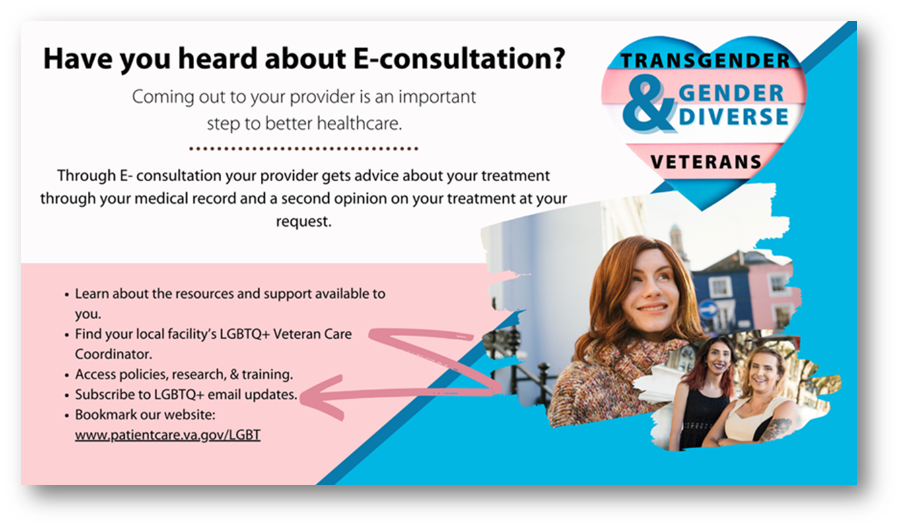
Transgender and gender diverse eConsult
Transgender & Gender Diverse eConsult
Notes:
The LGBTQ+ Health Program manages an interfacility consult (IFC) for transgender and gender diverse Veteran care to support clinical services and increase access to high-quality care for Veterans and promote clinical competence for providers. With the Veteran’s consent, this interfacility e-consult enables clinical providers (any discipline) to receive non-urgent consultation from an interdisciplinary team of experts on transgender and gender diverse care for Veterans related to any aspect of treatment planning. Topics can include but are not limited to (1) Mental Health Assessment and Hormone Readiness; (2) Psychotherapy; (3) Primary Care; and (4) Prescribing Medications. The e-consult is provider-to-provider consultation and does not provide direct patient care.
The GAPS program was established in 2021 through to standardize a treatment program utilizing virtual care options to expand access to high quality voice and communication treatment for rural transgender Veterans. GAPS aims to narrow the gap in access to care by having VHA speech pathologists experienced in both voice evaluation and treatment and telehealth technologies deliver services to the Veteran’s home. Services can be accessed through interfacility consultation from any VHA provider. This program does provide direct patient care.

Slide 9
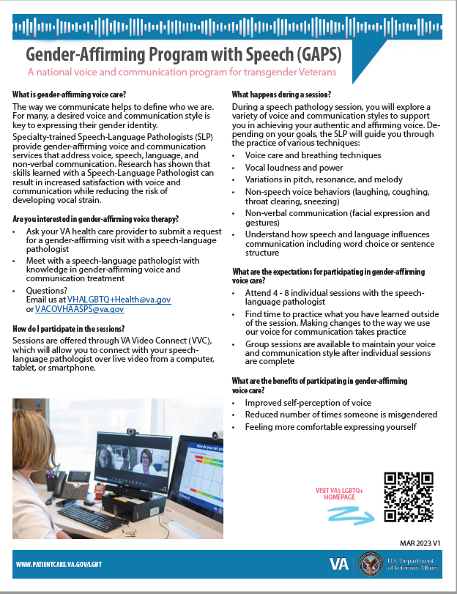
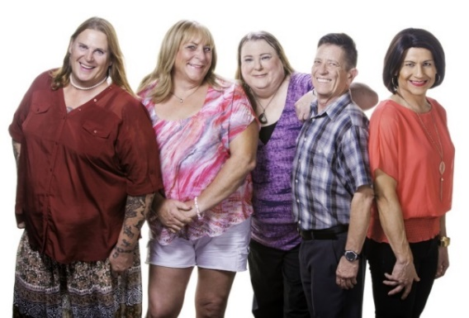
Gender affirming speech
Gender Affirming Speech (GAPS) eConsult
For many, a desired voice and communication style is key to expressing their gender identity
Speech language pathologists provide gender-affirming voice and communication services that address speech, language, and non-verbal communication.
Services are provided virtually and conveniently to Veterans in their home using telehealth technology.
Notes:
The LGBTQ+ Health Program manages an interfacility consult (IFC) for transgender and gender diverse Veteran care to support clinical services and increase access to high-quality care for Veterans and promote clinical competence for providers. With the Veteran’s consent, this interfacility e-consult enables clinical providers (any discipline) to receive non-urgent consultation from an interdisciplinary team of experts on transgender and gender diverse care for Veterans related to any aspect of treatment planning. Topics can include but are not limited to (1) Mental Health Assessment and Hormone Readiness; (2) Psychotherapy; (3) Primary Care; and (4) Prescribing Medications. The e-consult is provider-to-provider consultation and does not provide direct patient care.
The GAPS program was established in 2021 through to standardize a treatment program utilizing virtual care options to expand access to high quality voice and communication treatment for rural transgender Veterans. GAPS aims to narrow the gap in access to care by having VHA speech pathologists experienced in both voice evaluation and treatment and telehealth technologies deliver services to the Veteran’s home. Services can be accessed through interfacility consultation from any VHA provider. This program does provide direct patient care.

Slide 10

Ready and Available to Assist
LGBTQ+ Veteran Care Coordinators
Can be contacted by LGBTQ+ Veterans, caregivers or family members to assist with information about VHA services and how to navigate VHA care.
Are knowledgeable about local community LGBTQ+ resources.
Work to reduce barriers to LGBTQ+ Veteran care to improve access to and quality of care. Including helping other VA employees learn.
10
Notes:
Images are authorized for use

Slide 11
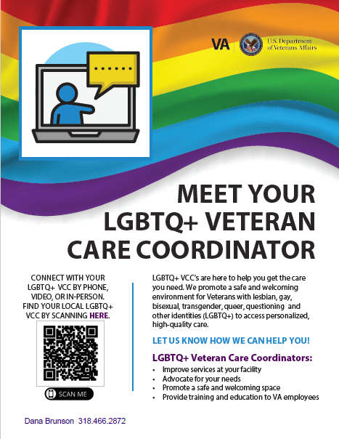
LGBTQ+ Veteran Care Coordinators
Find an LGBTQ+ VCC:
LGBTQ+ Veteran Care Coordinator Directory (sharepoint.com)
(Accessible to VA employees)
Find an LGBTQ+ VCC :
http://www.patientcare.va.gov/LGBT
(Accessible to the public)
Or contact us by email: VHALGBTQ+health@va.gov
11
Notes:
The Lesbian, Gay, Bisexual, Transgender and Queer (LGBTQ+) Veteran Care Coordinator (VCC) program was established in 2016 to ensure that the environment of care at Veterans Health Administration (VHA) facilities is affirming of LGBTQ+ Veterans. The LGBTQ+ VCC position ensures that Veterans have an identified affirming contact should questions about policies or processes arise and that VHA staff have a point of contact for training in culturally competent LGBTQ+ clinical services. Per VHA Directive 1340, each VA Medical Facility has at least one LGBTQ+ VCC who serves in this administrative role as a collateral duty. Often, but not always, LGBTQ+ VCCs are clinical providers appointed to the VCC role.
LGBTQ+ VCCs Serve as a point-person, source of information, Veteran advocate, and problem-solver for LGBTQ+ Veteran-related health care issues at the facility VCCs report to the medical center director
LGBTQ+ VCC priorities are to
Create a safe and welcoming environment throughout the facility.
Build a network of stakeholders, including building allies and partners within the facility and the community.
Maintain knowledge of local LGBTQ+ services and identification of gaps in care.
Educate and train staff to reduce barriers to LGBTQ+ Veteran care to improve access to and quality of care at the facility.
Can be consulted about ways to create a safe and affirming environment at your facility.
Are knowledgeable about LGBTQ+ stakeholders, allies, and resources within VA and the local community.
Work to reduce barriers to LGBTQ+ Veteran care to improve access to and quality of care.
VA employees can
Find an LGBTQ+ VCC:
In LGBTQ+ Veteran Care Coordinator Directory (sharepoint.com)
(Accessible to VA employees)
Veterans and other individuals Find an LGBTQ+ VCC
http://www.patientcare.va.gov/LGBT
( Accessible to the public)
Or anyone can contact us by email: VHALGBTQ+health@va.gov

Slide 12
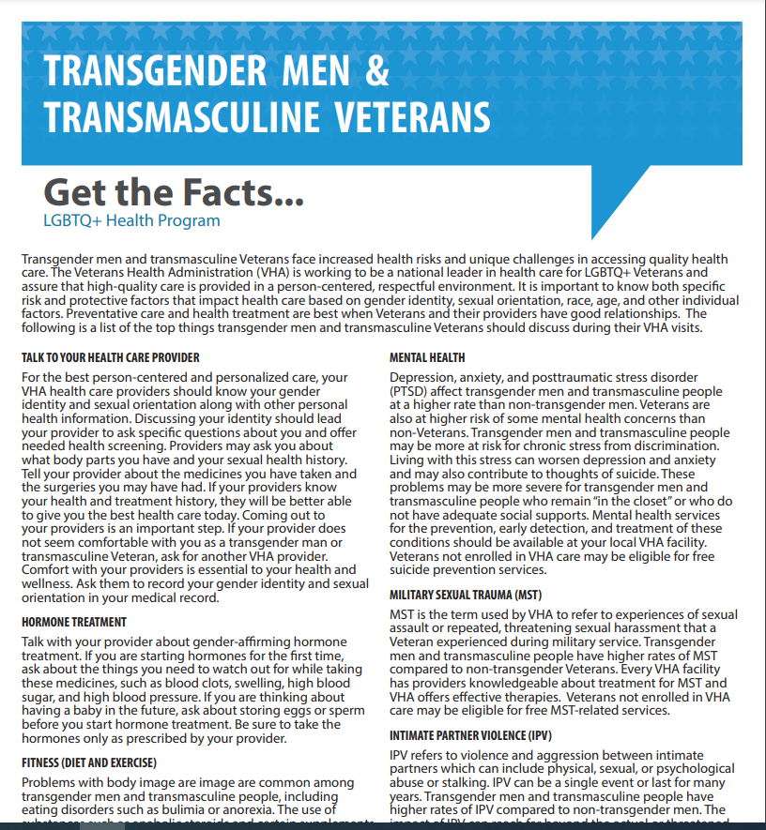
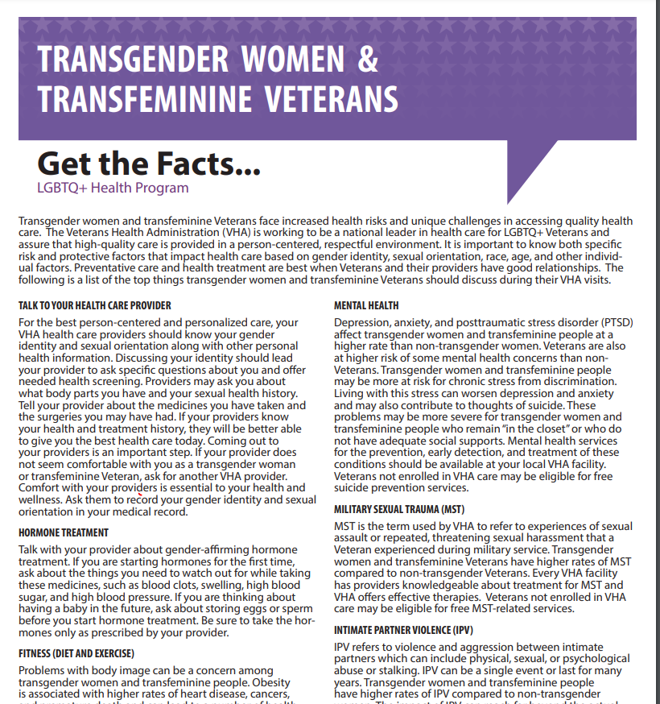
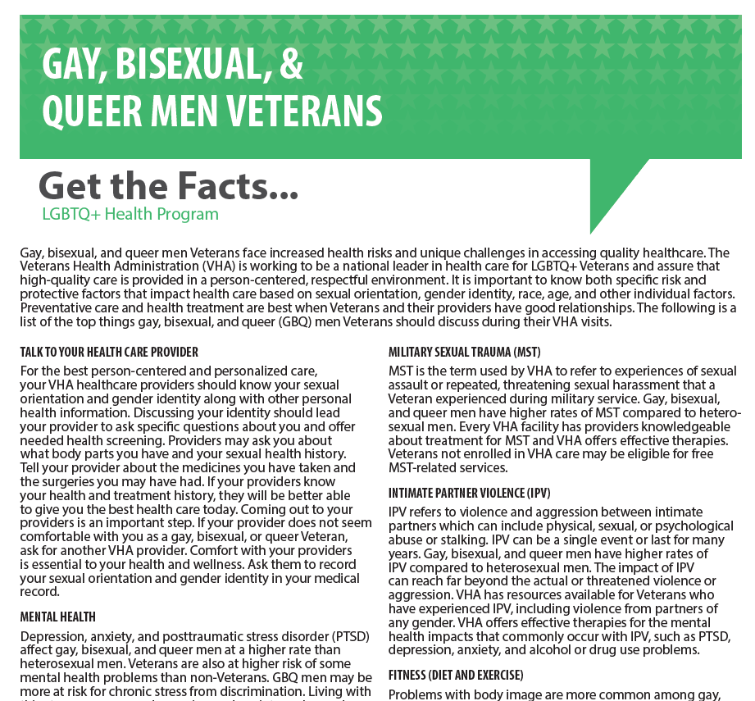
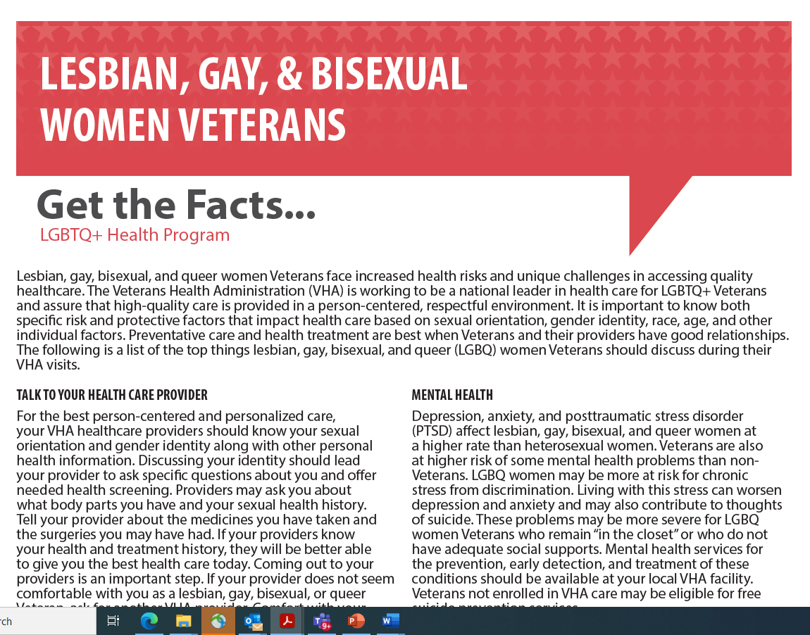
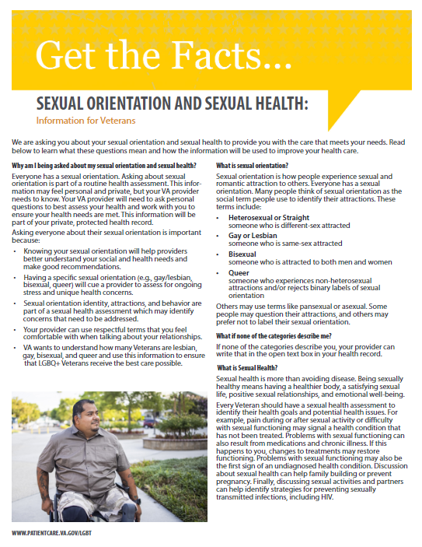
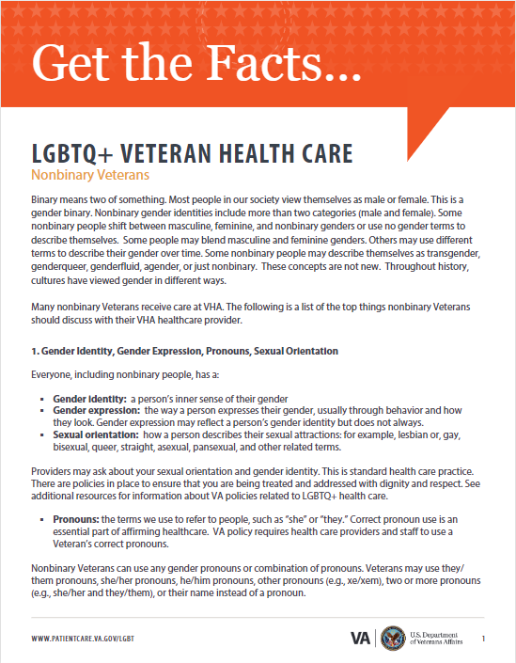
LGBTQ+ Health Fact Sheets
Transgender Men & Transmasculine Veterans Health Care Fact Sheet (PDF)
Transgender Women & Transfeminine Veterans Health Care Fact Sheet (PDF)
Gay, Bisexual, and Queer Veteran Health Care Fact Sheet (PDF)
Lesbian, Bisexual, and Queer Veteran Health Care Fact Sheet (PDF)
Nonbinary Veteran Health Care Fact Sheet (PDF)
Sexual Orientation and Sexual Health Veteran Fact Sheet (PDF)

Slide 13

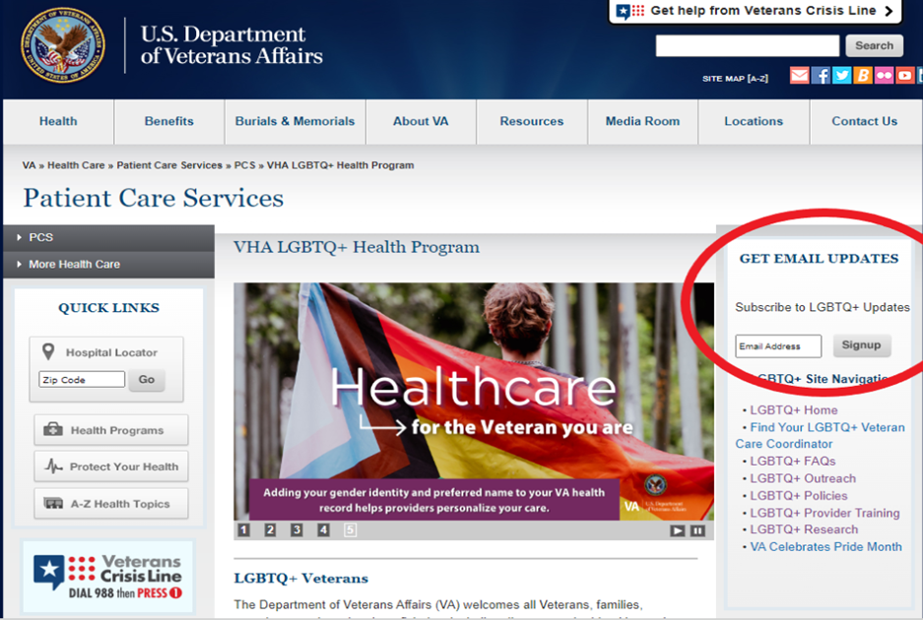
LGBTQ+ Health Program
  Public website: http://www.patientcare.va.gov/LGBT
  SharePoint site (education, fact sheets, etc): VA LGBTQ+ Resources - Home (sharepoint.com)
  Contact us by email: VHALGBTQ+health@va.gov
13

