Slide 1
Prosthetic and Sensory Aids Service Briefing
Alison C. Cormier, Field Operations Manager
Penny L. Nechanicky, Executive Director
Prosthetic and Sensory Aids Service
Rehabilitation and Prosthetic Services
July 2022

Slide 2
Prosthetic and Sensory aids service (psas)
PSAS is the largest and most comprehensive provider of prosthetic devices and sensory aids. The term “prosthetic” includes artificial limbs and any devices that support or replace a body part or function.
Mission
To provide medically appropriate equipment, supplies, and services that optimize Veteran health and independence.
Goal
To ensure devices and services for Veterans are strategically sourced and consistent with clinical need.
Final Rule, Prosthetic and Rehabilitative Items and Services (effective February 26, 2021) establishes national policy and procedures for the provision of prosthetic services.

Slide 3
PSAS TEAM
Central Office
PSAS National Director
Clinical Liaisons
Field Operation Manager
Program Managers
Data Management Team
Executive Assistant
O&P National Director
Program Managers
Data Manager
Field
VISN Prosthetics Representatives
Facility Prosthetics Representatives
Data Analysts
O&P Clinical Staff
Purchasing Agents
Support/Administrative Staff
June 2002

Slide 4
Prosthetic and rehabilitative items and services regulation
Prosthetic and Sensory Aids Service (PSAS) published a final rule, Prosthetic and Rehabilitative Items and Services (PARIS), effective February 26, 2021.
VA Press Release: Prosthetic and Rehabilitative Items and Services Regulation
All PSAS policies, standard operating procedures and Directives must adhere to this authority.
Regulation Key Goals:
Prioritize medical needs of Veterans by empowering the Veteran and clinician to jointly decide which prosthetic items will best meet the Veteran’s treatment and/or rehabilitation needs;
Align PSAS with clinical services to provide Veterans with medical devices and services that best meet their medical needs; and
Create uniform decision making regarding when and how PSAS will issue items and services to Veterans.
PSAS is providing ongoing PARIS Regulation communication and education

Slide 5
Defined Categories of care
VA is authorized to provide the following 15 categories of items and services under the regulation:
Adaptive Household Items
Adaptive Recreation Equipment
Cognitive Devices
Communication Devices
Home Exercise Equipment
Home Medical Equipment
Home Respiratory Equipment
Implants
Mobility Aids
Orthotic Devices
Prosthetic Devices
Specialized clothing made necessary by the wearing of a prosthetic device
Repairs
Replacements
Training and fitting

Slide 6
Types of specialty care/ Medical conditions served by psas
Veterans with needs related to:
Amputation
Spinal Cord Injury/Disorders
Polytrauma
Hearing and Vision
Podiatric Care
Cardio-Pulmonary Disease
Traumatic Brain Injury
Speech/Language deficit
Geriatric Impairments
Neurologic Dysfunction
Muscular Dysfunction
Women’s Health
Orthopedic Care
Diabetes/Metabolic Disease
Peripheral Vascular Disease
Cerebral Vascular Disease

Slide 7
PSAS Women Veterans
Dedicated PSAS Women Veterans Emphasis Workgroup.
Women's Health, PSAS, Social Work, Reproductive Health, WHS Deputy Directors, O&P, LGBT Health Program, Mental Health.
Updated PSAS Women Veteran Fact Sheet.
PROSTHETIC AND SENSORY AIDS SERVICES FOR WOMEN (va.gov)
Partnership with Community Care and process improvements with SEOC.
Dedicated team assigned to PSAS supporting actions to improve access and care coordination.
Specific Devices Examples
Nursing bras and breast pumps
Post mastectomy items
Wigs for alopecia, post chemotherapy
Long-acting reversible contraceptives (e.g., intrauterine devices)
Maternity support belts & items
Pelvic floor devices
Vaginal dilators
Mastectomy bathing suits

Slide 8
GENERAL DEVICE EXAMPLES
Specific examples of services and devices include but are not limited to:
Custom fabrication, fitted limbs, and device support for the spine or limbs
Canes, walkers, and wheelchairs
Aids for daily living
Hearing aids and eyeglasses
Diabetic shoes and inserts
Sleep Apnea Positive Airway Pressure equipment and accessories
Home respiratory therapy, home oxygen, and concentrators
Surgical implants
Rental of devices, such as beds, wound Vac’s, and patient lifts and beds
Bathroom safety devices
June 2002

Slide 9
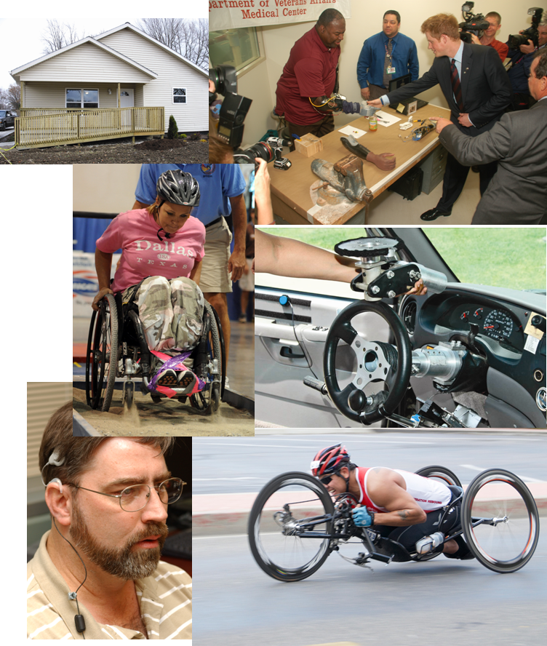
PSAS SERVICES / DEVICES / BENEFITS
Services
Orthotic and Prosthetic Services, Restorations
Home Oxygen
Dog Insurance
Devices
Durable Medical Equipment and Supplies
Wheelchairs and Accessories
Eyeglasses, Blind Aids, Low Vision Aids
Hearing Aids and Assistive Listening Devices
Health Monitoring Equipment
Artificial Limbs/Custom Braces
Surgical Implants
Adapted Sports and Recreational Equipment
Benefit Programs
Automobile Adaptive Equipment (AAE)
Clothing Allowance
Home Improvements and Structural Alterations (HISA)
June 2002

Slide 10
PROCESS FOR ORDERING PROSTHETIC ITEMS
PSAS liaisons between Veterans, Clinicians, and Vendors to facilitate purchase and delivery of medically necessary device / service
Vendors working with VA provide price quotes for market research, and deliver the purchased device / service in a timely manner
Clinician evaluates Veteran then writes a prescription through a consult to Prosthetics for the medically appropriate device / service
VETERAN
Contracting receives acquisition plan, conducts market research, creates a contract award, and obligates funds to award the contract to the vendor for device / service
PSAS verifies the consult includes proper diagnoses and medical justification for requested item, then purchases or provides acquisition plan to procure requested device / service
June 2002

Slide 11
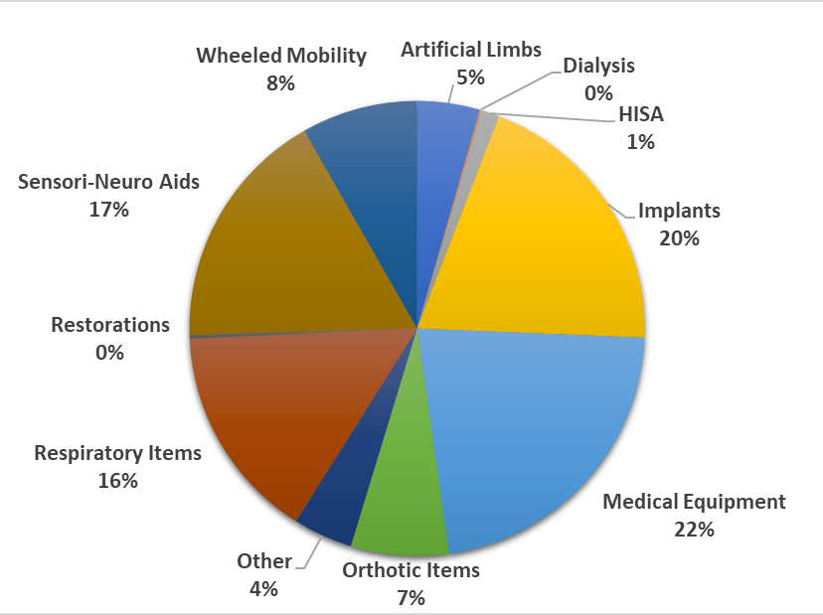
CATEGORY BREAKDOWN OF PSAS BUDGET – FY21
More than 50% of all Veterans treated in VHA received PSAS items and services.
In FY21, VA obligated:
~ $3.3B to provide 21M devices/items to 3.3M Veterans.
June 2002

Slide 12
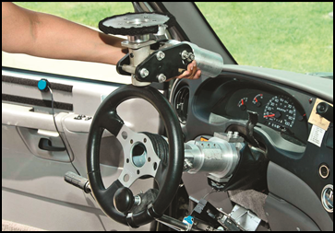
Automobile adaptive equipment
The Automobile Adaptive Equipment Program is a joint Veterans Health Administration (VHA) / Veterans Benefit Administration (VBA) program with basic authority under Title 38 United States Code Chapter 39; Title 38 Code of Federal Regulations 17.155-17.159
The program provides necessary equipment such as:
Platform wheelchair lifts or ramps
Power door openers
Lowered floors/raised roofs (if patient has seating height of 52” or more)
Raised doors (if a patient has a seating height of 49” or more and unable to lean forward to clear the door and resume normal seating position)
Hand controls
Left foot gas pedals
Reduced effort and zero effort steering and braking
Digital driving systems

Slide 13
Clothing allowance
VA must pay a Clothing Allowance to Veterans who have:
A Service-Connected Disability or Condition compensable under 38 U.S.C. 1151 that requires the Veteran to wear or use a prosthetic or orthopedic device that wears or tears clothing or
A Service-Connected skin condition, medication prescribed by a physician, which causes irreparable damage to the Veteran’s outer garments.
As of December 16, 2011, Veterans became eligible to receive multiple clothing allowance benefits, with a limit of two (2) per garment affected and total maximum of four (4) clothing allowances.
Annual clothing allowance benefit is $891 (FY 22)
Maximum of four (4) clothing allowances amount is $3564 (FY 22)

Slide 14
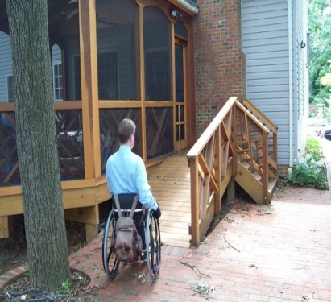
Home improvements & structural alterations (HISA)
The HISA benefit provides home improvements and structural alterations necessary only to ensure the continuation of treatment and/or to provide access to the home or to essential lavatory and sanitary facilities authorized under 38 USC § 1717.
Lifetime benefit up to $6,800 may be provided for:
Veterans and Servicemembers who have a Service-connected condition
Veteran who have a Non-service-connected condition rated 50% or more service connected
Lifetime benefit up to $2,000 may be provided for:
Non-service-connected Veterans

Slide 15
Thank you!
Prosthetic & Sensory Aids Service
VA Central Office
(202) 461-4239
www.prosthetics.va.gov

