Slide 1
Suicide Rates and Risk Among Women Veterans

Slide 2
2022 National Veteran Suicide Prevention Annual Report
2022
NATIONAL VETERAN
SUICIDE PREVENTION
ANNUAL REPORT
VA Suicide Prevention
Office of Mental Health and Suicide Prevention
September 2022

Slide 3
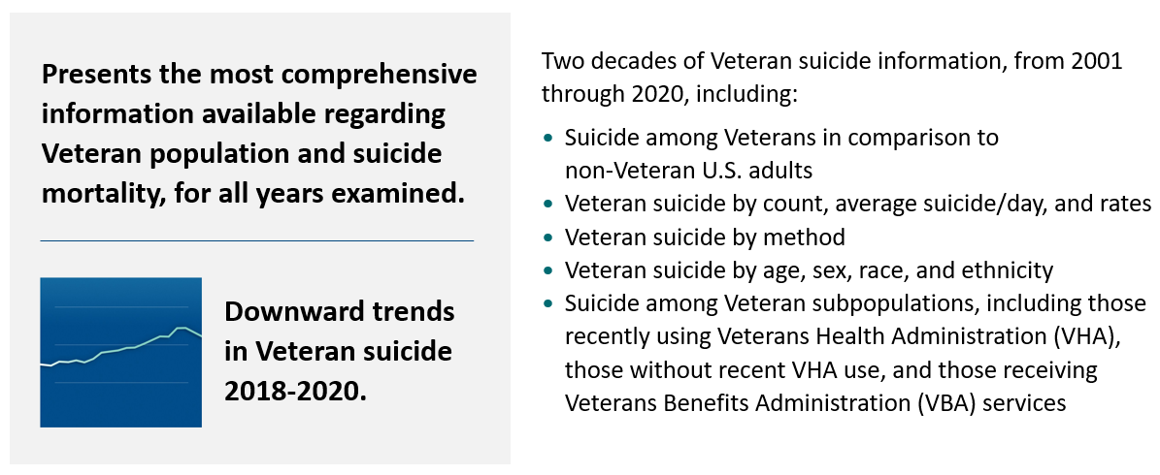
Executive Summary

Slide 4
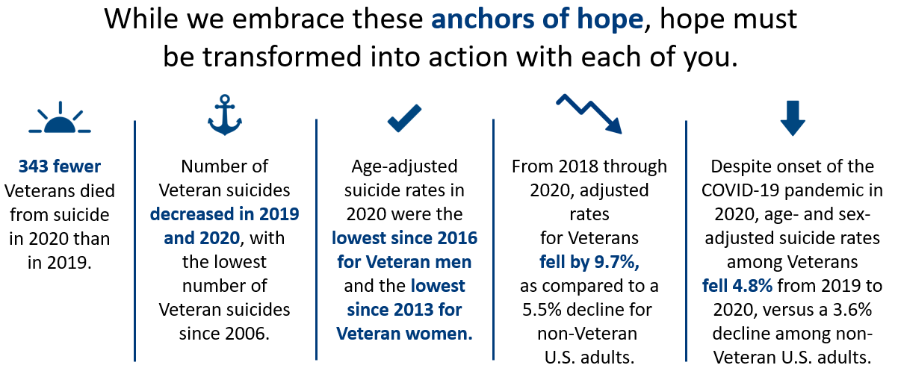
Anchors of Hope
Notes:
(Anchor 1) 343 fewer Veterans died from suicide in 2020 than in 2019, and 2020 had the lowest number of Veteran suicides since 2006.
From 2001 to 2018, the number of Veteran suicides increased on average by 47 deaths per year. 2019 and 2020 had consecutive reductions, of 307 and 343 suicides, respectively, an unprecedented decrease since 2001.
From 2018 to 2020, adjusted rates for Veterans fell by 9.7%. By comparison, the adjusted rate for non-Veteran U.S. adults fell by 5.5%.
The age-adjusted suicide rate for women Veterans in 2020 was the lowest since 2013, and the age-adjusted suicide rate for Veteran men was the lowest since 2016.
From 2019 to 2020, among Veteran men, the age-adjusted suicide rate fell by 0.7%, and among Veteran women, the age-adjusted suicide rate fell by 14.1%. Among non-Veteran U.S. men, the age-adjusted rate fell by 2.1%, and among non-Veteran women, the age-adjusted rate fell by 8.4%.
Assessment of Veteran suicide rates by race showed decreases from 2019 to 2020 for all groups.
Despite the 24.6% decrease in the Veteran population from 2001 to 2020, the number of Veterans with VHA health care encounters in the year or prior year rose 55.0%, from 3.8 million to 5.9 million.
Despite onset of the COVID-19 pandemic in 2020, age- and sex-adjusted suicide rates among Veterans fell 4.8% from 2019 to 2020, versus a 3.4% decline among non-Veteran U.S. adults.

Slide 5
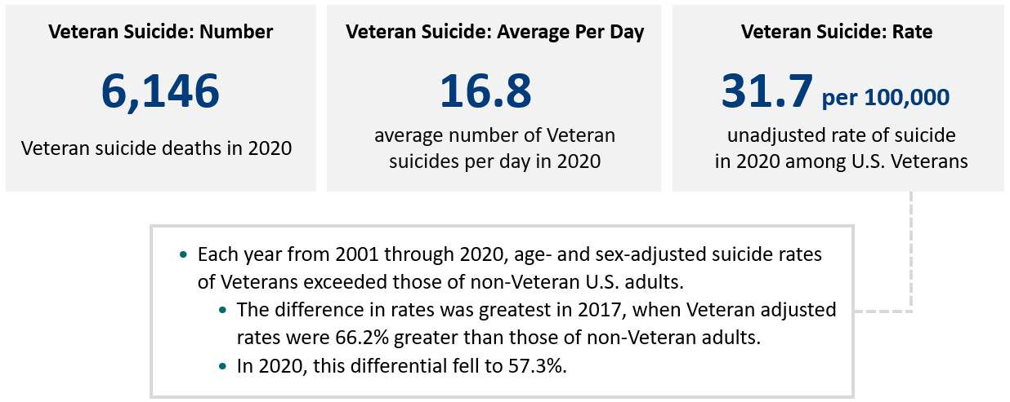
High-Level Data Points
Notes:
While we see decreases across count, average, and rate from 2019-2020, more work remains as Veterans remain at higher risk for suicide.
(This was pulled from slides with Dr. Kearney’s edits.)
Veteran Suicide Number and Rate
In 2020, there were 6,146 Veteran suicide deaths, which was 343 fewer than in 2019. The unadjusted rate of suicide in 2020 among U.S. Veterans was 31.7 per 100,000.
Veteran Suicide Average per Day
The average number of Veteran suicides per day in 2020 was 16.8. It was highest in 2018 at 18.6 per day.
Age- and Sex-Adjusted Suicide Rates
Over the period from 2001 to 2020, age- and sex-adjusted suicide rates for Veterans peaked in 2018 and then fell in 2019 and 2020. From 2018 to 2020, age- and sex-adjusted suicide rates for Veterans fell by 9.7%.
Among non-Veteran U.S. adults, age- and sex-adjusted suicide rates also peaked in 2018 and fell in 2019 and 2020. From 2018 to 2020, age- and sex-adjusted suicide rates for non-Veteran adults fell by 5.5%.
In each year from 2001 to 2020, age- and sex-adjusted suicide rates of Veterans exceeded those of non-Veteran U.S. adults. The differential in adjusted rates was smallest in 2002, when the Veteran rate was 12% higher than for non-Veterans, and largest in 2017, when the Veteran rate was 66.2% higher. In 2020, the rate for Veterans was 57.3% higher than that of non-Veteran adults.
From 2019 to 2020, the age- and sex-adjusted suicide rate for Veterans fell by 4.8%, while for non-Veteran U.S. adults, the adjusted rate fell by 3.6%.
From 2019 to 2020, among Veteran men, the age-adjusted suicide rate fell by 0.7%, and among Veteran women, the age-adjusted suicide rate fell by 14.1%. By comparison, among non-Veteran U.S. men, the age-adjusted rate fell by 2.1%, and among non-Veteran women, the age-adjusted rate fell by 8.4%.

Slide 6
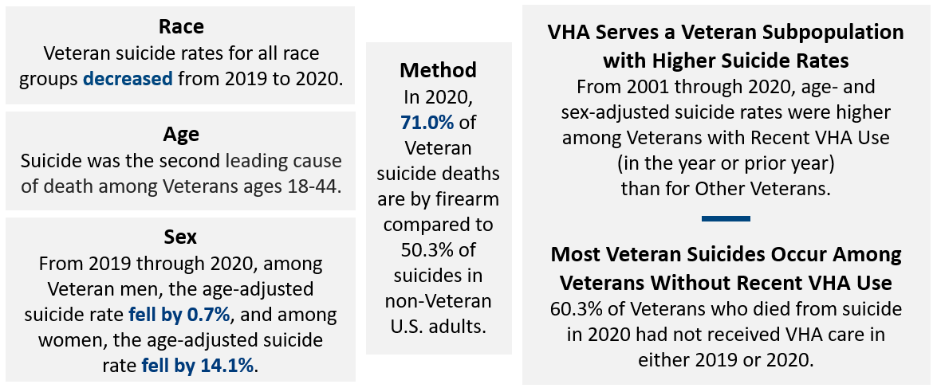
Key Data Categories
Notes:
Race Unadjusted Suicide Rates
Veteran suicide rates for all race groups decreased from 2019 to 2020.
Unadjusted Method-Specific Suicide Rates
Over time, there were substantial increases in rates of suicide involving firearms and suffocation.
Further analyses indicate that firearm suicide mortality rates are greater among Veteran men (24.3/100,000 in 2020) than Veteran women (6.7/100,000 in 2020).
Leading Cause of Death (Veterans)
Among all Veterans in 2020, suicide was the 13th leading cause of death.
VHA Care
Veteran VHA users with Diagnoses Related to Gender Identity
The number of Veteran VHA patients with diagnoses related to gender identity increased from 2,515 in 2011 to 8,316 in 2019, and the unadjusted annualized suicide rate fell from 267.8 per 100,000 person-years in 2011 to 98.5 per 100,000 person-years in 2019.
Veteran Suicide Decedents per Day in 2020
Veteran with VHA Encounter in Year of Death or Year Prior: 39.7%, 6.7 suicides per day
Veteran with VHA encounter within Five Years Prior to Death: 5.6%, 0.9 suicides per day
VHA-Enrolled Veteran without VHA Encounters with Past Five Years: 9.4%, 1.6 suicides per day
Veteran with Any Contact with VBA in Year of Death or Year Prior: 5.7%, 1.0 suicides per day
Veteran with No Contact with VHA or VBA: 39.7%, 6.7 suicides per day

Slide 7
Women Veteran Risk Factors

Slide 8
Suicide Risk Factors for Women Veterans
Self Directed Violence (SDV): Women attempt suicide more often than men yet die by suicide at lower rates than men
Substance Abuse: While a current diagnosis of any SUD was associated with increased risk for suicide among both male and female Veterans, the strength of the association was 2 to 3 times higher for women than for men
Mental Health Conditions: Women Veterans were more likely than male Veterans to report a lifetime diagnosis of depression, anxiety, or posttraumatic stress disorder (PTSD).
Military Sexual Trauma (MST): is associated with increased risk for suicide even after accounting for specific mental health conditions like PTSD or depression. The increase in risk was particularly high among women Veterans.
Eating Disorders: Eating disorders are associated with increased risk for suicidal ideation, attempts, and death by suicide.
Notes:
Self Directed Violence (SDV): Women attempt suicide more often than men yet die by suicide at lower rates than men
Recovery from self-directed violence and suicide attempts differed by gender. Women Veterans focused on developing connections with others and wanted to increase their self-knowledge and self-worth, while male Veterans were focused on trying to live up to their ideal selves by living and doing the right thing. Both women and men also wanted to feel a stronger sense of purpose in their lives
Substance Abuse: While a current diagnosis of any SUD was associated with increased risk for suicide among both male and female Veterans, the strength of the association was 2 to 3 times higher for women than for men
Among female Veterans, those who were currently drinking at hazardous levels had higher risk for suicidality than did female Veterans who were moderate drinkers or did not drink at all
Mental Health Conditions: The link between psychopathology and suicide risk is stronger among women Veterans than male Veterans.
Women Veterans were more likely than male Veterans to report a lifetime diagnosis of depression, anxiety, or posttraumatic stress disorder (PTSD).
Military Sexual Trauma (MST): is associated with increased risk for suicide even after accounting for specific mental health conditions like PTSD or depression. The increase in risk was particularly high among women Veterans.
VA data show that 1 in 3 women respond yes, to having experienced MST.
Eating Disorders: Eating disorders are associated with increased risk for suicidal ideation, attempts, and death by suicide.
The prevalence of eating disorders among Veterans is at least as high as in the general population, and rates are higher among women Veterans than male Veterans.
(Denneson et al., 2021)
Denneson, LM., Tompkins, KJ., McDonald, KL., Britton, PC., Hoffmire, CA., Smolenski, DJ., Carlson, KF., Dobscha, SK. (2021). Gender Differences in Recovery Needs After a Suicide Attempt, Medical Care: 59, 65-69
(Bohnert et al., 2017)
Bohnert, K. M., M. A. Ilgen, S. Louzon, J. F. McCarthy, and I. R. Katz. 2017. Substance use
disorders and the risk of suicide mortality among men and women in the US Veterans Health
Administration. Addiction 112, no. 7:1193–1201.
(Wilson et al., 2018).
Wilson, S. M., T. K. Burroughs, A. R. Newins, et al. 2018. The association between alcohol
consumption, lifetime alcohol use disorder, and psychiatric distress among male and female
Veterans. Journal of Studies on Alcohol and Drugs 79, no. 4: 591–600.

Slide 9
Suicide Risk Factors For Women Veterans2
Adverse Childhood Experiences: Women Veterans are more likely than women who never served in the military to have experienced ACEs
Intimate Partner Violence: Experiencing IPV is associated with increased likelihood of suicidal
Postpartum Depression: Up to 20% of postpartum deaths are suicide-related.
Menopause: Perimenopause women may have increased risk for suicidal ideation compared with pre- and post- menopausal women, as well as compared with men.
Sexual Health: Emerging research with women Veterans suggests that sexual dysfunction is associated with suicidal ideation, even after accounting for mental health diagnoses, branch of service, and demographic characteristics.
Notes:
Adverse Childhood Experiences: Women Veterans are more likely than women who never served in the military to have experienced specific adverse childhood experiences in their youth, including emotional abuse and exposure to intimate partner violence.
Intimate Partner Violence: Experiencing IPV is associated with increased likelihood of suicidal ideations and attempts.
Women Veterans are at a higher risk for experiencing IPV than civilian women during their lifetime.,
Experiencing IPV is associated with additional suicide risk factors, such as mental and physical health problems, hopelessness, and social isolation.
Menstrual Cycles: One study documented that women who have premenstrual dysphoric disorder had a greater likelihood of having suicidal thoughts or making suicidal attempts than women without premenstrual symptoms.
Pregnancy and Childbirth: Up to 20% of postpartum deaths are suicide-related.
Pregnancy is a major cause of discontinuing antidepressant use, and perinatal women who die by suicide are less likely than non-perinatal women to be receiving psychiatric treatment at the time of their death.
Menopause: There is some indication that during perimenopause women may have increased risk for suicidal ideation compared with pre- and post- menopausal women, as well as compared with men.
Sexual Health: Emerging research with women Veterans suggests that sexual dysfunction is associated with suicidal ideation, even after accounting for mental health diagnoses, branch of service, and demographic characteristics.
The association between sexual dysfunction and suicidal ideation is even stronger in women Veterans who have experienced sexual assault.
Problems with Emotion Regulation: Adverse childhood experiences and complex trauma can reduce a women’s ability to maintain emotional stability and manage strong emotions under stress. Problems with emotion regulation are associated with greater risk for suicidal ideation and behaviors.
Pregnant women Veterans were twice as likely to experience depression, PTSD, and anxiety than their non pregnant Veteran peers. (Women Veteran Cohort Study, Brandt, C., 2012).
Blosnich, J. R., Dichter, M. E., Cerulli, C., Batten, S. V., & Bossarte, R. M. (2014). Disparities in adverse childhood experiences among individuals with a history of military service. JAMA Psychiatry, 71(9), 1041–48.
Cavanaugh, C.E., J. T. Messing, M. Del-Colle, C. O’Sullivan, and J. C. Campbell. 2011. Prevalence and correlates of suicidal behavior among adult female victims of intimate partner violence. Suicide and Life-Threatening Behavior 41, no. 4:372–83.
Dichter, M. E., C. Cerulli, and R. M. Bossarte. 2011. Intimate partner violence victimization among women veterans and associated heart health risks. Women’s Health Issues 21, no. 4:S190–94.
Iovine-Wong, P. E., C. Nichols-Hadeed, J. T. Stone, et al. 2019. Intimate partner violence, suicide, and their overlapping risk in women veterans: a review of the literature. Military Medicine 184, no. 5-6. https://doi.org/10.1093/milmed/usy355.
Iovine-Wong, P. E., C. Nichols-Hadeed, J. T. Stone, et al. 2019. Intimate partner violence, suicide, and their overlapping risk in women veterans: a review of the literature. Military Medicine 184, no. 5-6. https://doi.org/10.1093/milmed/usy355
Pilver, C. E., D. J. Libby, and R. A. Hoff. 2013. Premenstrual dysphoric disorder as a correlate of suicidal ideation, plans, and attempts among a nationally representative sample. Social Psychiatry and Psychiatric Epidemiology 48, no. 3:437–46.
Petersen, I., R. E. Gilbert, S. J. Evans, S. Man, and I. Nazareth. 2001. Pregnancy as a major determinant for discontinuation of antidepressants: An analysis of data from The Health Improvement Network. The Journal of Clinical Psychiatry 72, no. 7:979–85.
Khalifeh, H., I. M. Hunt, L. Appleby, and L. M. Howard. 2016. Suicide in perinatal and non-perinatal women in contact with psychiatric services: 15 year findings from a UK national inquiry. The Lancet Psychiatry 3, no. 3:233–42.
.(Lindalh et al., 2005).

Slide 10
Protective Factors for Suicide in Women (Veteran and Non-Veteran)
Willingness to ask for help: Women are more likely to use telephone help lines, visit/access family doctors, or discuss problems with others.
Religious Activity: Frequent attendance in faith-based activities reduces suicide risk.
Spirituality: Found to be protective against suicide attempts in women, especially in African-American women.
Motherhood: Women with young children especially have a lower risk of suicide.
Connectedness: Women with family, social support, and children tend to promote engagement outside the family.
  Meaning in life may play an important role in promoting mental health and well-being and potentially conferring resiliency to contemplations of suicide.
Notes:
Talking Points:
Religious affiliation does not necessarily protect against suicidal ideation but does protect against suicide attempts. Whether religious affiliation protects against suicide attempts may depend on the culture-specific implications of affiliating with a particular religion, since minority religious groups can feel socially isolated.
• Religious service attendance is not especially protective against suicidal ideation, but does protect against suicide attempts, and possibly protects against suicide.
Willingness to seek help:
Vijayakumar, L. (2015). Suicide in women. Indian Journal Of Psychiatry, 57(6), 233. doi: 10.4103/0019-55
Hawton, K. 2000. Sex and suicide: Gender differences in suicidal behaviors. British Journal of Psychiatry, 177: 484-5
Religious Activity:
Pew Study of religious activity across the world found women more religious than men.
The Gender Gap in Religion Around the World, Pew Research Center, Religion & Public Life, March 2016
Spirituality:
Kaslow, N., Webb Price, A., Wyckoff, S., Bender Grall, M., Sherry, A., & Young, S. et al. (2004). Person Factors Associated With Suicidal Behavior Among African American Women and Men. Cultural Diversity And Ethnic Minority Psychology, 10(1), 5-22. doi: 10.1037/1099-9809.10.1.5
Kleiman, E., & Liu, R. (2014). Prospective prediction of suicide in a nationally representative sample: Religious service attendance as a protective factor. British Journal of Psychiatry, 204(4), 262–66.
• Frequent religious service attendance is a long-term protective factor against suicide.
Lawrence, R. E., Oquendo, M. A., & Stanley, B. (2016). Religion and suicide risk: A systematic review. Archives of Suicide Research, 20(1), 1–21.
Motherhood:
Vijayakumar, L. (2015). Suicide in women. Indian Journal Of Psychiatry, 57(6), 233. doi: 10.4103/0019-5545.161484
Kleiman, E. M., & Liu, R. T. (2013). Social support as a protective factor in suicide: Findings from two nationally representative samples. Journal of Affective Disorders, 150(2), 540–45.
• Social support is associated with decreased likelihood of a lifetime suicide attempt.
Connectedness:
Vijayakumar, L. (2015). Suicide in women. Indian Journal Of Psychiatry, 57(6), 233. doi: 10.4103/0019-5545.161484
Heisel, M. J., & Flett, G. L. (2016). Does recognition of meaning in life confer resiliency to suicide ideation among community-residing older adults? A longitudinal investigation. The American Journal of Geriatric Psychiatry, 24(6), 455–66.
Meaning in life at baseline was negatively associated with either the onset, exacerbation, or both of suicide ideation over time.
Study findings add to a growing body of knowledge suggesting that meaning in life may play an important role in promoting mental health and well-being and potentially conferring resiliency to contemplations of suicide in later life.
Heisel, M. J., Neufeld, E., & Flett, G. L. (2016). Reasons for living, meaning in life, and suicide ideation: Investigating the roles of key positive psychological factors in reducing suicide risk in community-residing older adults. Aging & Mental Health, 20(2), 195–207.
• Reasons for living scores explained significant variance in suicide ideation.
• Meaning in life explained significant unique variance in suicide ideation.
• Meaning in life significantly mediated the association between reasons for living and suicide ideation.

Slide 11
Lethal Means Safety and Women Veterans

Slide 12
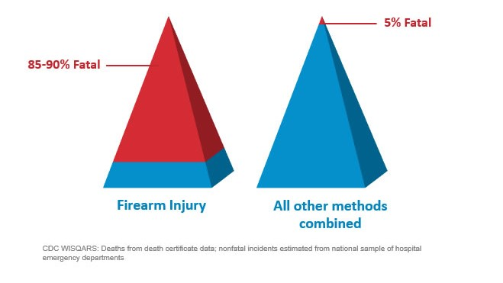
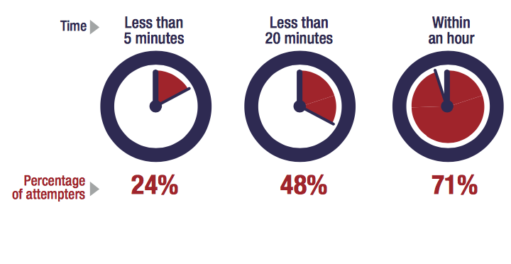
Lethal Means Safety Matters
Lethal Means Safety Matters:
Most Suicidal Crises are Brief
Time from Decision to Action < 1 hour
Suicide attempts by firearm are between 85-95% fatal compared with all other methods of suicide.
Source: Simon, T.R., Swann, A.C., Powell, K.E., Potter, L.B., Kresnow, M., and O’Carroll, P.W. Characteristics of Impulsive Suicide Attempts and Attempters. SLTB. 2001; 32(supp):49-59.
Source: CDC WISQARS and US Dept. of Veterans Affairs
https://www.mirecc.va.gov/lethalmeanssafety/facts/
Note: Approximately 1/3 of Veterans in large surveys store their firearms loaded and unlocked.
Building in time and space between the impulse to act and the means to harm one’s self saves lives.
Notes:
When lethal means are made less accessible or lethal, suicide rates by those means decline (Gunnel, 2003, 2007; Hawton, 2002)
Increasing time and space between individuals facing a suicidal crisis and a firearm has been shown to prevent suicide (Barber & Miller, 2014; Mann et al., 2005; and Pirkis et al., 2015)
By increasing time and space between any means and individuals at risk for suicide, suicide is reduced (Cornwell et al., 2002; Dahlberg et al., 2004; Wiebe 2003)

Slide 13
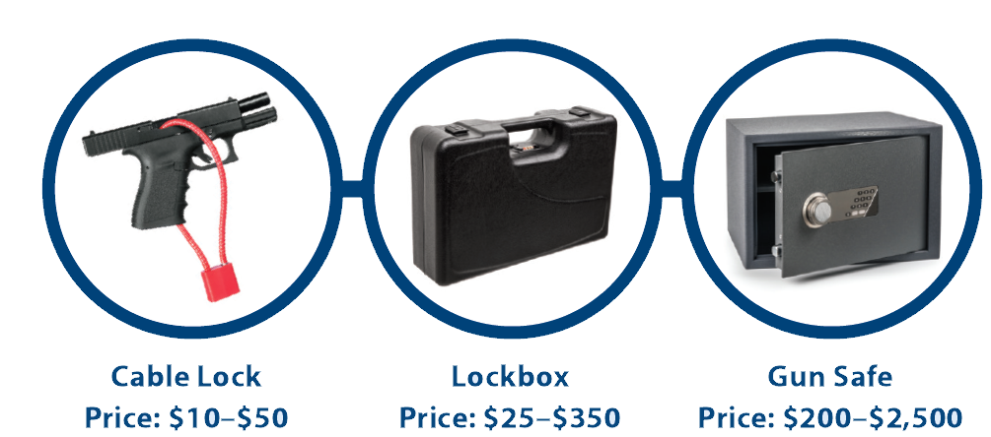
Practice safe storage of firearms, medications and other lethal means
Visit www.keepitsecure.net to learn more about the importance of firearm and other lethal means safety.
Nearly half of all Veterans own a firearm, and most Veteran firearm owners are dedicated to firearm safety. Firearm injuries in the home can be prevented by making sure firearms are unloaded, locked, and secured when not in use, with ammunition stored in a separate location
There are several effective ways to safely secure firearms, as shown below. Learn more and find the option that works best for you and your family from the National Shooting Sports Foundation at www.nssf.org/safety

Slide 14

Keepitsecure
Space Between Thought and Trigger - X30 - YouTube
Female Veteran - 30 Seconds
Gratitude to NSSF and other partners for input in the development of this campaign
KeepItSecure.Net: Lethal Means Safety Campaign Focused on Firearm Safety

Slide 15
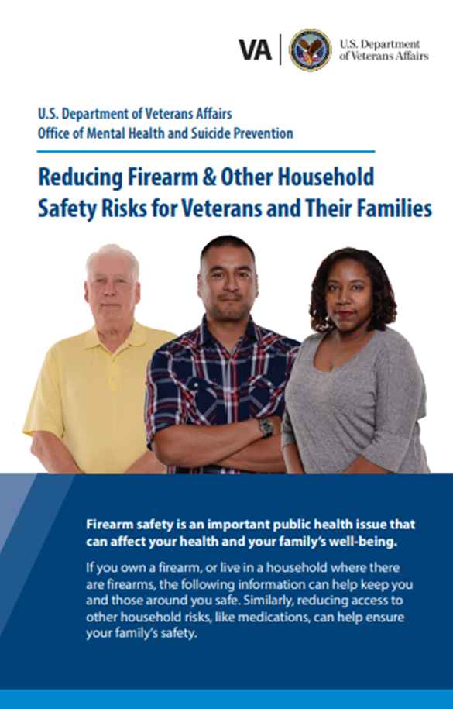
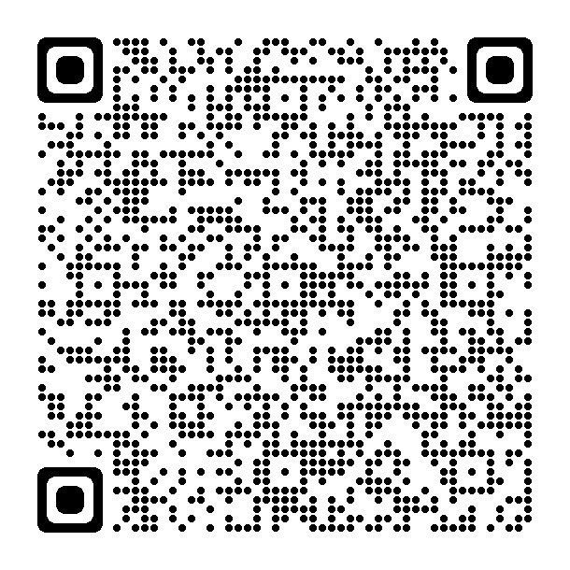
Lethal Means Safety Resources
    Reducing Firearm & Other Household Safety Risks Brochure
    Best practices for safely storing firearms and medications
    Guides on how to talk to Veterans about safe storage.
Normalize the discussion….
it is OK to ask if someone is having thoughts about suicide. And it is OK to ask about how they are storing their firearms too.

Slide 16
Implementing a Public Health Approach for Veteran Suicide Prevention

Slide 17
Question
What do you think is meant when we say a public health approach to suicide prevention?

Slide 18
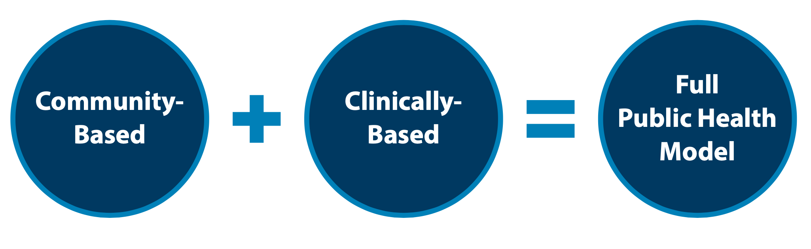
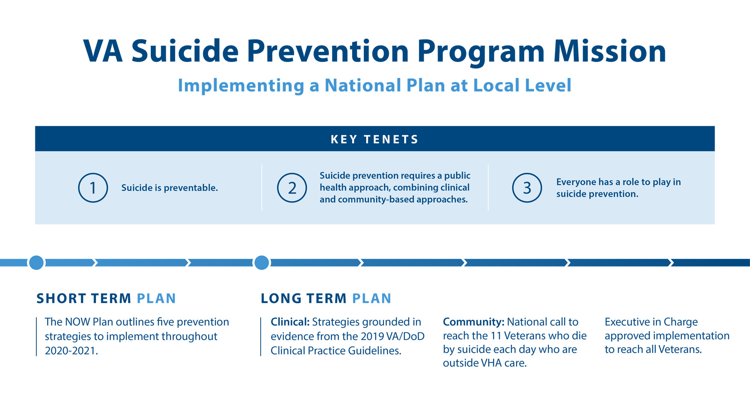
Public Health Strategy
VA's public health strategy combines partnerships with communities to implement tailored, local prevention plans while also focusing on evidence-based clinical strategies for intervention. Our approach focuses on both what we can do now, in the short term, and over the long term, to implement VA’s National Strategy for Preventing Veteran Suicide.

Slide 19
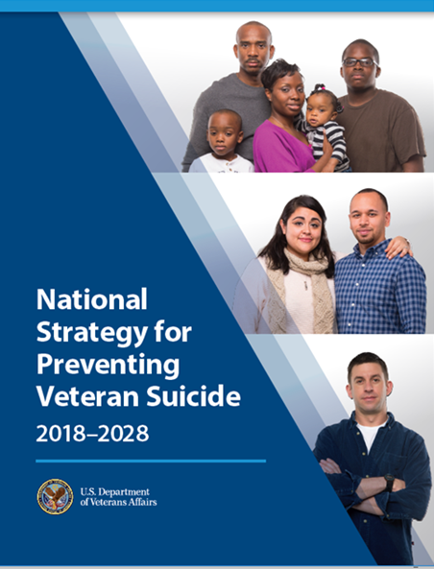
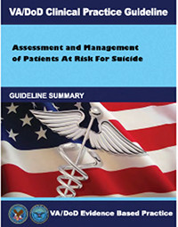
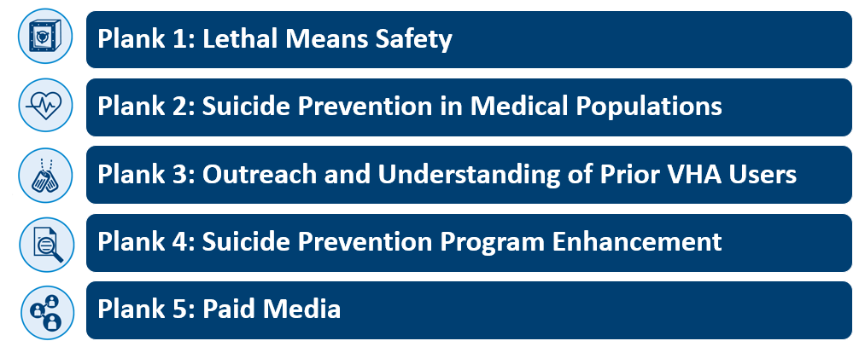
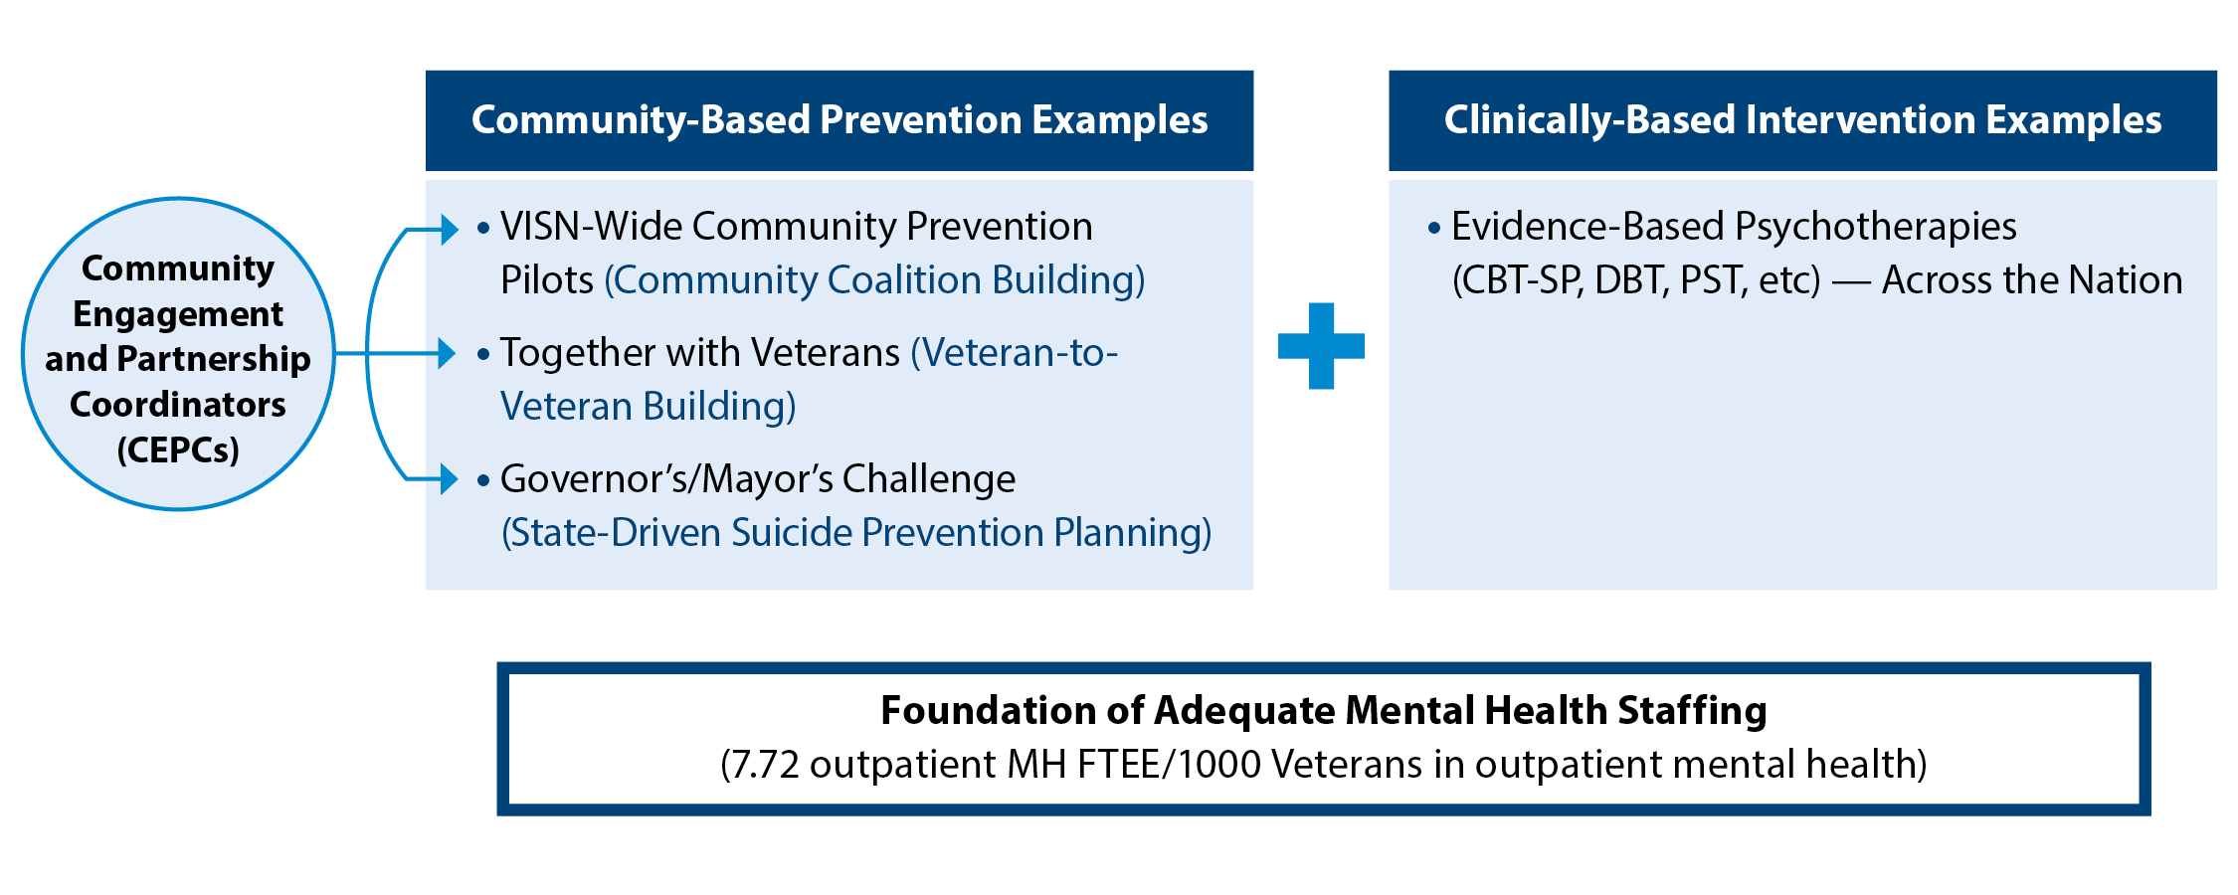
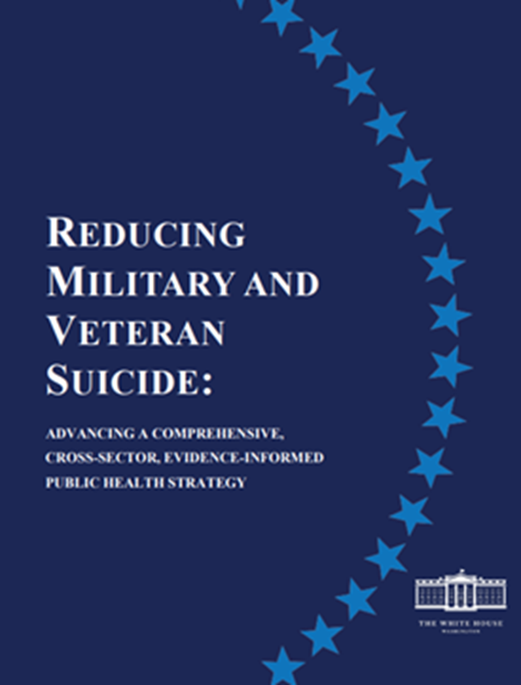
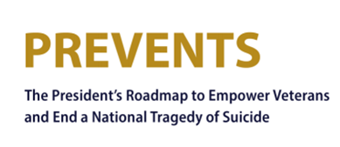

VA Suicide Prevention:
Operationalizing the National Strategy and CPG
SP Now
SP 2.0
Community-Based Prevention
Veterans Integrated Service Networks (VISN)-Wide Community Prevention Pilots (community coalition building)
Together With Veterans (Veteran-to-Veteran building)
Governor’s/Mayor’s Challenge (state-driven suicide prevention planning)
Evidence-based psychotherapies & interventions implemented through clinical video telehealth
  Cognitive Behavioral Therapy for Suicide Prevention (CBT-SP)
  Problem-Solving Therapy for Suicide Prevention (PST-SP)
  Dialectical Behavior Therapy
  Safety Planning Intervention
Foundation of Adequate Mental Health Staffing
(7.72 outpatient mental health full-time equivalent employees/1,000 Veterans in outpatient mental health)
Links to documents available by clicking on icons
Notes:
Explain structural overview for WHY Suicide Prevention exists, where does SP’s mission come from

Slide 20
Addressing Barriers to Women Accessing VHA Care
Training VA Clinicians to Provide Specialized Care for Women Veterans
Continuum of Services
Gender-Sensitive Treatment Options
Choice of Provider Gender
Veteran Centered Care
Women Peer Support Services
Women’s Mental Health Champions
Reproductive Mental Health Consultation Program
Notes:
Women’s Mental Health Champions: A national network used to disseminate information, facilitate consultations, and develop local resources. Specialty care programs target problems such as PTSD, substance use, depression, and MST.
Reproductive Mental Health Consultation Program: Provides expert consultation to all VA clinicians on topics such as the psychopharmacologic treatment of premenstrual, perinatal and perimenopausal mental health conditions, which can be associated with suicide risk.
Treating Eating Disorders: Multidisciplinary Eating Disorder Treatment Teams are available in all VISNs to provide specialized outpatient treatment and consultation. Eating disorders are associated with increased risk for suicide attempts and death by suicide.
Skills Training for Affective and Interpersonal Regulation (STAIR): An evidence-informed, cognitive behavioral therapy for PTSD, including chronic and complicated forms, as well as for PTSD and co-occurring disorders.
Parenting STAIR: An additional treatment for Veterans who have completed a course of STAIR and have persistent reactions that negatively impact their parenting and parent-child relationships.
Training VA Clinicians to Provide Specialized Care for Women Veterans:
VA has implemented extensive, specialized training initiatives to ensure VA mental health providers have the expertise to address women Veterans’ diverse treatment needs and preferences.
Continuum of Services:
VA offers a full continuum of mental health services, including general outpatient, specialty, residential and inpatient treatment options. Specialty care programs target problems such as PTSD, substance use, depression, and MST-related conditions. Evidence-based therapies are available at all VA medical centers. In fiscal year 2020, 44% of women Veterans who accessed VA care used mental health services.
Gender-Sensitive Treatment Options:
When a women Veteran, receiving outpatient care is not comfortable in mixed-gender group therapy settings, alternates are available, including women-only group therapy, individual therapy, tele-MH and referrals to Vet Centers.
Choice of Provider Gender:
More than half of VA mental health providers are female, and national policy strongly encourages all VA health care facilities to offer Veterans the choice of a provider of a particular sex for MST-related treatment whenever possible, and to offer all Veterans consultation with a same-gender provider for gender-specific concerns.
Veteran-Centered Care:
VA does not promote one type of mental health treatment environment as universally appropriate for all women.
Some women Veterans may benefit from single-gender treatment environments, to foster their sense of safety, ability to address gender-related concerns, and strong peer and social support.
Some women Veterans may benefit from mixed-gender treatment environments, which can offer a therapeutic environment in which to confront fears and misperceptions about the opposite sex.
The individual Veteran’s clinical needs and treatment preferences inform which treatment environment is most appropriate. This approach also recognizes the importance of offering choice, flexibility, and options of care.
Gender Sensitive Treatment Options
When a women Veteran receiving outpatient, care is not comfortable in mixed-gender group therapy settings, alternates are available, including individual therapy, telemental health, and referrals to Vet Centers.
For Veterans who need more intensive treatment and support, VA has residential programs that provide treatment to women only, or that have separate tracks for men and women. Mixed-gender options are also available.
VA also has inpatient programs for acute care needs, such as psychiatric emergencies and stabilization, or medication adjustment.
Over 50% of women Veterans who have served in Iraq and Afghanistan have accessed VA healthcare and women Veterans are the fastest growing segment of eligible VHA users
Gender specific care for women Veterans may include things such as care for: depression, urogenital health issues, musculoskeletal injuries and pain, and traumatic brain injuries.
Many female Veterans are exposed to combat while in Iraq and Afghanistan and work in roles such as military police, convoy and unit security, controlling traffic, enforcing military regulations, searching Iraq and Afghan civilian women for weapons or EIDs. In 2009, approximately 75% of all military fatalities in Afghanistan came from these Military Occupational Series (Mattocks, K., et al., 2012).
Veteran Centered Care is also about recognizing the different experience women have while serving and deployed then men have. Often women experience more family disruption, 40% of women in the military have children and at least 30,000 single mothers have deployed during the conflicts in Iraq and Afghanistan (Makekau, M., 2013). Additionally, deployments may be more stressful for women serving in the National Guard or Reserves as they have a unique role of transitioning between military and civilian responsibilities and generally have less social support from home communities compared to military serving on active duty (Mattocks, K., et al. 2012).
Makekau, M. (2013). Helping Kids through Mom’s Deployment. Time. Retrieved on August 16, 2012, from Helping Kids Through Mom’s Deployment | TIME.com
Mattocks, Kristin M.; Haskell, Sally G.; Krebs, Erin E.; Justice, Amy C.; Yano, Elizabeth M.; and Brandt, Cynthia, "Women at war: Understanding how women veterans cope with combat and military sexual trauma" (2012). Public Health Resources. 184. https://digitalcommons.unl.edu/publichealthresources/184

Slide 21
Research Efforts for Women Veterans and Suicide Prevention
VA Women’s Health Research Network: VA Health Services Research & Development (HSR&D) has led the effort to include and expand research on women Veterans.
  VA HSR&D and WHRN took lead on a special supplement of the journal, Medical Care, published in February 2021, which focused on “Advancing Knowledge of Suicide Risk and Prevention among Adult Women”. This special supplement published new research addressing suicide risk, resilience, surveillance, and prevention among adult women, with a special emphasis on women Veterans and active-duty servicewomen.
HSR&D Suicide Prevention Research Impact NeTwork (SPRINT): SPRINT is a research consortium focused on suicide prevention. This funded effort supports the coordination of suicide prevention research efforts and investigators across the VA enterprise. Women Veterans have been identified as a special population needing additional research emphasis to better understand gender specific suicide prevention strategies.
VCL Studies on women Veteran callers (highlighted on upcoming slide)
Notes:
Women Veterans Suicide Prevention Research Work Group: WHRN launched the Women Veterans Suicide Prevention Research Work Group in March 2017 in an effort to bring national attention and resources to bear on accelerating research into women Veterans’ unique risks and resiliencies and gender differences that may inform the tailoring of suicide prevention interventions. This working group provides technical support for researchers, promotes collaboration with national VA program offices, and increases dissemination and translation of research into clinical practice, public health strategies, and policies.

Slide 22
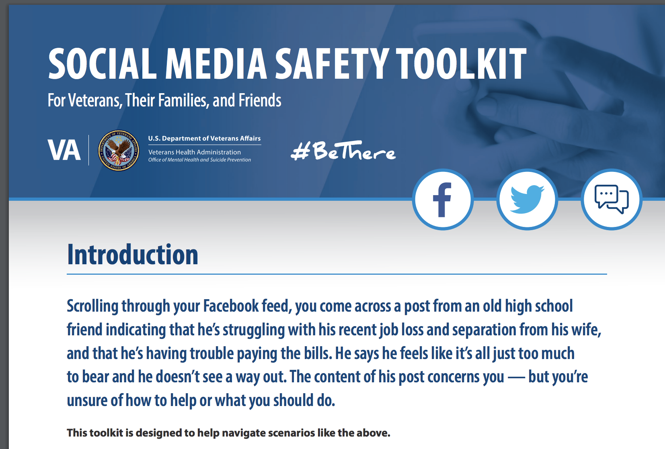
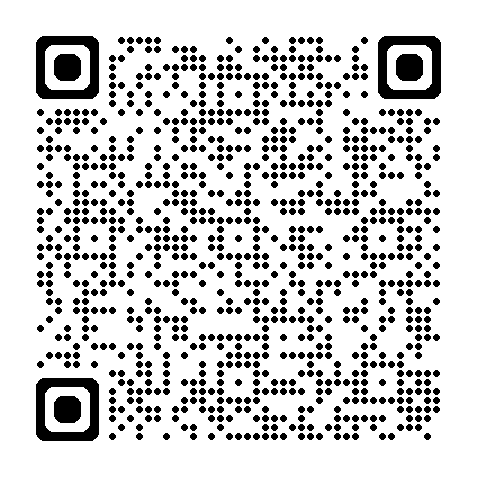
Share Information on Your Social Media:
Social Media Safety Toolkit
As discussed in the National Strategy for Preventing Veteran Suicide, social media is an important intervention channel and a key piece of VA’s comprehensive, community-based suicide prevention strategy.
The Social Media Safety Toolkit for Veterans, their families, and friends equips everyone with the knowledge needed to respond to social media posts that indicate a Veteran may be having thoughts of suicide.
The toolkit includes best practices, resources, and sample responses.
(VA Social Media Toolkit; National Strategy for Preventing Veteran Suicide)
Notes:
The Social Media Safety Toolkit for Veterans, Their Families, and Friends equips everyone with the knowledge needed to respond to social media posts that indicate a Veteran may be having thoughts of suicide. The toolkit includes best practices, resources, and sample responses.
As discussed in the National Strategy for Preventing Veteran Suicide, social media is an important intervention channel and a key piece of VA’s comprehensive, community-based suicide prevention strategy.
Many service members and Veterans are active on social media platforms, and some have posted to express emotional distress or thoughts of suicide. Social media has become a critical channel for VA and partners like you to reach Veterans in crisis with safe messaging and resources.
VA is sharing the Social Media Safety Toolkit among VA employees, with partner organizations, and throughout communities nationwide to help ensure that people who live and work with Veterans every day are equipped to reach Veterans with safe messaging and lifesaving resources.
Download the Social Media Safety Toolkit at https://www.mentalhealth.va.gov/suicide_prevention/docs/OMH-074-Suicide-Prevention-Social-Media-Toolkit-1-8_508.pdf.

Slide 23
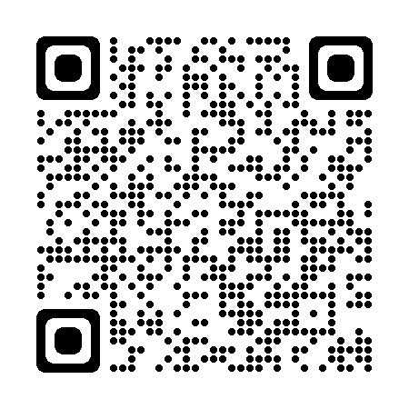
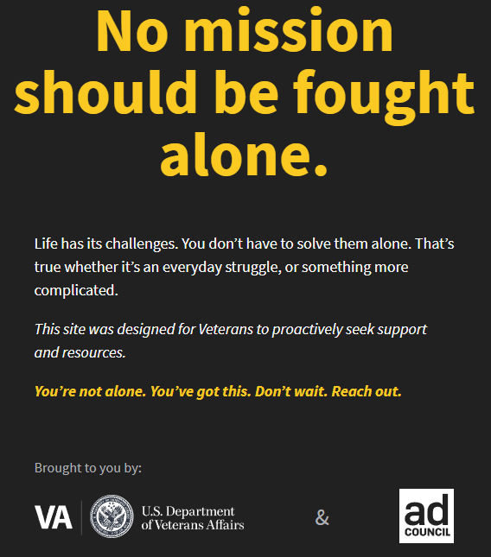
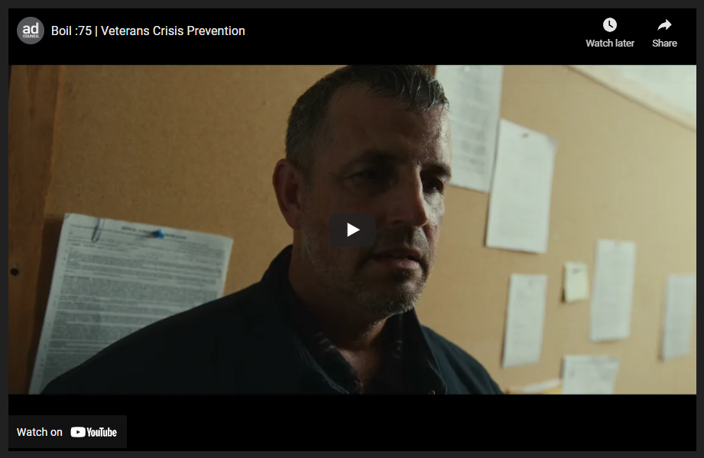
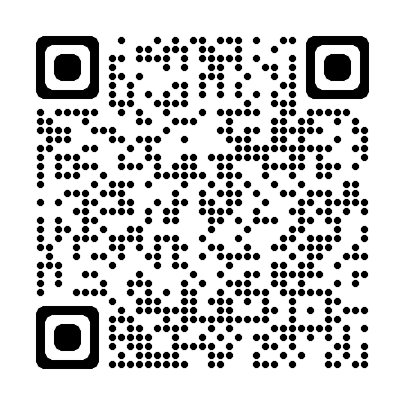
Example of Information to Share
Changing the Culture Together: Don’t wait. Reach out. (www.va.gov/REACH)
Watch: Boil :60 | Veterans Crisis Prevention - YouTube
Normalizing life’s challenges, destigmatizing reaching out for help

Slide 24
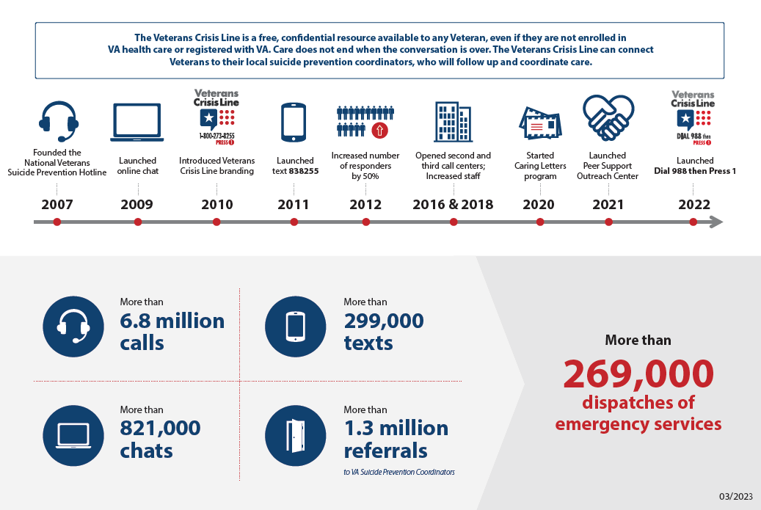
Answering the Call: VCL and 988 Roll Out
What is 988? (veteranscrisisline.net)
Notes:
Worth highlighting the work of VCL and the mention the 988 collaboration efforts as part of the comprehensive approach to the work.
Dial 988 then Press 1 is required by law for phone carriers to be compliant no later than July 16, 2022.
Veterans will continue to use
chat (VeteransCrisisLine.net/Chat) and
text (838255) after the transition.
The former 10-digit Veterans Crisis Line number (1-800-273-8255, Press 1) will remain active.
Updated digital and promotional materials will be available later this year for your use and promotion.
The Veterans Crisis Line’s new, easy-to-remember number—Dial 988 then Press 1—will help Veterans and their loved ones reach crisis support quickly and efficiently.
Signed into law in 2020, the National Suicide Hotline Designation Act authorized 988 as the new three-digit number for the National Suicide Prevention Lifeline.
All telephone service providers in the U.S. must activate the number no later than July 2022; however, many providers have chosen to implement the service sooner.
After activation, the 10-digit number will still be available for Veterans and their supporters to use.
Results: The data included 116,029 calls by women veterans and 651,239 calls by men veterans between January 1, 2018-December 31, 2019. Timing (hour/day/season) of VCL calls was similar between women and men callers. We observed gender differences in reason for call, with the most salient differences in reasons related to interpersonal violence, including sexual trauma (e.g., military sexual trauma as reason for call - prevalence ratio (PR) for women vs. men = 9.13, 95% CI = 8.83, 9.46). Women callers were also more likely than men callers to screen positive for suicide risk (PR = 1.28, 95% CI = 1.26, 1.29), receive a higher suicide risk assessment rating (PR = 1.05, 95% CI = 1.02, 1.07), and be referred to a VA Suicide Prevention Coordinator for follow-up (PR = 1.09, 95% CI = 1.09, 1.11).
Conclusions: Analysis of VCL call data indicated both similarities and differences across genders in call characteristics, including interpersonal relationships and experiences of abuse and assault as particularly salient factors prompting women veterans' calls to VCL. This study also suggests the presence of increased suicide risk among women versus men veteran VCL callers.

Slide 25
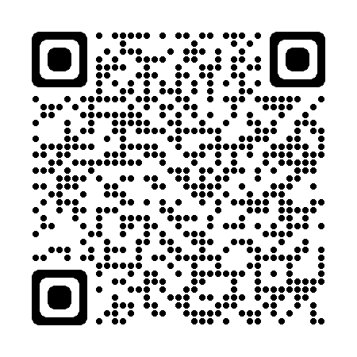
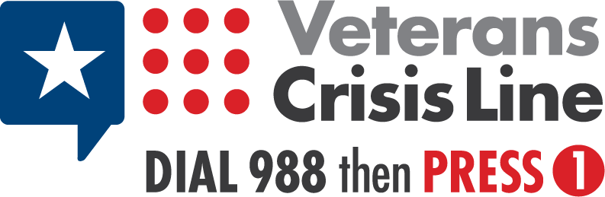
Share the VCL Number
Free, Confidential Support 24/7/365
Veterans
Service members
Family members
Friends
Veterans Crisis Line
Notes:
Veterans Crisis Line: The Veterans Crisis Line connects Veterans in crisis and their families and friends with qualified, caring VA responders through a confidential toll-free hotline, online chat, or text. Veterans and their loved ones can call 1-800-273-8255 and Press 1, chat online, or send a text message to 838255 to receive confidential crisis intervention and support 24 hours a day, 7 days a week, 365 days a year. More information is available at https://www.veteranscrisisline.net/.

Slide 26
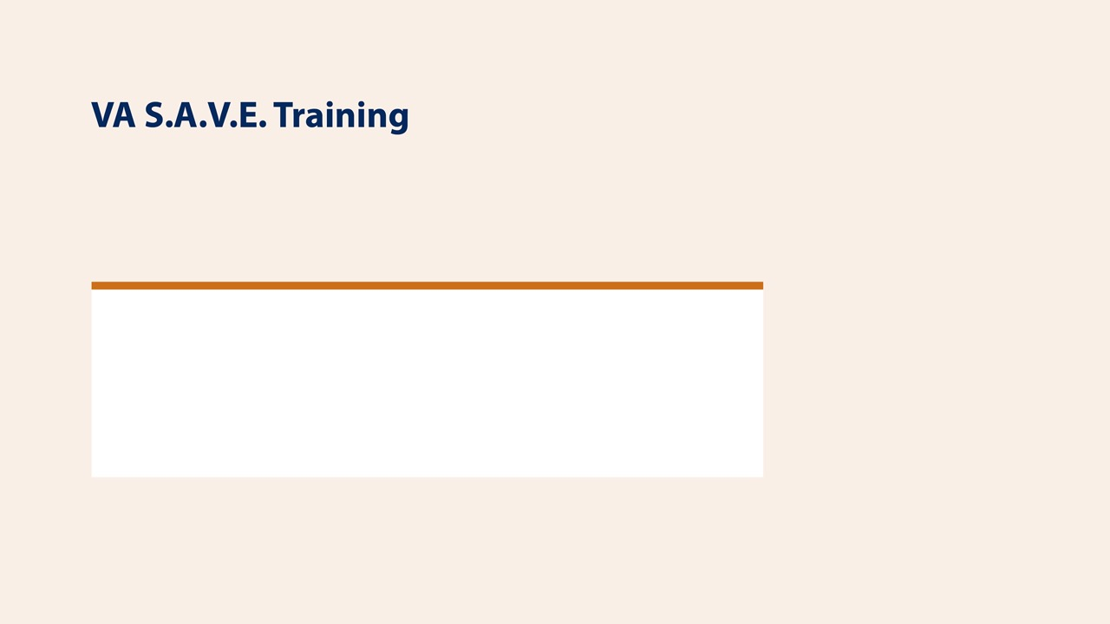

VA Save Training
Promote Suicide Prevention Training
This free suicide prevention training video is less than 25 minutes long and available to everyone, 24/7. It's offered in collaboration with the PsychArmor Institute.
Available online for free: https://psycharmor.org/courses/s-a-v-e/

Slide 27
Questions?
Thank You.

Slide 28
Women Veteran Care and Resources

Slide 29
Women Veterans Call Center
This service provides women Veterans with information about relevant VA benefits and services and answers women Veterans’ questions about their benefits.
Call or text 1-855-VA-WOMEN (1-855-829-6636) to contact responders who can make referrals to Women Veterans Program Managers, the Health Eligibility Center, the Veterans Benefits Administration, and suicide and homeless crisis lines as needed.
More information about the Women Veterans Call Center is available at www.womenshealth.va.gov/programoverview/wvcc.asp.
1-855-VA-WOMEN (1-855-829-6636)

Slide 30
Clinical Care for Women
Primary Care
  Women Veterans Program Manager: At every VA Medical Center, there is a designated Women Veterans Program Manager who acts as an administrative leader for the Women’s Health Program and advocates for women Veterans.
  Designated Women’s Health Providers: Women Veterans can be assigned to trained and experienced Designated Women’s Health Providers, who provide general primary care and gender-specific care as part of the patient-provider relationship.
Specialty Medicine
  VA finalized regulations in February 2017 to support in vitro fertilization services for both male and female Veterans who qualify by virtue of a service-connected disability that results in their inability to procreate without the use of fertility treatment.

Slide 31
MST-Related Care
VA’s Universal Screening Program: Every Veteran seen for health care is asked about experiences of MST. This helps ensure Veterans are connected with appropriate MST-related services as needed and that this history is taken into account in provision of care more generally. It is also is an important way of identifying individuals potentially at increased risk for suicide.
Treating MST-Related Conditions: VA provides free care for any mental or physical health conditions related to a Veteran’s experiences of MST. This free MST-related care is available at every VA health care system. MST-related counseling is also available at VA’s Vet Centers. Veterans do not need to have a VA disability rating (that is, have a service-connected disability) and may be able to receive services even if they are not eligible for other VA care.
MST Coordinator: Every VA health care system has a designated MST Coordinator who serves as the local point person for MST-related issues and can help Veterans access MST-related services and programs.

Slide 32
Military Sexual Trauma-Related Services
Addressing the needs of MST survivors is a key priority for VHA. Efforts include:
  Outreach efforts including posters, handouts, and educational documents for Veterans and a public-facing MST-specific website (www.mentalhealth.va.gov/msthome.asp).
  MST-related training opportunities for staff, including monthly training calls, an annual conference on treatment program development, online courses, and a community of practice website.
  Mandatory training on MST required for all mental health and primary care providers in VHA.
  National MST Support Team to promote best practices related to MST
  MST Consultation Program available to any VA staff member with a question related to assisting Veterans who experienced MST.
Since VA began MST-specific monitoring in Fiscal Year 2007, there has been a 344 percent increase (through FY19) in the number of women Veterans receiving MST-related outpatient care, indicating the positive impact of these efforts.
Notes:
SOURCE: Women Veterans Talking Points for HVAC Roundtable (3/5/19). Information given by Susan McCutcheon to John McCarthy.
Military Sexual Trauma
Addressing the needs of MST survivors is a key priority for the Veterans Health Administration (VHA).
VHA has a number of initiatives to ensure targeted, specialized services are available and that Veterans are aware of these services.
Since Fiscal Year 2007 (through FY19), these efforts have resulted in a 344 percent increase in the number of women Veterans receiving MST-related outpatient care, indicating the positive impact of these efforts.
VHA efforts to date include:
Free of charge outpatient, inpatient, and pharmaceutical care for all MST-related mental and physical health.
Eligibility for MST-related care is expansive, and Veterans may be able to receive free MST-related care even if they are not eligible for other VA care.
Every VA health care system has a designated MST Coordinator who serves as the local point person for MST-related issues and can help Veterans access MST-related services and programs.
Throughout the year, facility MST Coordinators engage in local outreach efforts to raise awareness about the availability of MST-related services.
Development of gender-inclusive and gender-specific outreach posters, handouts, and educational documents for Veterans, inclusion of information about MST on relevant va.gov websites, and creation of an MST-specific website.
A range of national MST-related training opportunities for staff, including monthly training calls, an annual conference on treatment program development, online courses, and a community of practice intranet website.
All mental health and primary care providers in VHA must complete mandatory training on MST and VA’s national MST Support Team has established an MST Consultation Program that is available to any VA staff member with a question related to assisting Veterans who experienced MST. OMHSP has funded a national MST Support Team since FY07 that:
Coordinates and expands national MST-related education and training
Promotes best practices in the field through consultation and technical assistance
Performs national monitoring
Provides consultation to VA Central Office on MST-related policy issues
Responds to information requests from VA leadership and other stakeholders

Slide 33
Women Veterans Call Center2
This service provides women Veterans with information about relevant VA benefits and services and answers women Veterans’ questions about their benefits.
Call or text 1-855-VA-WOMEN (1-855-829-6636) to contact responders who can make referrals to Women Veterans Program Managers, the Health Eligibility Center, the Veterans Benefits Administration, and suicide and homeless crisis lines as needed.
More information about the Women Veterans Call Center is available at www.womenshealth.va.gov/programoverview/wvcc.asp.
1-855-VA-WOMEN (1-855-829-6636)

