Slide 1
Veteran and Military Spouse Talent Engagement Program (VMSTEP) Presented by: Dr. Andreé-Monique Sutton, DBH, LPC, NCC Director of Operations Veteran and Military Spouse Talent Engagement Program (VMSTEP)

Slide 2
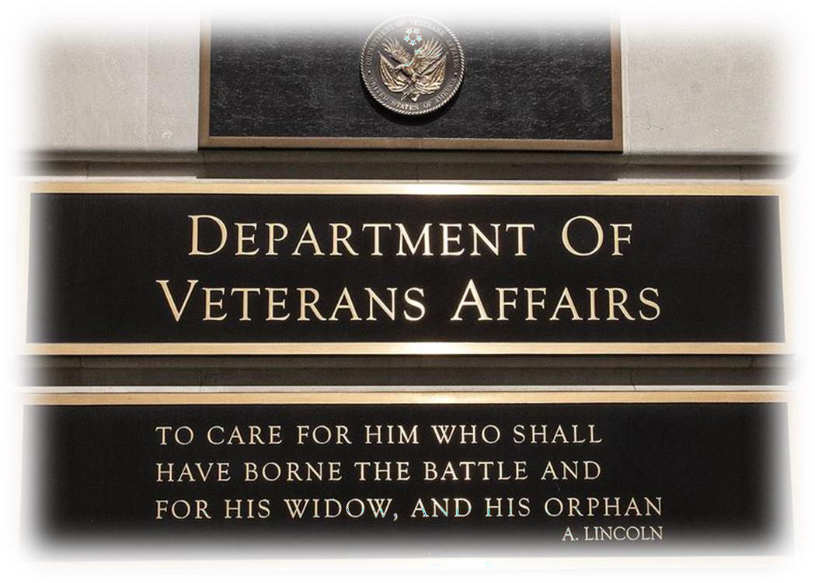
Mission
“VA strives to become the leader and Employer of Choice for Veterans, military spouses, Veterans’ families, survivors, caregivers, and families across the Federal Government."
– Secretary Denis McDonough, 2022
By doing so, we will bring on the best employees to have “Heroes Serving Heroes”
Mission of the Veteran and Military Spouse Talent Engagement Program:
The Veteran and Military Spouse Talent Engagement Program (VMSTEP) provides employment readiness assistance and outreach to transitioning service members, Veterans, and eligible military spouses while advocating the use of special hiring authorities, employment programs, and Veteran retention strategies to help VA become the employer of choice for Veterans and military spouses
Veteran and Military Spouse Talent Engagement Program
Notes:
Heroes serving Heroes!
VMSTEP works to train and support our VA colleagues to recruit, hire, and retain these heroes as well as build our internal and external partnerships to raise awareness and visibility of what VA is doing in this space.
I would like to figure out how to combine the first two slides – mission and who we are. We don’t need 2 slides that say the same thing.

Slide 3
Impact
“VA integrates the principles of I-DEA into the fabric of our mission for employees, Veterans, their families, caregivers, and survivors and creates an environment that is inclusive, diverse, equitable, and accessible to all.”
STABILITY: Provides stability and financial security for families and ultimately helps to improve health outcomes:
Mental Health
Suicide Prevention
Homelessness
Caregiving
Food Insecurity
Financial Stability
Transition
Veteran and Military Spouse Talent Engagement Program

Slide 4
VMSTEP forward to Recruit, Hire and Retain
RECRUIT: Networking and recruitment relationships
Outreach and marketing connections and training to help our VA colleagues recruit talent.
Support and participate in job fairs for Veterans, transitioning military service members, military spouses, and survivors.
Collaborate with other Federal agencies and partners
Encourage the use of special hiring authorities
Capture the attention of transitioning military service members, i.e., SkillBridge, Warriors to Workforce (W2W) program, VA Veterans Health Administration, and Technical Career Field Program (TCF).
HIRE: Culturally competent and a diverse workforce
Diversity and inclusivity: Veterans and military spouses come from a variety of different backgrounds and cultures and bringing vast experience, perspective, ideas, thoughts, education, and talent.
Helps all of us better serve Veterans, their families and survivors.
RETAIN: Career advancement and employee engagement
Creative outside the box thinking about remote, telework and other flexible portable work opportunities.
These workforce solution enable military spouses to continue their careers through military relocations.
Supports military readiness and the whole health of the military family as well as supports transition.
Veteran and Military Spouse Talent Engagement Program
Notes:
Encourage the use of special hiring authorities: 30% or more SC, military spouse, Pathways Program

Slide 5
Veteran Hiring Authorities
30 Percent or More Disabled Veterans
The 30 Percent or More Disabled Veteran authority allows any Veteran with a 30 percent or more service-connected disability to be hired noncompetitively to any position for which they meet the qualification requirements. This is a time-limited appointment of more than 60 days, during which time Veterans may be converted to a career or career-conditional appointment based on successful performance. There are no grade level limitations for job opportunities under this authority.
Veterans Recruitment Appointment (VRA)
The Veterans’ Recruitment Appointment (VRA) authority allows agencies to hire eligible Veterans noncompetitively through the GS-11 grade level. Veterans can be converted to a career or career-conditional appointment after two years of successful performance. If a Veteran is hired to fill a temporary/term position under VRA, the Veteran will not be converted after two years of service. Veterans’ Preference applies when using this authority.
Veterans Employment Opportunity Act (VEOA) of 1998
Veterans Employment Opportunity Act of 1998, as amended (VEOA) is a competitive service appointing authority that can only be used when filling permanent, competitive service positions. It allows Veterans and other preference eligibles to apply that are open to “status” candidates.
Veteran and Military Spouse Talent Engagement Program

Slide 6
Other Authorities and Programs
Schedule A
Schedule A authority allows agencies to noncompetitively hire eligible disabled Veterans and persons with disabilities who have severe physical, psychological or intellectual disabilities. Veterans can be converted to a career or career-conditional appointments based on successful performance and there are no grade restrictions for job opportunities under this authority.
Veteran Readiness and Employment (VR&E formerly VocRehab)
Disabled Veterans eligible for training under the VA Vocational Rehabilitation program may enroll for training or work experience at an agency under the terms of an agreement between the agency and VA.
Direct Hiring Authority Direct-Hire Authority (DHA) is an appointing (hiring) authority that the Office of Personnel Management (OPM) can give to Federal agencies for filling vacancies when a critical hiring need or severe shortage of candidates exists.
Veteran and Military Spouse Talent Engagement Program
Notes:
Direct Hiring Authority . A Direct-Hire Authority (DHA) is an appointing (hiring) authority that the Office of Personnel Management (OPM) can give to Federal agencies for filling vacancies when a critical hiring need or severe shortage of candidates exists.

Slide 7
Successful VA Internship Programs
Warriors to Workforce (W2W) 1 year program offers Veterans with a service-connected disability to transition into a new career field in the federal government. Hired as GS-5 Government employees; receive college credits from business course with accredited institution After successful completion of the program, interns are converted to GS-7 Contract Specialist and advance to the Acquisition Internship Program
VA Warrior Training Advancement Course (WARTAC)10–12 week education and employment program for wounded warriors and transitioning service members. Participants learn a skillset of a Veteran Service Representative. Complete a VBA training program during their final 180 days of active-duty service.
Pathways OPM Federal Internship Program for College Students and Recent Graduates
Presidential Management Fellows Program
USAJobs Search for student programs
GHATP - Students and Trainees - VHA VHA’s Graduate Healthcare Administration Training Program
Workforce Recruitment Program Recruitment and referral program that connects federal and private-sector employers nationwide with highly motivated college students and recent graduates with disabilities through summer or permanent jobs.
Veteran and Military Spouse Talent Engagement Program

Slide 8
Military Spouse Hiring Authority 1
The Noncompetitive Appointment of Military Spouses hiring authority
The government-wide hiring authority is available to all agencies for hiring certain eligible military spouses.
The Noncompetitive Appointment of Certain Military Spouses hiring authority allows agencies to appoint certain military spouses without using traditional competitive examining procedures.
It applies to the following categories of military spouses:
Spouses of service members of the armed forces on active duty
Spouses of service members who incurred a 100% disability because of the service member's active-duty service
Spouses of service members killed while on active duty
Agencies can choose to use this authority:
Filling competitive service positions on a temporary (not to exceed 1 year), term (more than 1 year but not more than 4 years), or permanent basis.
Must post a Job Opportunity Announcement (JOA) on the USAJOBS website.
Spouses must apply and be found qualified for the position.
The authority does not entitle spouses to an appointment over any other applicant; it is used at the discretion of an agency.
Veteran and Military Spouse Talent Engagement Program

Slide 9
Military Spouse Hiring Authority
Executive Order 13832
“Enhancing the Noncompetitive Civil Service Appointments of Military Spouses” encourages agencies to hire military spouses to the greatest extent possible and places mandatory reporting requirements by all agencies.
2019 National Defense Authorization Act (NDAA)
Codified at 5 U.S.C. 3330d, temporarily removed the provisions that limited application to a “relocating military spouse” authorized via PCS orders and replaced it with spouses currently married to active-duty military members. In doing so, spouses are not restricted to the geographic location of the active-duty military member. Military spouses have more flexibility when seeking employment stateside and may also have limited opportunities overseas.
2023 NDAA Sec. 1111
Modification of temporary expansion of authority for noncompetitive appointments of military spouses by federal agencies. Extension of Sunset to Dec 31, 2028. *
Veteran and Military Spouse Talent Engagement Program
Notes:
SEC. 1111. MODIFICATION OF TEMPORARY EXPANSION OF AUTHORITY FOR NONCOMPETITIVE APPOINTMENTS OF MILITARY SPOUSES BY FEDERAL AGENCIES. (a) EXTENSION OF SUNSET.—Subsection (e) of section 573 of the John S. McCain National Defense Authorization Act for Fiscal Year 2019 (Public Law 115–232; 5 U.S.C. 3330d note) is amended, in the matter preceding paragraph (1), by striking ‘‘the date that is 5 years after the date of the enactment of this Act’’ and inserting ‘‘December 31, 2028’’. (b) REPEAL OF OPM LIMITATION AND REPORTS.—Subsection (d) of such section is repealed.

Slide 10
VA’s PACT to you
How VA is improving recruitment and retention
Recruitment and retention of top talent is a priority at VA.
PACT Act impact is Department wide – VBA – claims and VRE, BVA appeals, OGC, OIT support, OALC contracts. PACT Act will offer expedited hiring authority for college graduates into competitive service jobs.
Better Pay Easier Hiring Practices Investing in Workforce
Veteran and Military Spouse Talent Engagement Program
Notes:
I think we need to tie what we are doing to PACT Act – benefits and services. I like the slide on VHA – can we make one that shows we need to hire for VBA, BVA and OGC and OIT? PACT Act impact is Department wide – VBA – claims and VRE, BVA appeals, OGC, OIT support, OALC contracts – thoughts?

Slide 11
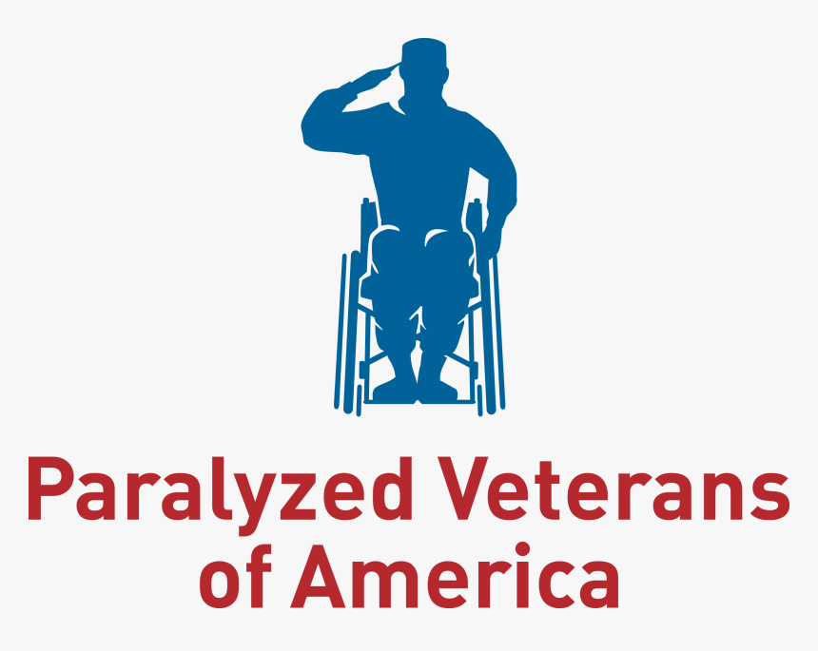
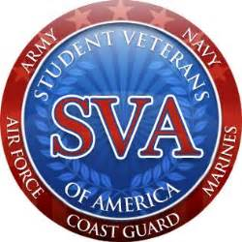
Building Partnerships
Building partnerships expands the network of talent engagement to help VA recruit and hire Veterans, military spouses, survivors, and caregivers.
Veteran and Military Spouse Talent Engagement Program

Slide 12
Q & A Resources:
READ more about the PACT Act
EXPLORE what it means to work at VA
LEARN about our careers and culture
SEARCH for a VA career near you at VACareers.va.gov
Veteran and Military Spouse Talent Engagement Program

Slide 13
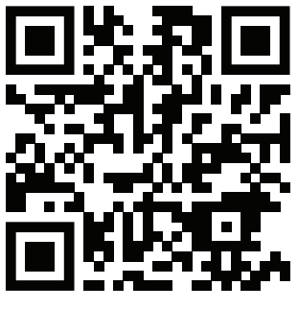
Thank you!
Thank you for joining us for an overview of VA’s rebranded Veteran and Military Spouse Talent Engagement Program (VMSTEP)
Please use your smart phone to take a
photo of the QR code to obtain quick
access and download the VA Welcome Kit.
It is a wonderful guide that outlines
VA benefits and programs along with
a helpful checklists on applying for benefits:
www.va.gov/welcome-kit/
Notes:
I like the QR Code !!– it needs to be at the end.

